Slide 1
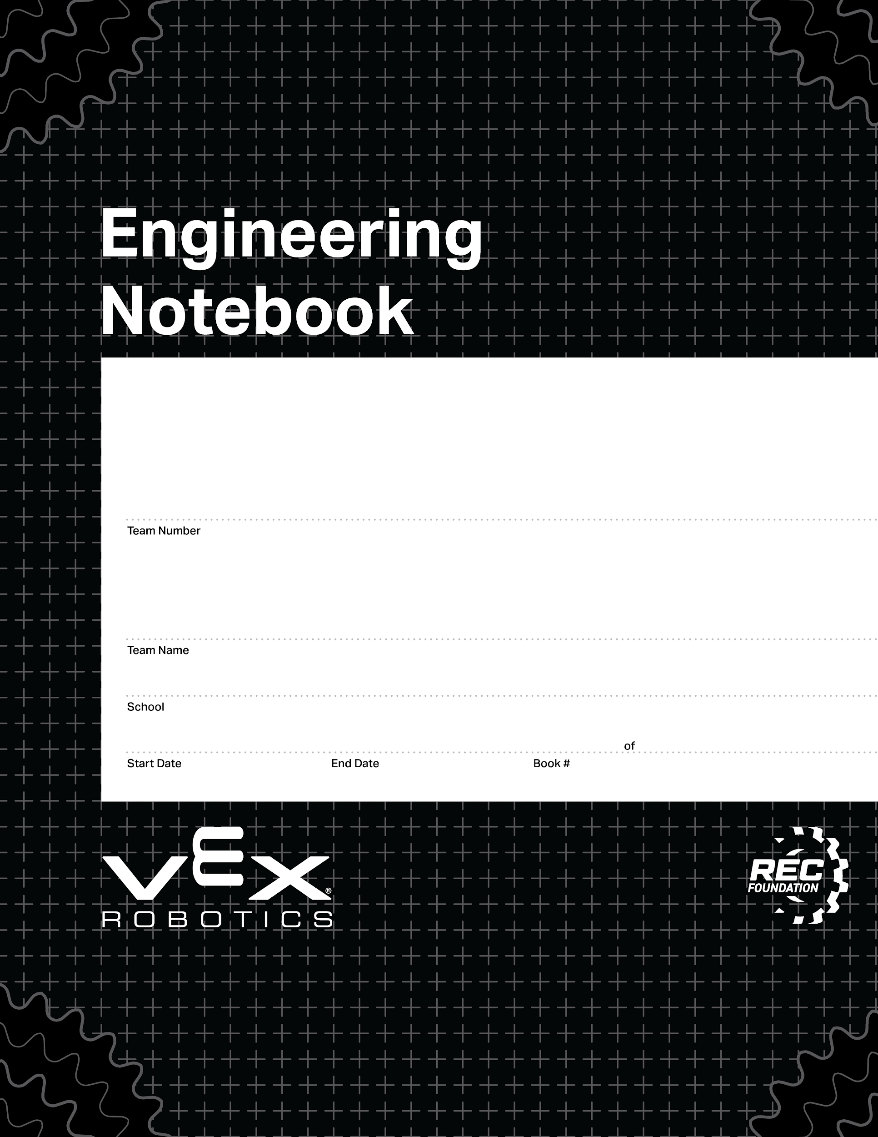
37528A
DIMAS!!!!!!!(DEE-MAHS)
Colorado Early Colleges Windsor
08/27/2024
06/10/2024
1
1
V3.0 Date 6.10.24

Slide 2
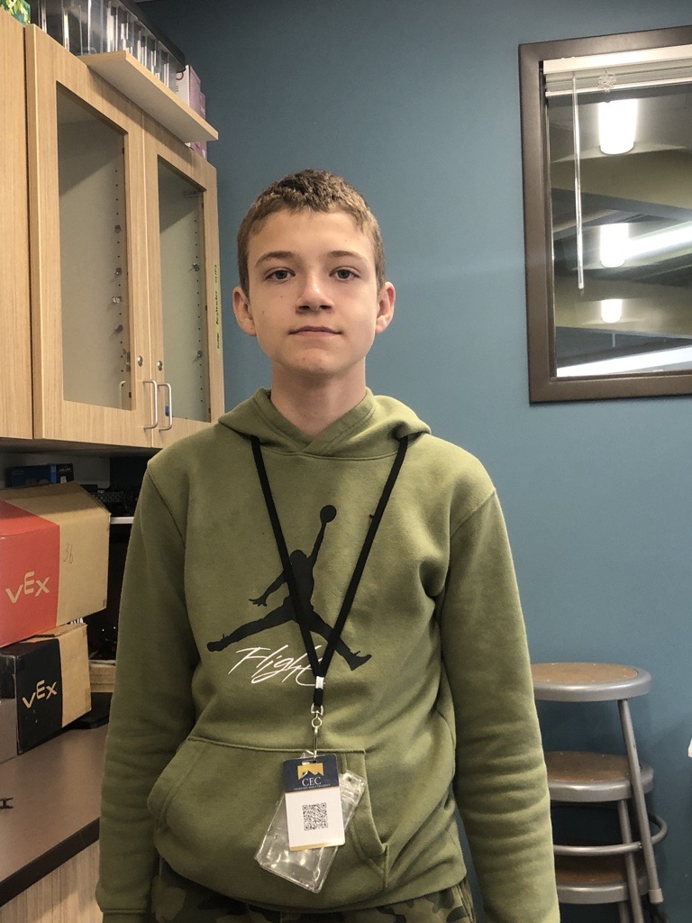
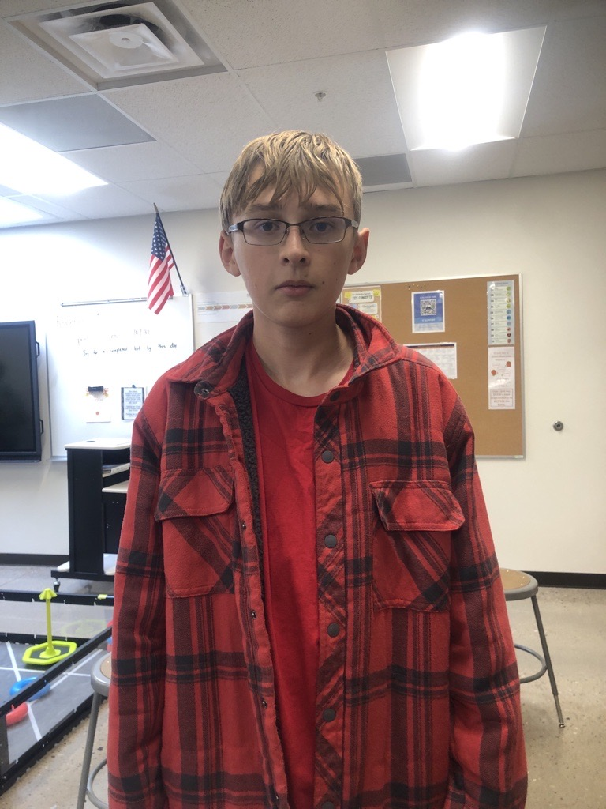
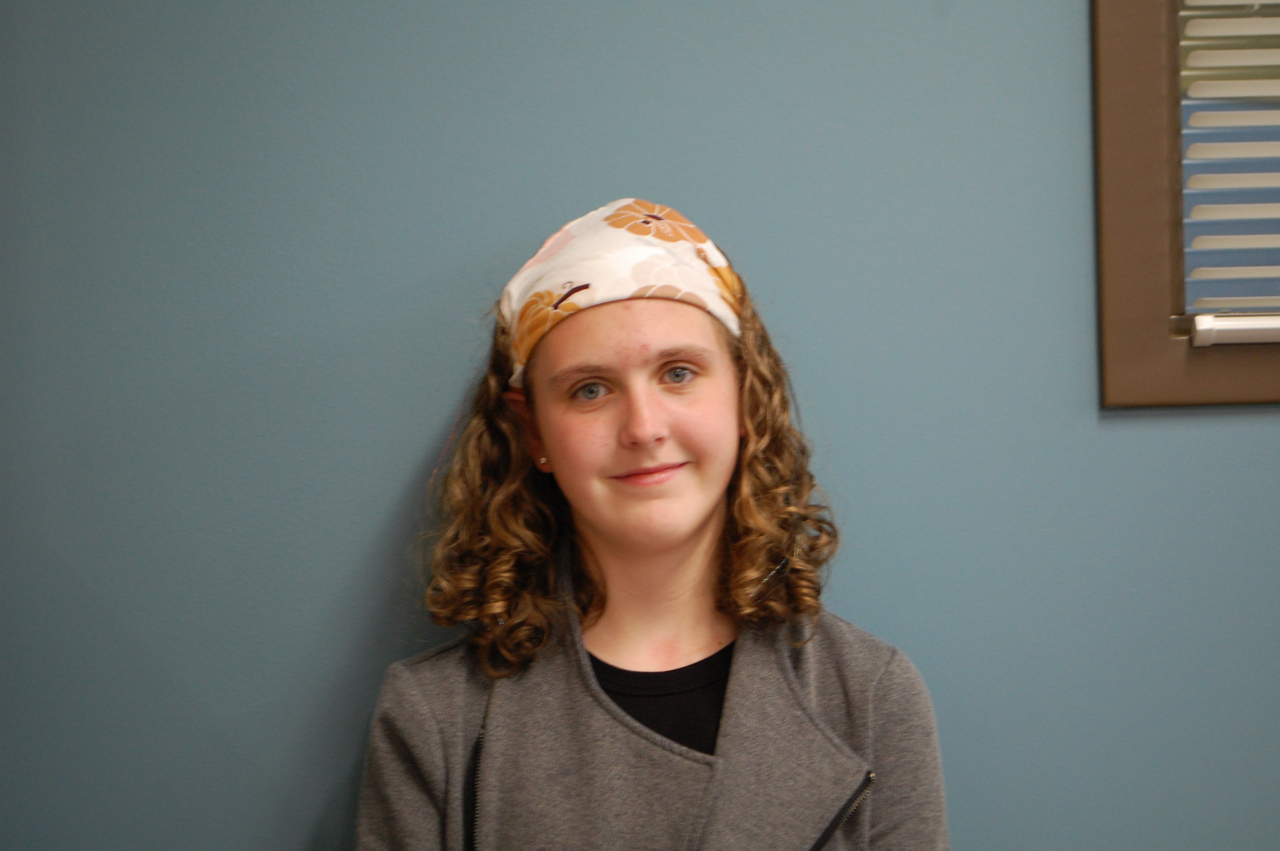
Dimas Tarin
Coder, Fixer, Designer
I am a 12-year-old boy, who likes to code and play video games. When I grow up, I want to be an electrical engineer.
Ryder Sandstrum
Primary Driver, Builder
I am 14-year-old boy who is obsessed with war thunder. When I grow up, I want be a pilot.
Abigail Way
Note booker, Scrum Master, and Socializer
I am a 14-year-old girl, who loves building things with my hands and building books. When I grow up, I want to be either a biomedical or biochemical engineer.

Slide 3
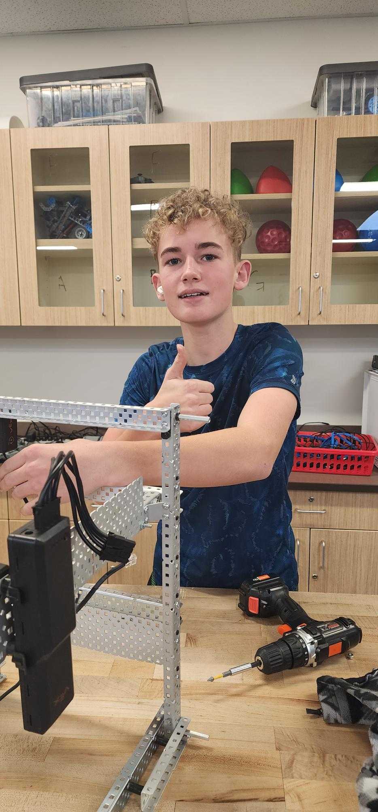
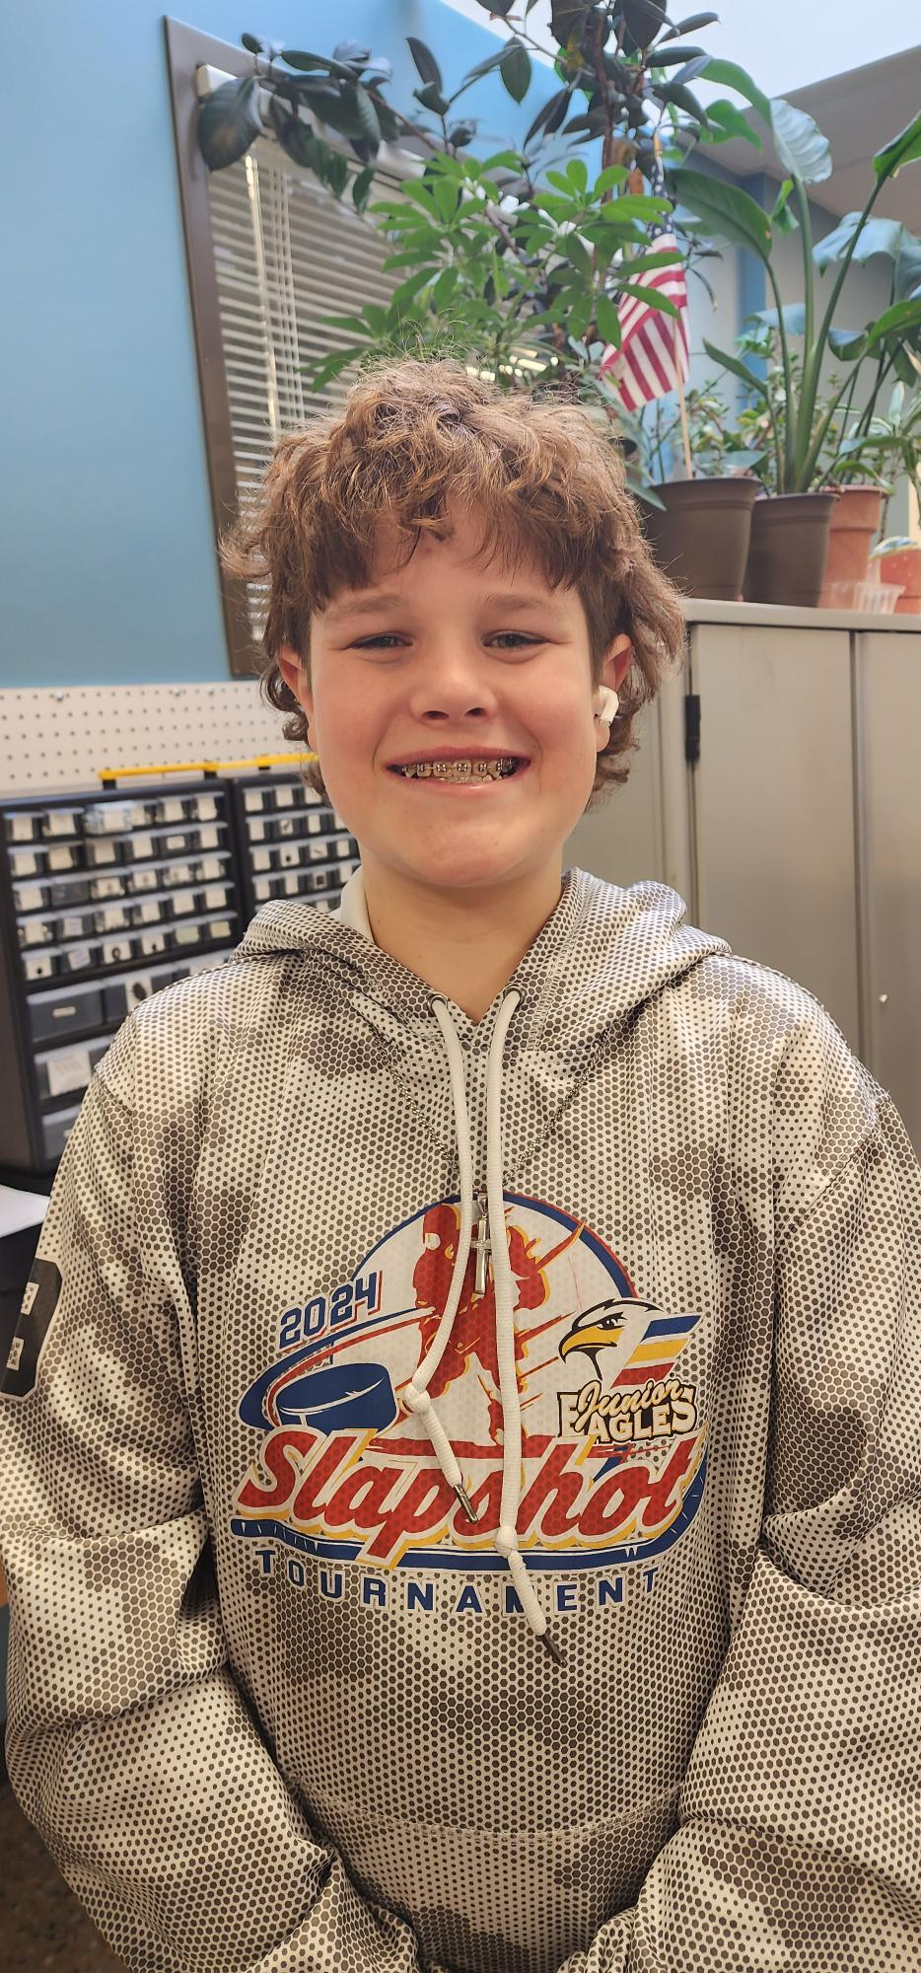
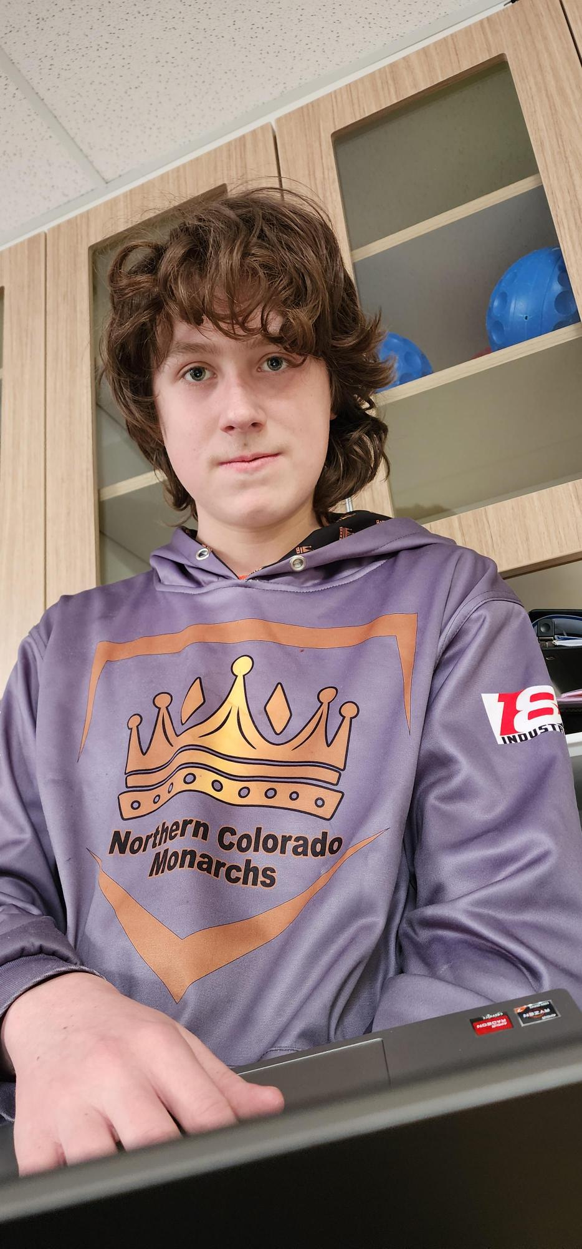
Augie Lerwick
Builder, different ideas to make it better, 3rd Driver
I am a 12-year-old boy, who likes to work with me hands and build parts to help improve our robot. When I grow up, I want to be a chiropractor or engineer.
Ryker Shamley
2nd Driver, Builder
I am a 14-year-old boy who likes to play hockey. When I grow up, I want to be a professional hockey player.
Michael Hassinger
Coder and Builder
I am a 13-year-old boy who likes to play Brawl Stars. When I grow up, I want to be a cyber security person.

Slide 4
Section A: Blank Pages dates on slides
7. Section B: Notes and Code dates on slides
17. Section C: Drawings dates on slides
41. Section D: Brain Ports/ Controller Program and Game Map date on slides
50. Section E: Scrum Notes/ Calendars dates on slides
98. Section F: Calendar dates on slides

Slide 5
Section A
This section contains the blank documents for your use.
Make sure to duplicate these BEFORE you use/move them.

Slide 6
Scrum meeting. Week of: MM/DD/YYYY
SCRUM Meetings
Week of 00/00/2025
Monday: What has each team member done since the last meeting? What will each team member do today? What problems are holding the team back?
Tuesday: What has each team member done since the last meeting? What will each team member do today? What problems are holding the team back?
Wednesday: What has each team member done since the last meeting? What will each team member do today? What problems are holding the team back?
Thursday: What has each team member done since the last meeting? What will each team member do today? What problems are holding the team back?
Friday: What has each team member done since the last meeting? What will each team member do today? What problems are holding the team back?

Slide 7
Sprint Plan / Sprint Backlog / Burndown Chart
Sprint #: ______________________________
Team: ________________________________
Team Members: _______________________
_____________________________________
_____________________________________
Product Backlog (at the start of this sprint, what is your product backlog):
Sprint Goal (write in full sentences what concise goals you have for the sprint):
Sprint Backlog / Burndown (Break product backlog items into sprint backlog items) Remember to INDENT sprint backlog items:
Task Date and name of who worked on this task:
____________________________________________________________________________________________________________________________________________________________________________________________________________

Slide 8
Sprint Retrospective
Sprint #: ______________________________
Team: ________________________________
Team Members: _______________________
_____________________________________
_____________________________________
During the Sprint Retrospective you will talk with your team and discuss the last sprint. You will need to contemplate and reflect on how well your team is working together. Then, answer the following questions:
What is working for our team, that we should CONTINUE doing (use complete sentences):
______________________________________________________________________________________________________________________________________________________________________________________________________________________________________________________________________________________________________________________________________________________________________________________________________________________
2. What is not working for our team, that we should STOP doing (use complete sentences):
3. What do we want to try doing as a team, that we should START doing (use complete sentences):
______________________________________________________________________________________________________________________________________________________________________________________________________________________________________________________________________________________________________________________________________________________________________________________________________________________
________________________________________________________________________________________________________________________________________________________________________________________________________________________________________________________________________________________________________________________________________________________________________________________________________________________

Slide 9
Sprint Review
Sprint #: ____________________________
Team: _____________________________
Team Members: __________________________________
__________________________________
During this Sprint we completed these sprint backlog items, define which product backlog item they were a part of. (use complete sentences):
______________________________________________________________________________________________________________________________________________________________________________________________________________________________________________________________________________________________________________________________________________________________________________________________________________________
2. Describe what your sprint goal was, and how your product met that goal:
______________________________________________________________________________________________________________________________________________________________________________________________________________________________________________________________________________________________________________________________________________________________________________________________________________________
3. We need to move these sprint backlog items back to our product backlog (if any) Make sure to think about prioritizing the tasks that are moved to the product backlog:
4. Demonstrate the product that you produced:
______________________________________________________________________________________________________________________________________________________________________________________________________________________________________________________________________________________________________________________________________________________________________________________________________________________________________________________________________________________________________________________________________________________________________________________________________________________________________________________________________

Slide 10
Engineering Design Progress
Sprint #: ____________________________
Team: _____________________________
Team Members: __________________________________
__________________________________
Identify the Problem:
2. Brainstorm, Diagram, or Prototype Solutions and Select the Best Solution and Plan:
4. Build and Program the Solution:
5. Test:

Slide 11
Section B Notes and Code

Slide 12
Review notebook requirement
Abigail Way
8/27/2024
1

Slide 13
Competition notes
Before Competition: We are all feeling the pressure of our first competition and noticing that we aren’t really prepared, that we should have been practicing way more than what we have been doing. While noticing this we went into panic made and really started powering through as many things as possible. We also notice on how our robot was outside the size limit and we needed to shorten some things to fit the requirements. Along with noticing how our code didn’t work (hoping to get this fix before the competition.) We have high hopes for the competition that everything will go smoothly and easily as things can go.
During Competition: The nerves are everything as we are waiting for others to arrive. Problems are occurring, our brain will not turn on and we don’t know why. Luckly, we figured it out and it was just the battery. There are a lot of different and cool robots. Now that inspection is over, we are all a lot calmer and more relaxed. We had a surprise guest arrive with the name of Augie. First competition was a bust, things kept breaking, we were up against high schoolers who had way better robots. The robot first-time failed things kept falling apart. Hoping to talk to some other high schoolers on what they have done and what they recommend. Looking at things we need to find a better way to pick up rings because the flaps keep coming off. We made it into an alliance don’t know how far we will go but its great for a first-time team! Along with a ton of good ideas from some of the best teams here. We lost our first alliance game but nothing surprising there…. We hope to redesign our robot to look more like some of the high school teams.
Talking with one of the high schoolers they said that more time on the robot can result in a better robot Pneumatics can be useful. Worry fist about the metal and motors and motors, sensors, and everything else first. Sensors can be helpful but not necessarily necessary. Inertial sensor. Working extra time can be helpful. Things will go wrong!
What would you recommend to a first-time team? Have time dedicated to code, don’t build the day before unless minor. Observe the teams around you. Trying to make an algorithms that works, build your knowledge. Work on things slowly, having one person work on specific things. Get good at doing one thing.
What are somethings you did that were helpful? Talking too couches, communication (outside of school) Work outside of class, Having another set of eyes. Many people helped get used to thing work. Trying to make the hardware as reliable as possible, make sure everything is reliable, if something breaks then don’t fix it the way you normally would, make it better, analyze the game, reliability. Team dynamics, people have specific jobs that they are good at. Modular systems
Abigail Way
11/2/24
2

Slide 14
Competition Debrief
Competition Debrief:
Robot design: would we like to do a “Vacuum” robot or one that can climb
Team size:
Competition in general:
Team size: What thoughts did we have bigger team's smaller teams
A bigger a team could be better to get more done along with a two robots to work and practice on, funding,
A big team could be better to get more done
Leaning to one big team of six
One big team, two identical robots, Vacuum robot!
11/5/2024
Agreements:
Rules/ Jobs:
Abby: Note booker, Builder, Filler, Socializer, Scrum Master
Dimas: Coder 2nd Builder, things notice amiss, designer
Ryder: Primary Driver 2nd Flexible
Augie:3rd Driver, Builder, coming up with different ideas to make it better/ designer, fixer at competition
Ryker: 2nd Secondary Drive Builder
Mike: Coder, 2nd Build
Role Swap: Understanding of each other and changing roles flip a coin
Conflict and design: Voting accept the outcome no pouting/ sourpuss/ no poopy head
Efficiency: When someone isn’t doing their job- Mr. Lyon (impartial) decides!
All committing to reading the rules and understanding them
Freedom to work alone: All committed to getting this done
All other conflicts determined by a vote if a tie Mr. Lyon breaks the tie.
If you aren't working on anything/don’t know what to do: Set up Pit, Organize, Drawing, Read game manual
Sign: Abigail Way, Augie lerwick, Mike. J. Hassinger, Ryder Sandstrum, Ryker Shamley, Dimas S. Tarin, son of Carlos, son of Jose,
Abigail Way
11/5/2024
3

Slide 15
Code
4

Slide 16
Code
5

Slide 17
Code
6

Slide 18
Skills challenge code
7

Slide 19
Skills challenge code
8

Slide 20
Competition debrief
Got a final ranking of ninth place! Lost one competition and got a disqualification for putting a mobile goal into a positive corner after the last fifteen seconds. We made an alliance with a team from Coal Ridge Middle School in Firestone Colorado.
Abigail Way
1/13/2025

Slide 21
Section C Drawings

Slide 22
Engineering Design Progress
Sprint #: 2
Team: Dimas
Team Members: Dimas, Abby, Ryder
Identify the Problem:
The problem we have to solve is to have a robot that can pick up rings and score them on to a mobile goal.
2. Brainstorm, Diagram, or Prototype Solutions and Select the Bast Solution:
After some tough we decided to try and make something that could suck up the rings, but we weren't quite sure how to quite achieve that goal at that time.
4. Build and Program the Solution: After we started to build the drive-train we realized that we had no clue what we were doing so we redirected to a different idea.
Abigail Way
1/28/25

Slide 23
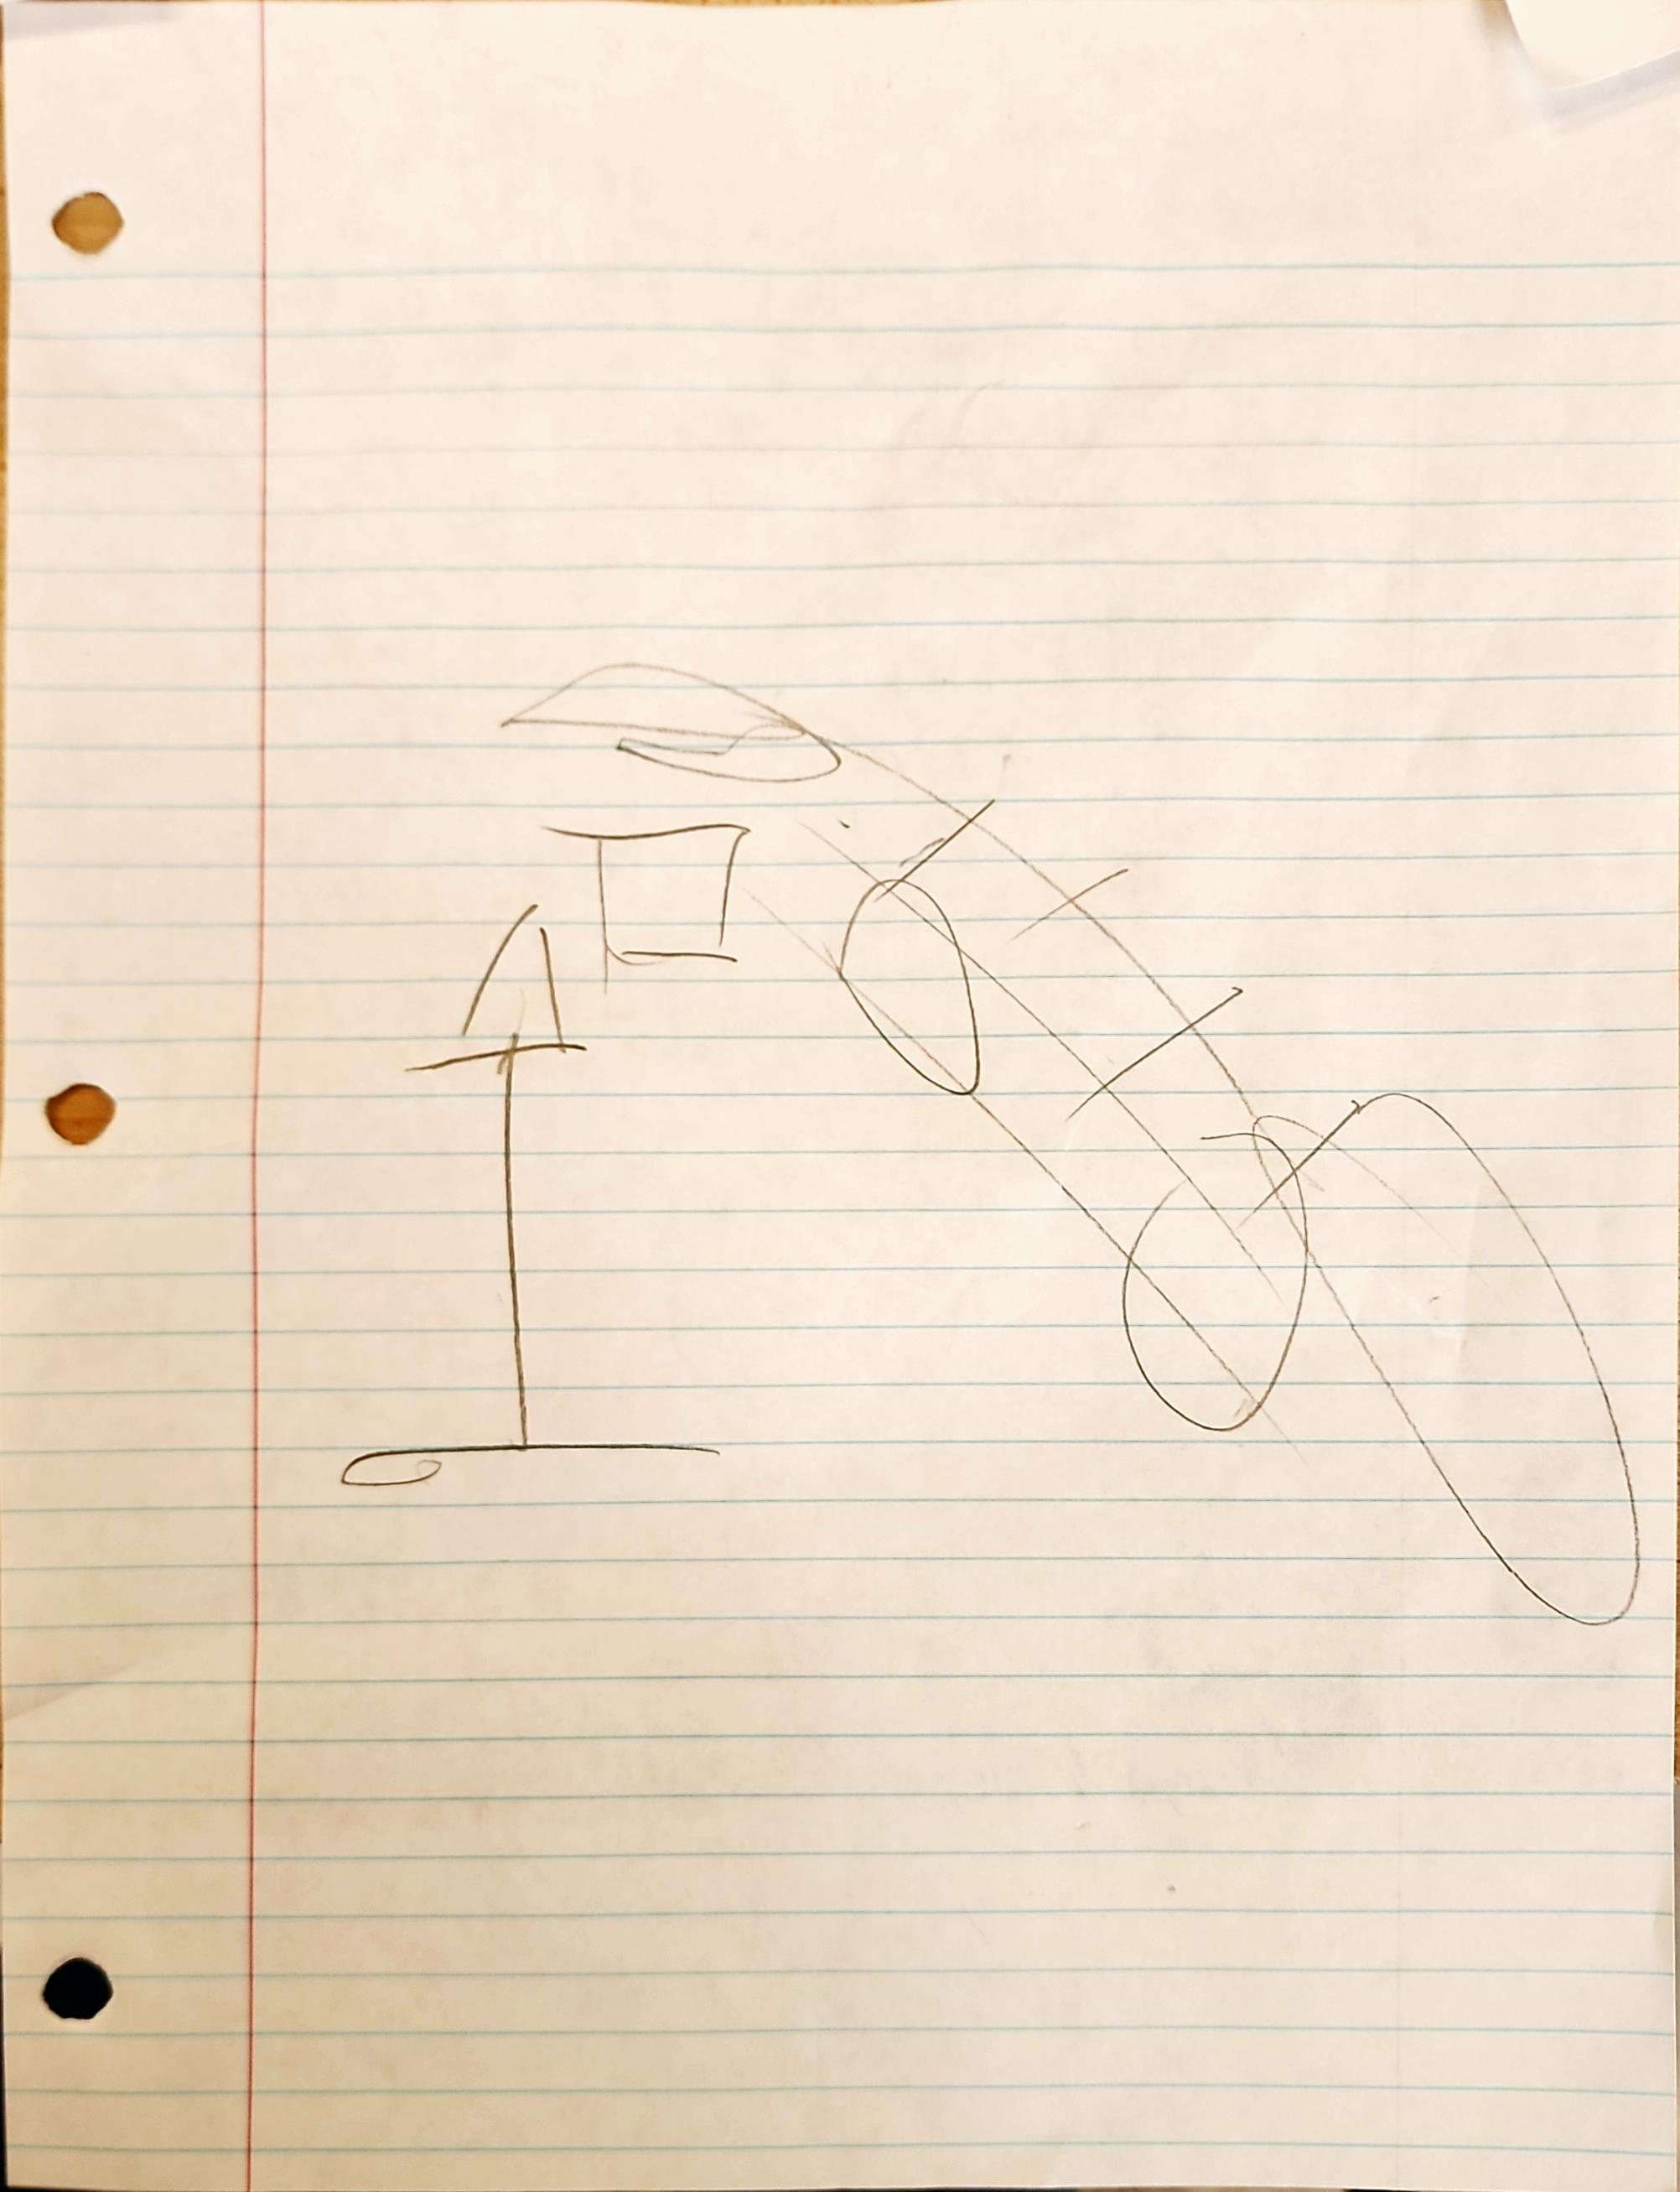
Aurora
Dimas
8/
9

Slide 24
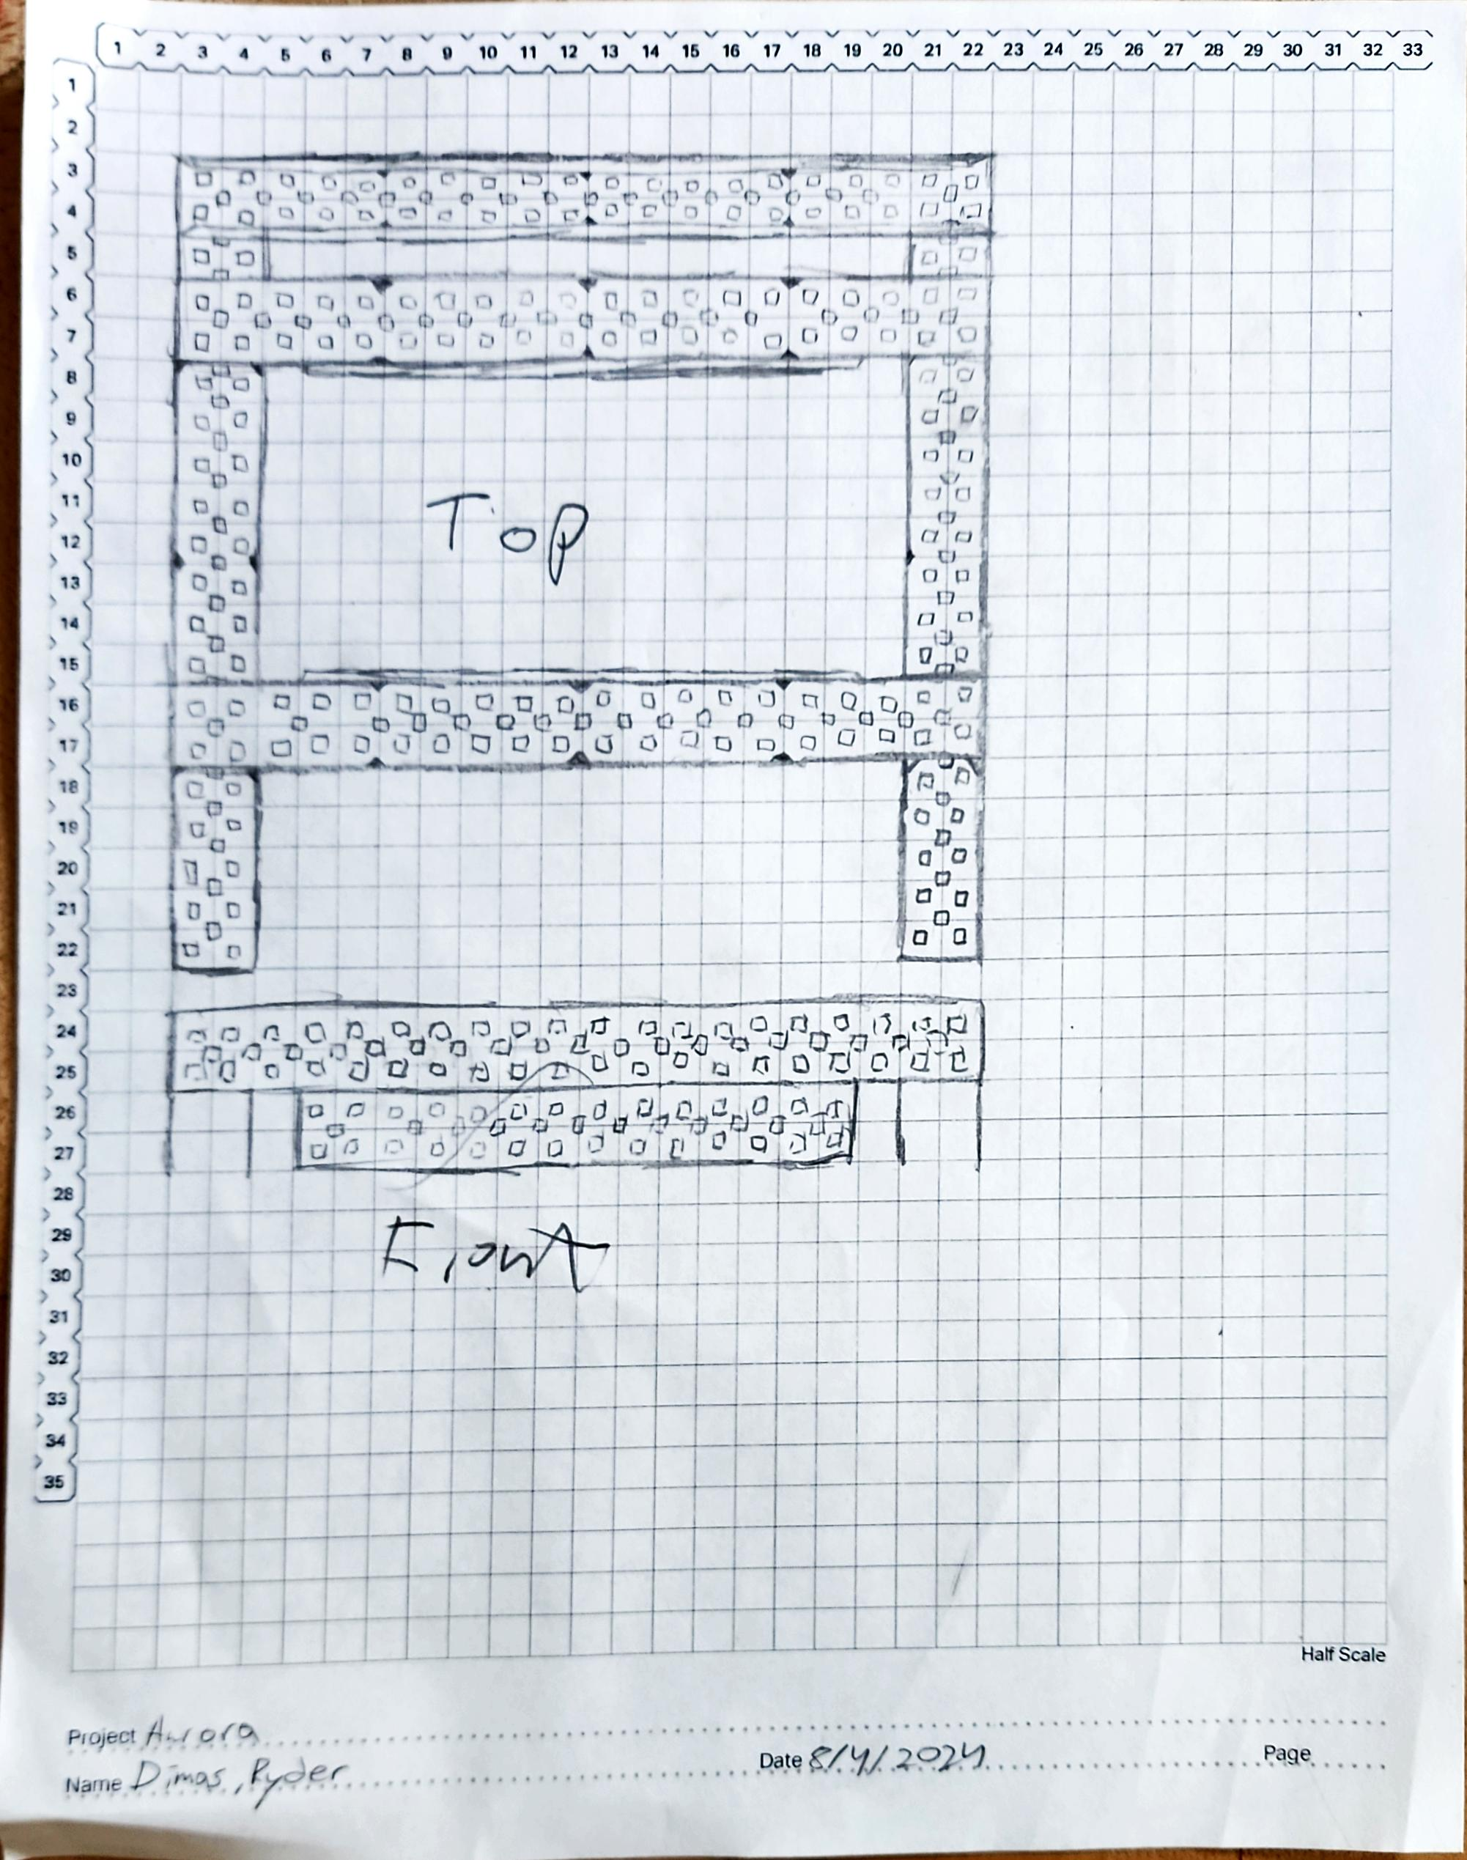
10
Notes:
First Base Drawing

Slide 25
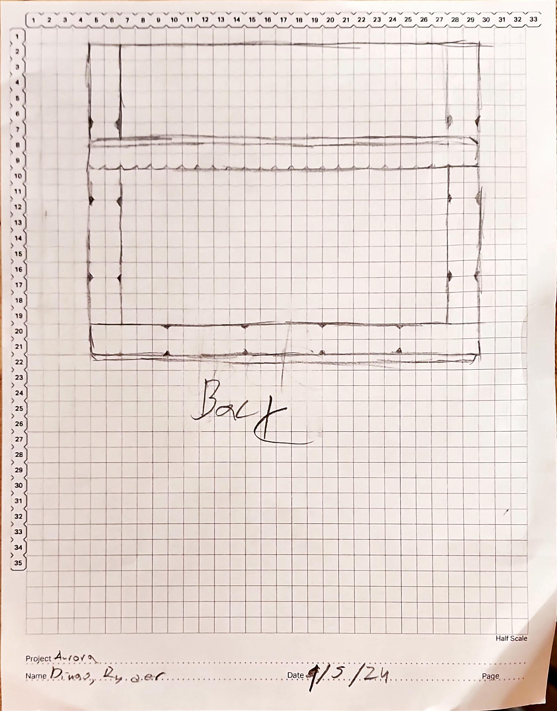
11
Notes:
Second Base Drawing

Slide 26
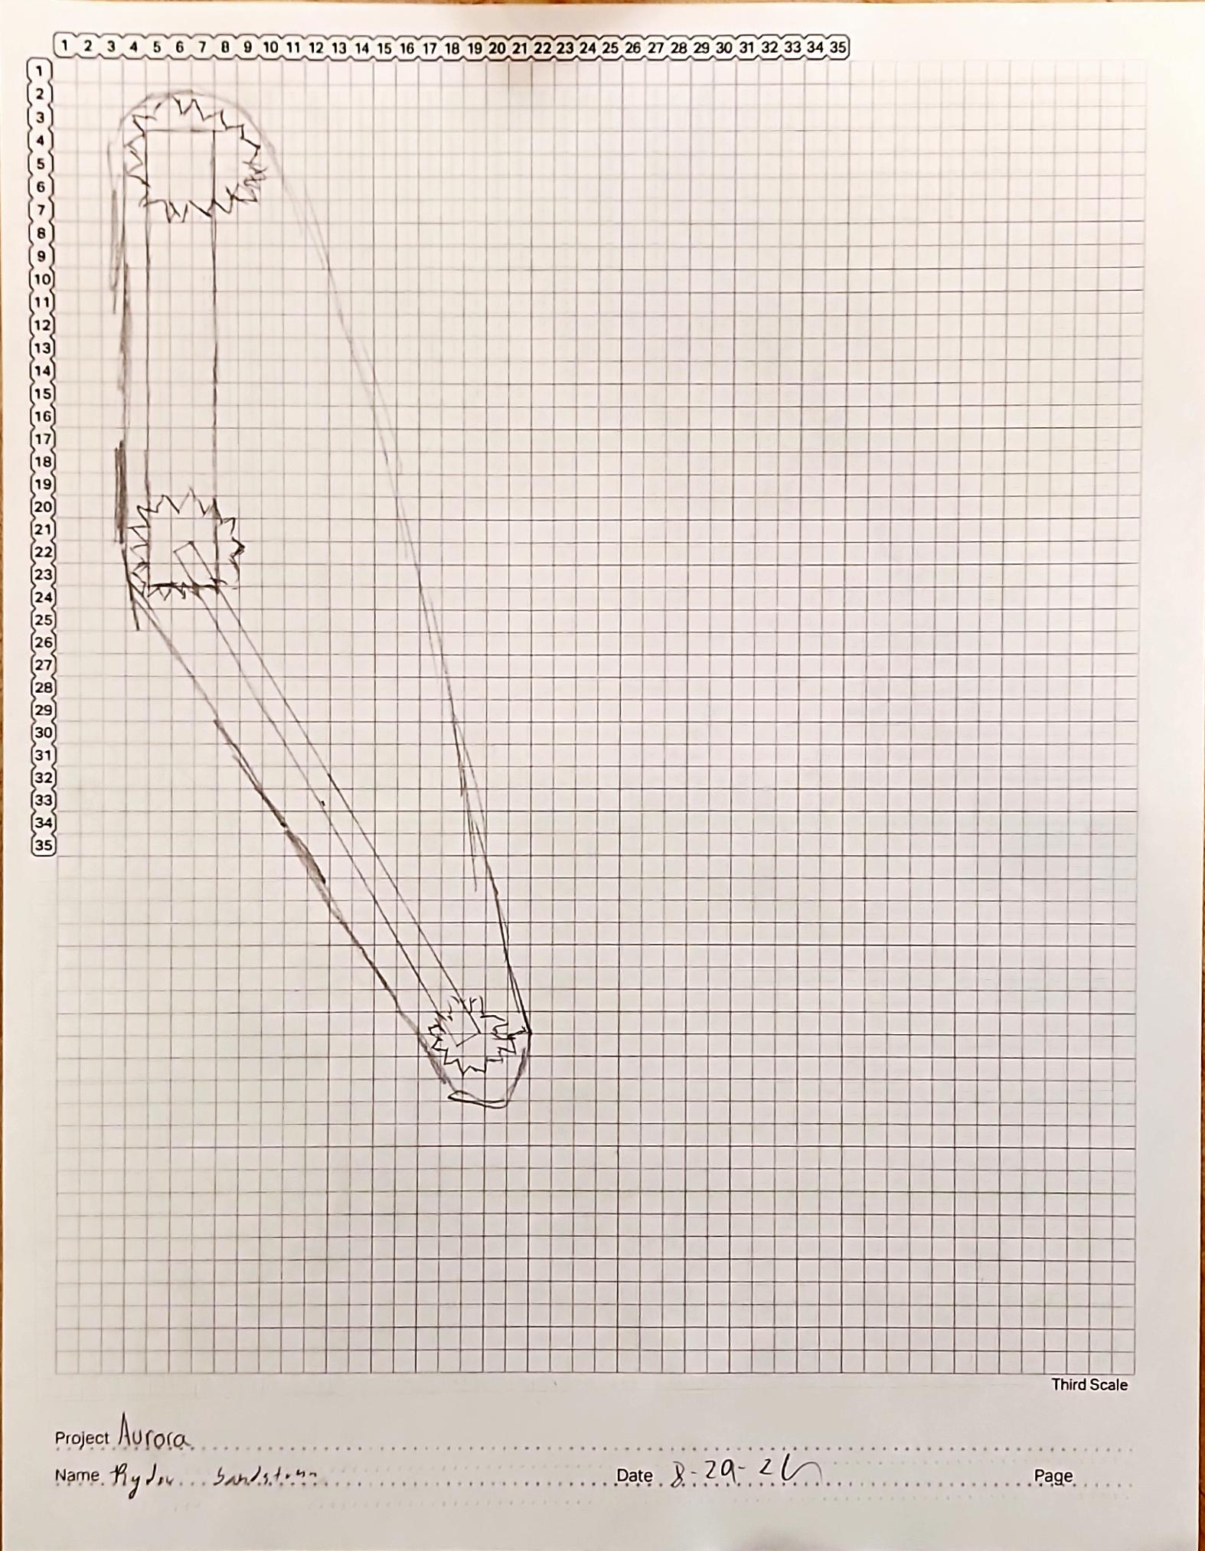
12
Notes:
First Conveyer Belt Drawing

Slide 27
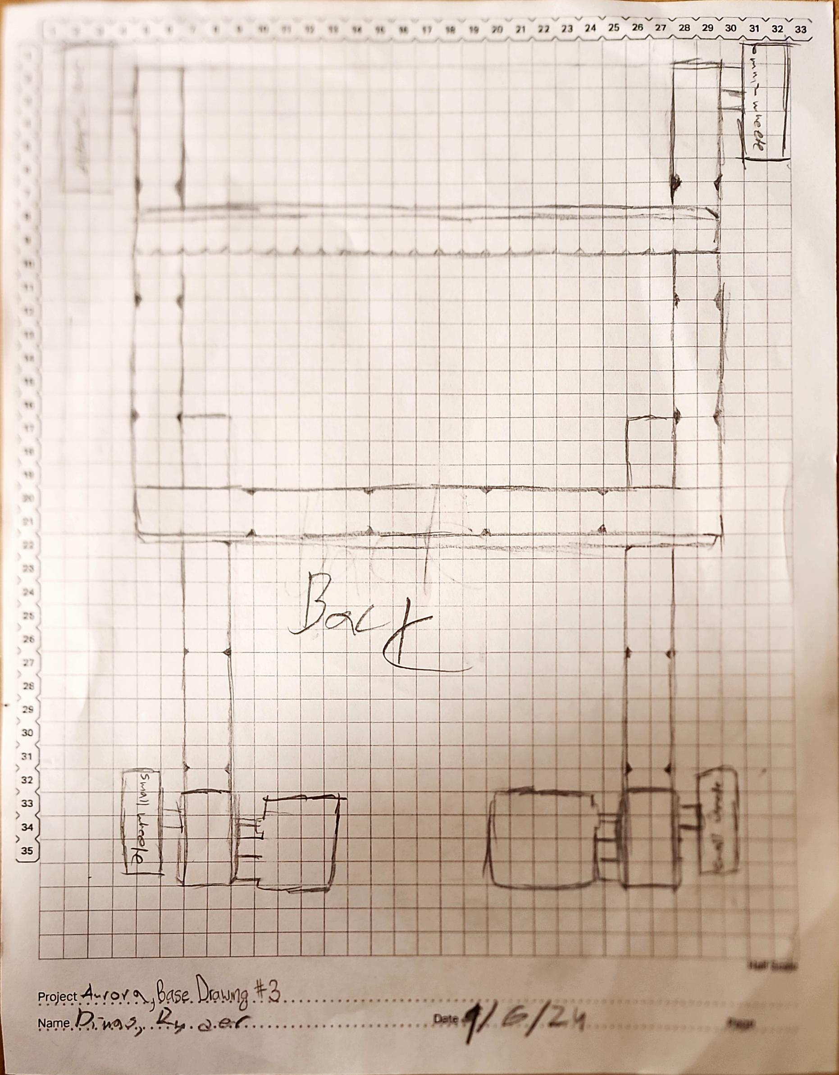
13

Slide 28
Engineering Design Process
Engineering Design Progress
Sprint #: 3
Team: Dimas
Team Members: Dimas, Abby, Ryder, Mike
Identify the Problem: We still needed a robot that could pick up rings and score them onto a mobile goal.
2. Brainstorm, Diagram, or Prototype Solutions and Select the Best Solution and Plan: After some research we came acrost the hero bot and decided that it would be a good design to try.
4. Build and Program the Solution: We built it in a couple of weeks and got word of competition that we could go to if our robot was ready, so we powered through and made the deadline for the robot to be entered into the competition.
5. Test: We had little time to really test out the robot to get all of the issues out before the competition. So, because of that we had a robot that could barely put one ring on in the competition.
Abigail Way
1/28/25

Slide 29
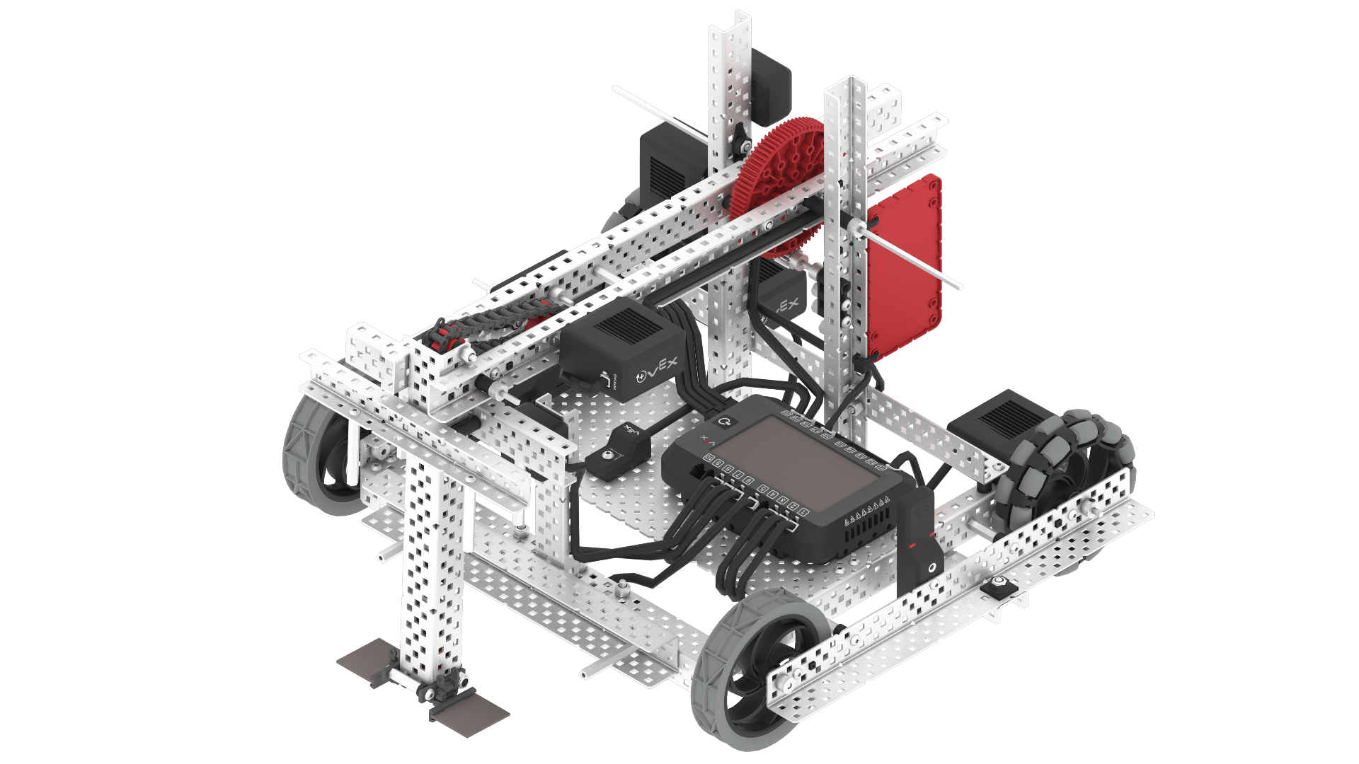
Hero Bot Drawing
Abigail Way
10/29/30
14

Slide 30
Engineering Design Process
Engineering Design Progress
Sprint #: 4
Team: Dimas
Team Members: Abby, Ryder, Dimas, Ryker, Mike, Auggie
Identify the Problem:
After the competition we realized that we had really bad robot and need something more, like one of the high schooler's robots from the competition. WE needed a robot that could suck up a ring and then launch it off kind of like our first robot idea but with a better understanding this time.
2. Brainstorm, Diagram, or Prototype Solutions and Select the Best Solution and Plan:
We examined all of the different pictures that we had taken from the competition and came up with a much simpler version that was not as complicated as all of the high schooler's but could still score multiple rings at a time.
4. Build and Program the Solution: After acquiring the parts that we needed we got started right away with building and some basic coding.
5. Test: This time we had a lot more time to work on testing the robot before our next competition. We got to make sure the drivetrain was working properly, the mobile goal grabber worked as it should, and that we could score a whole mobile goal in a matter of seconds.
Abigail Way
1/28/25

Slide 31
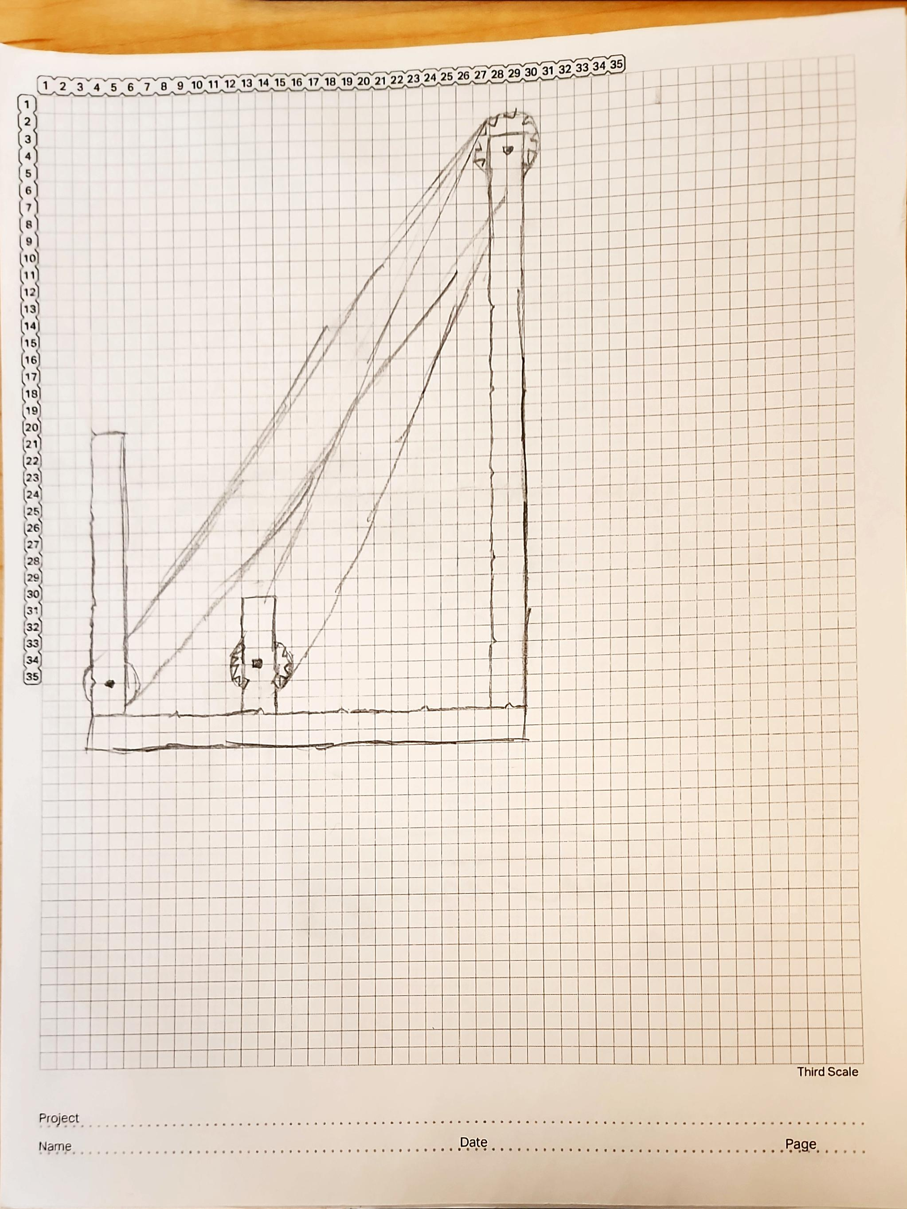
15

Slide 32
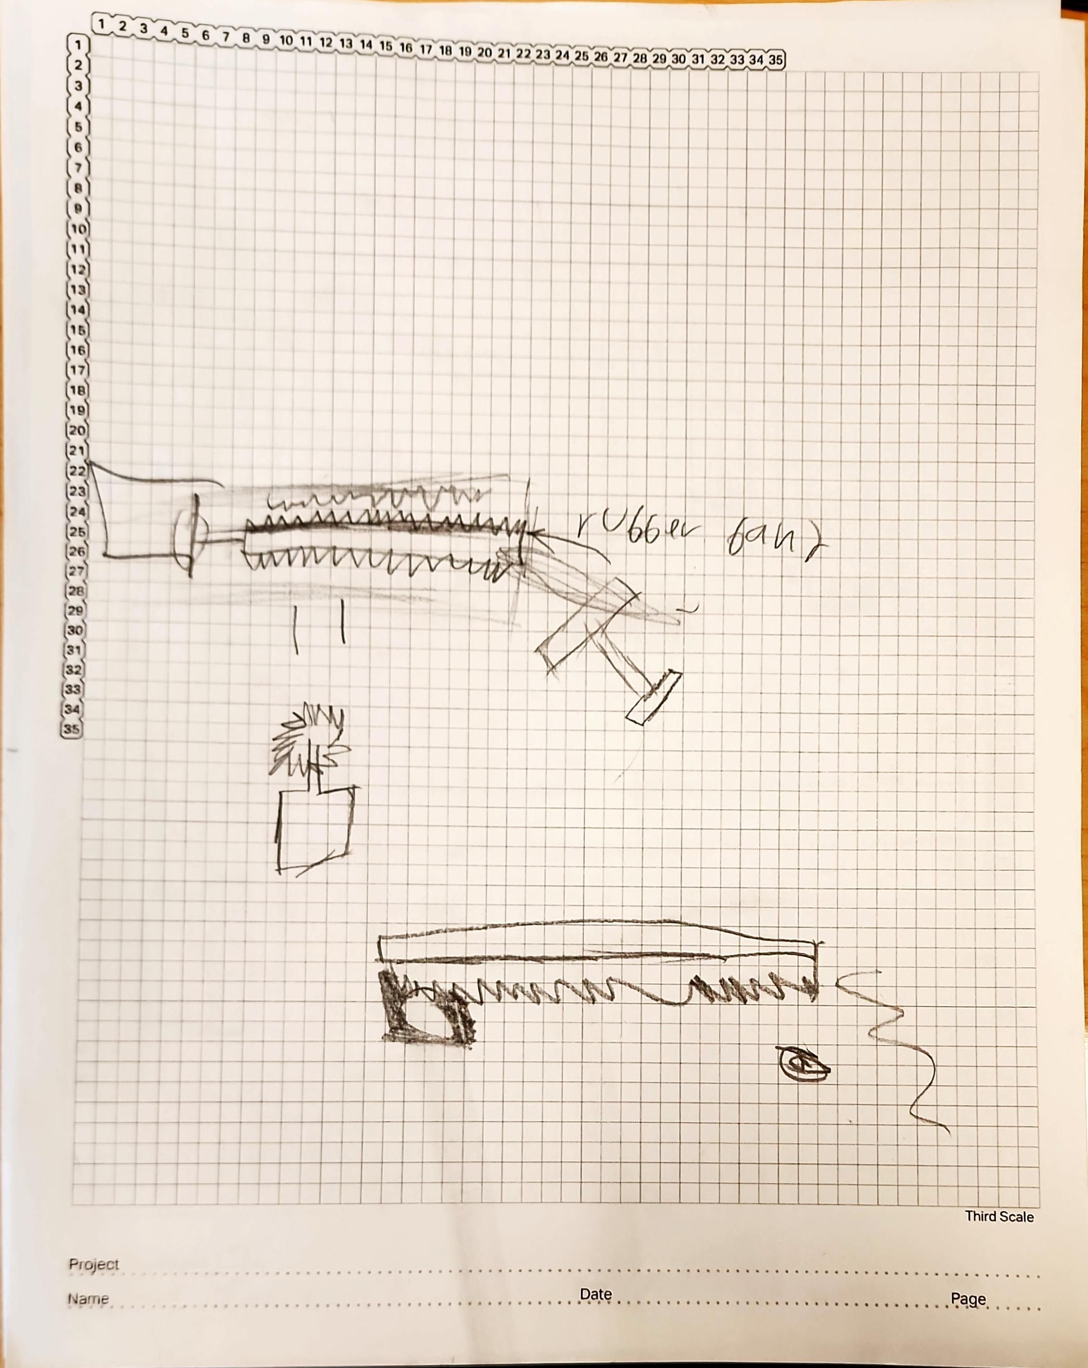
16

Slide 33
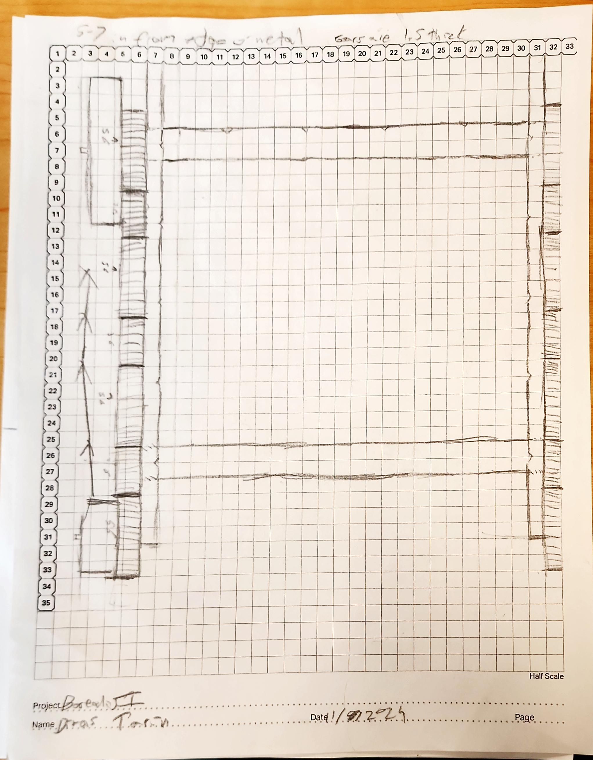
17

Slide 34
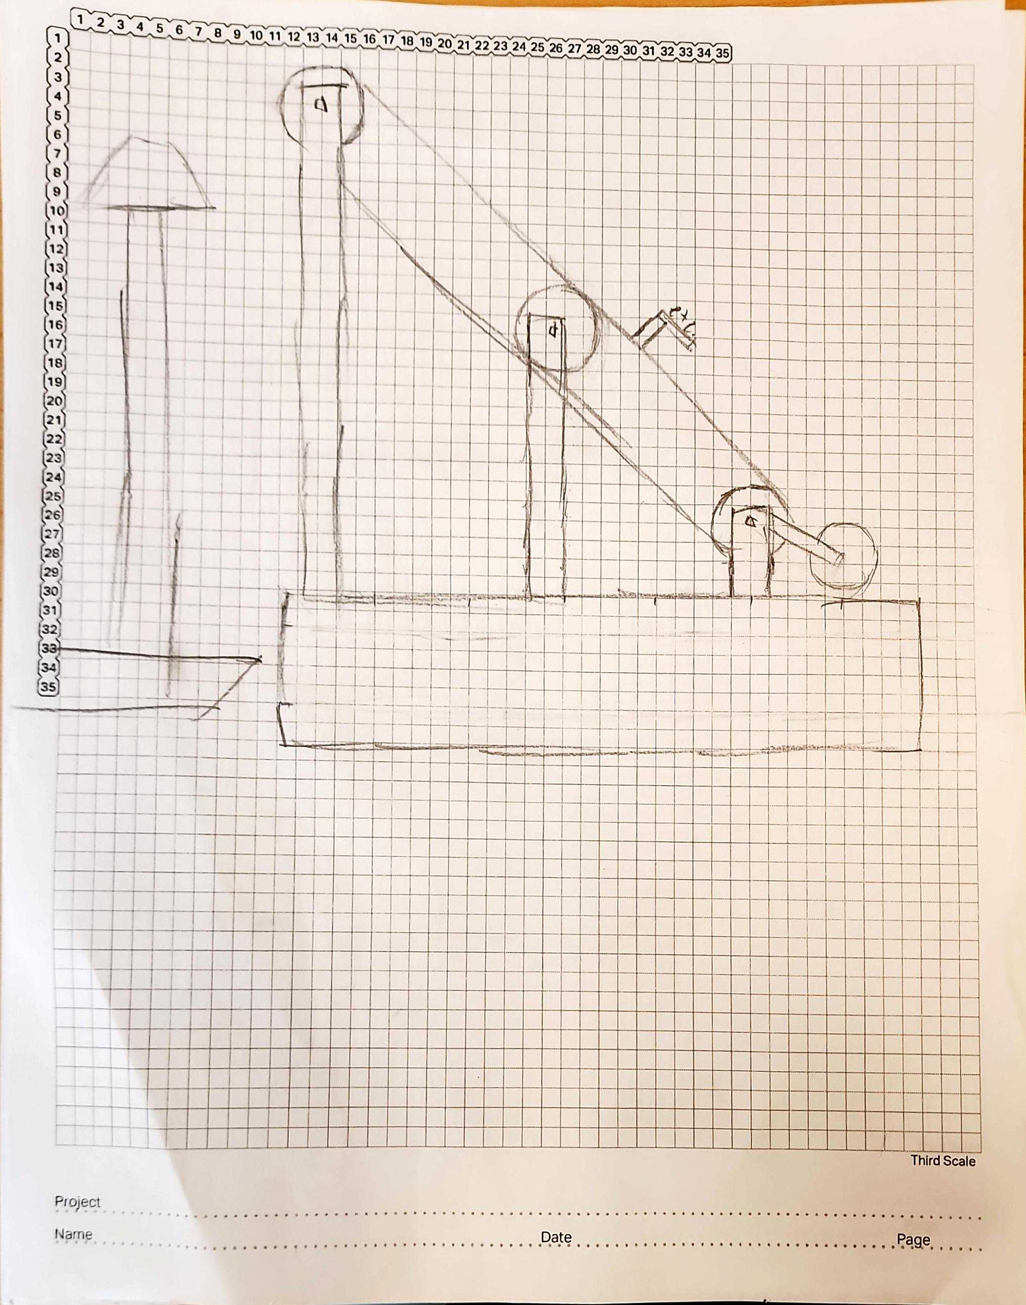
18

Slide 35
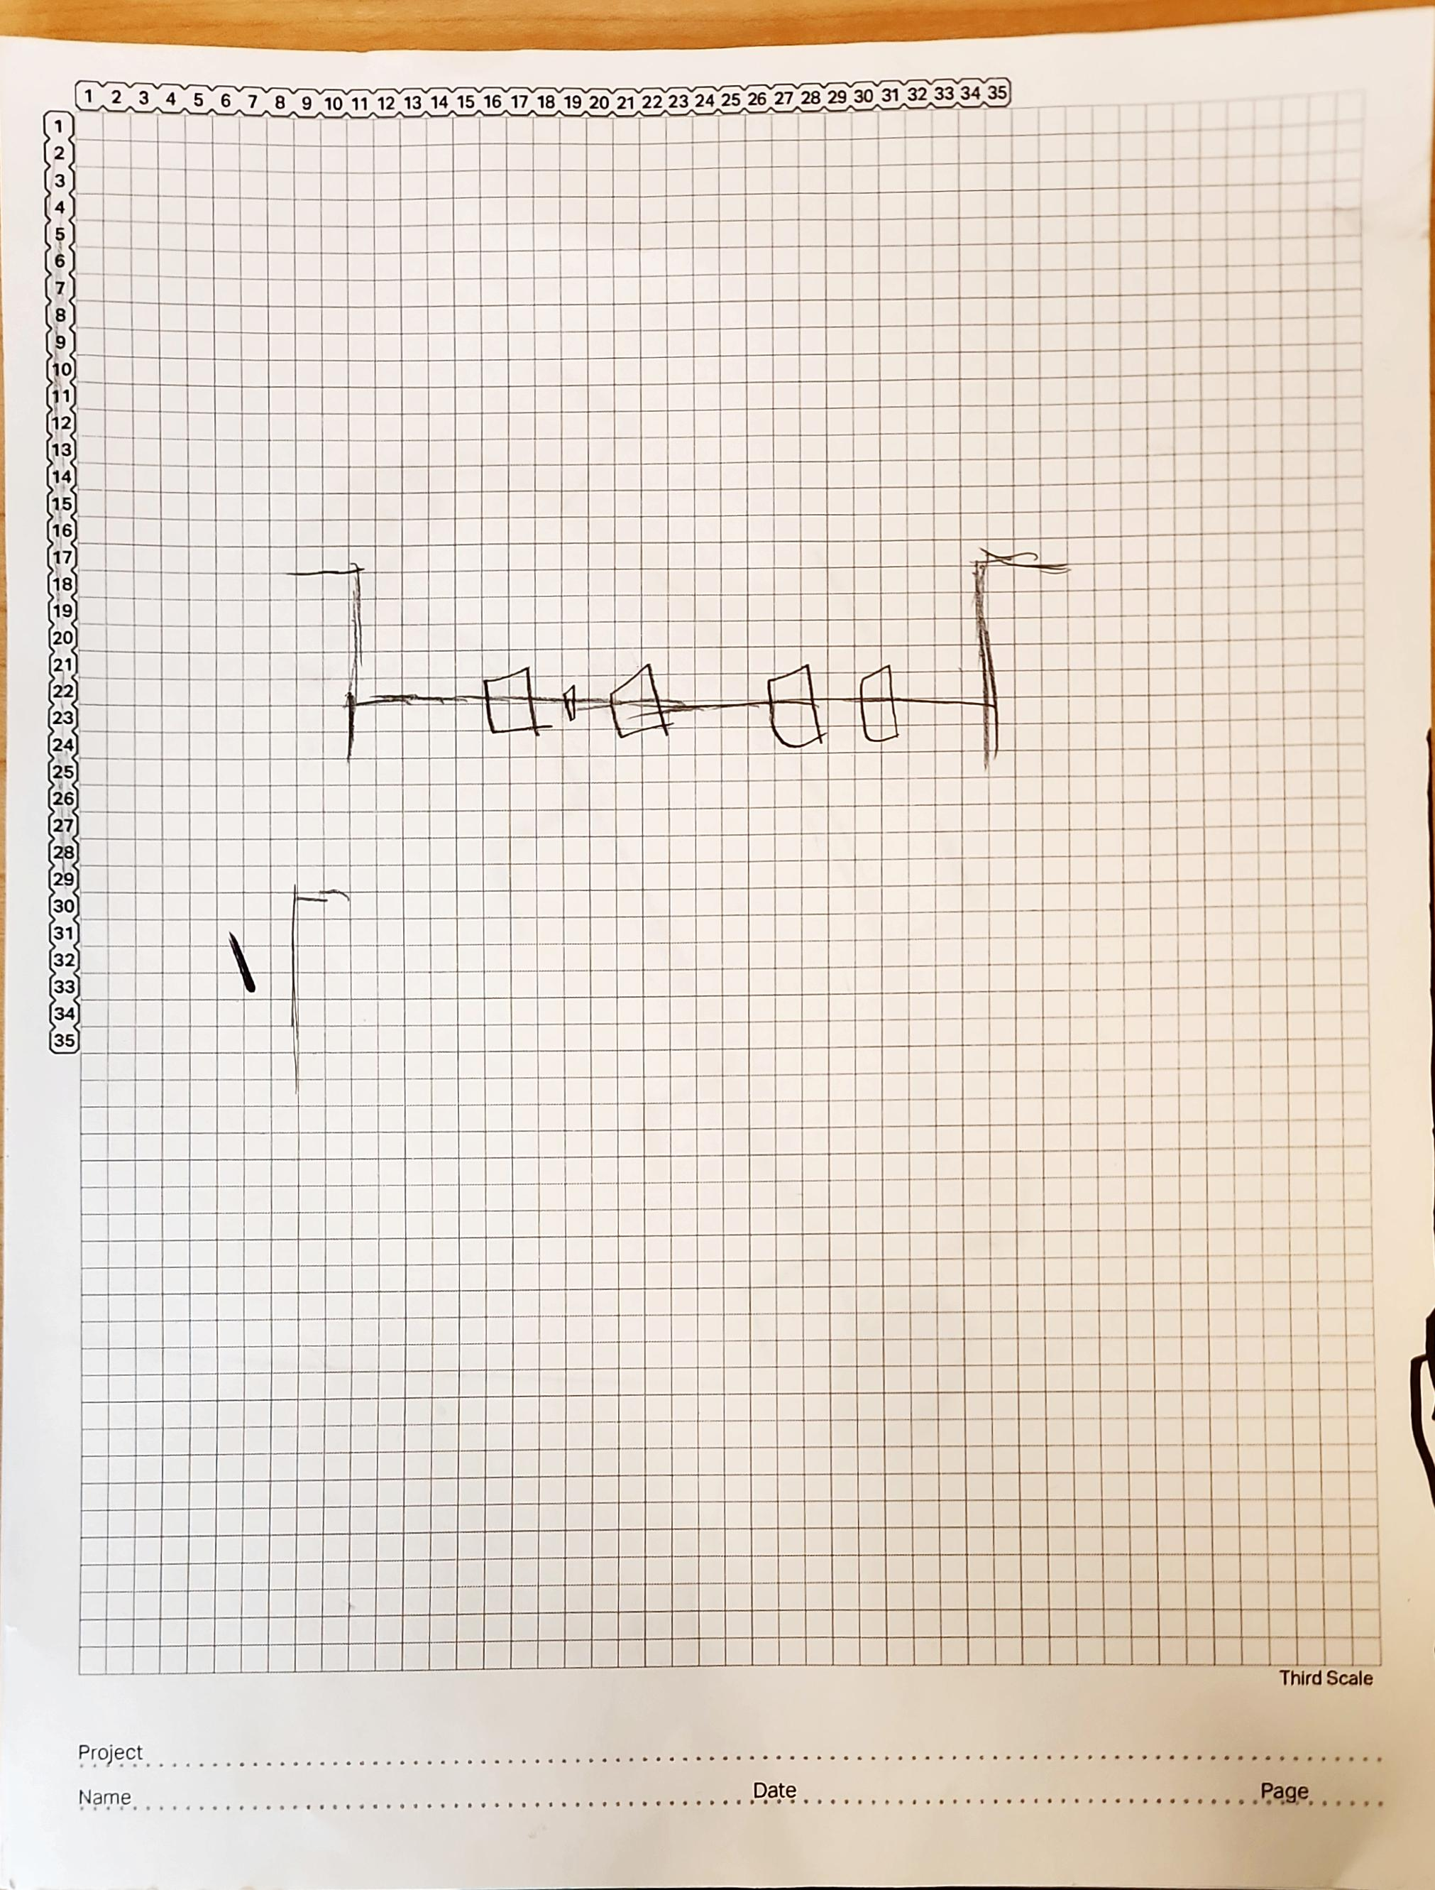
19

Slide 36
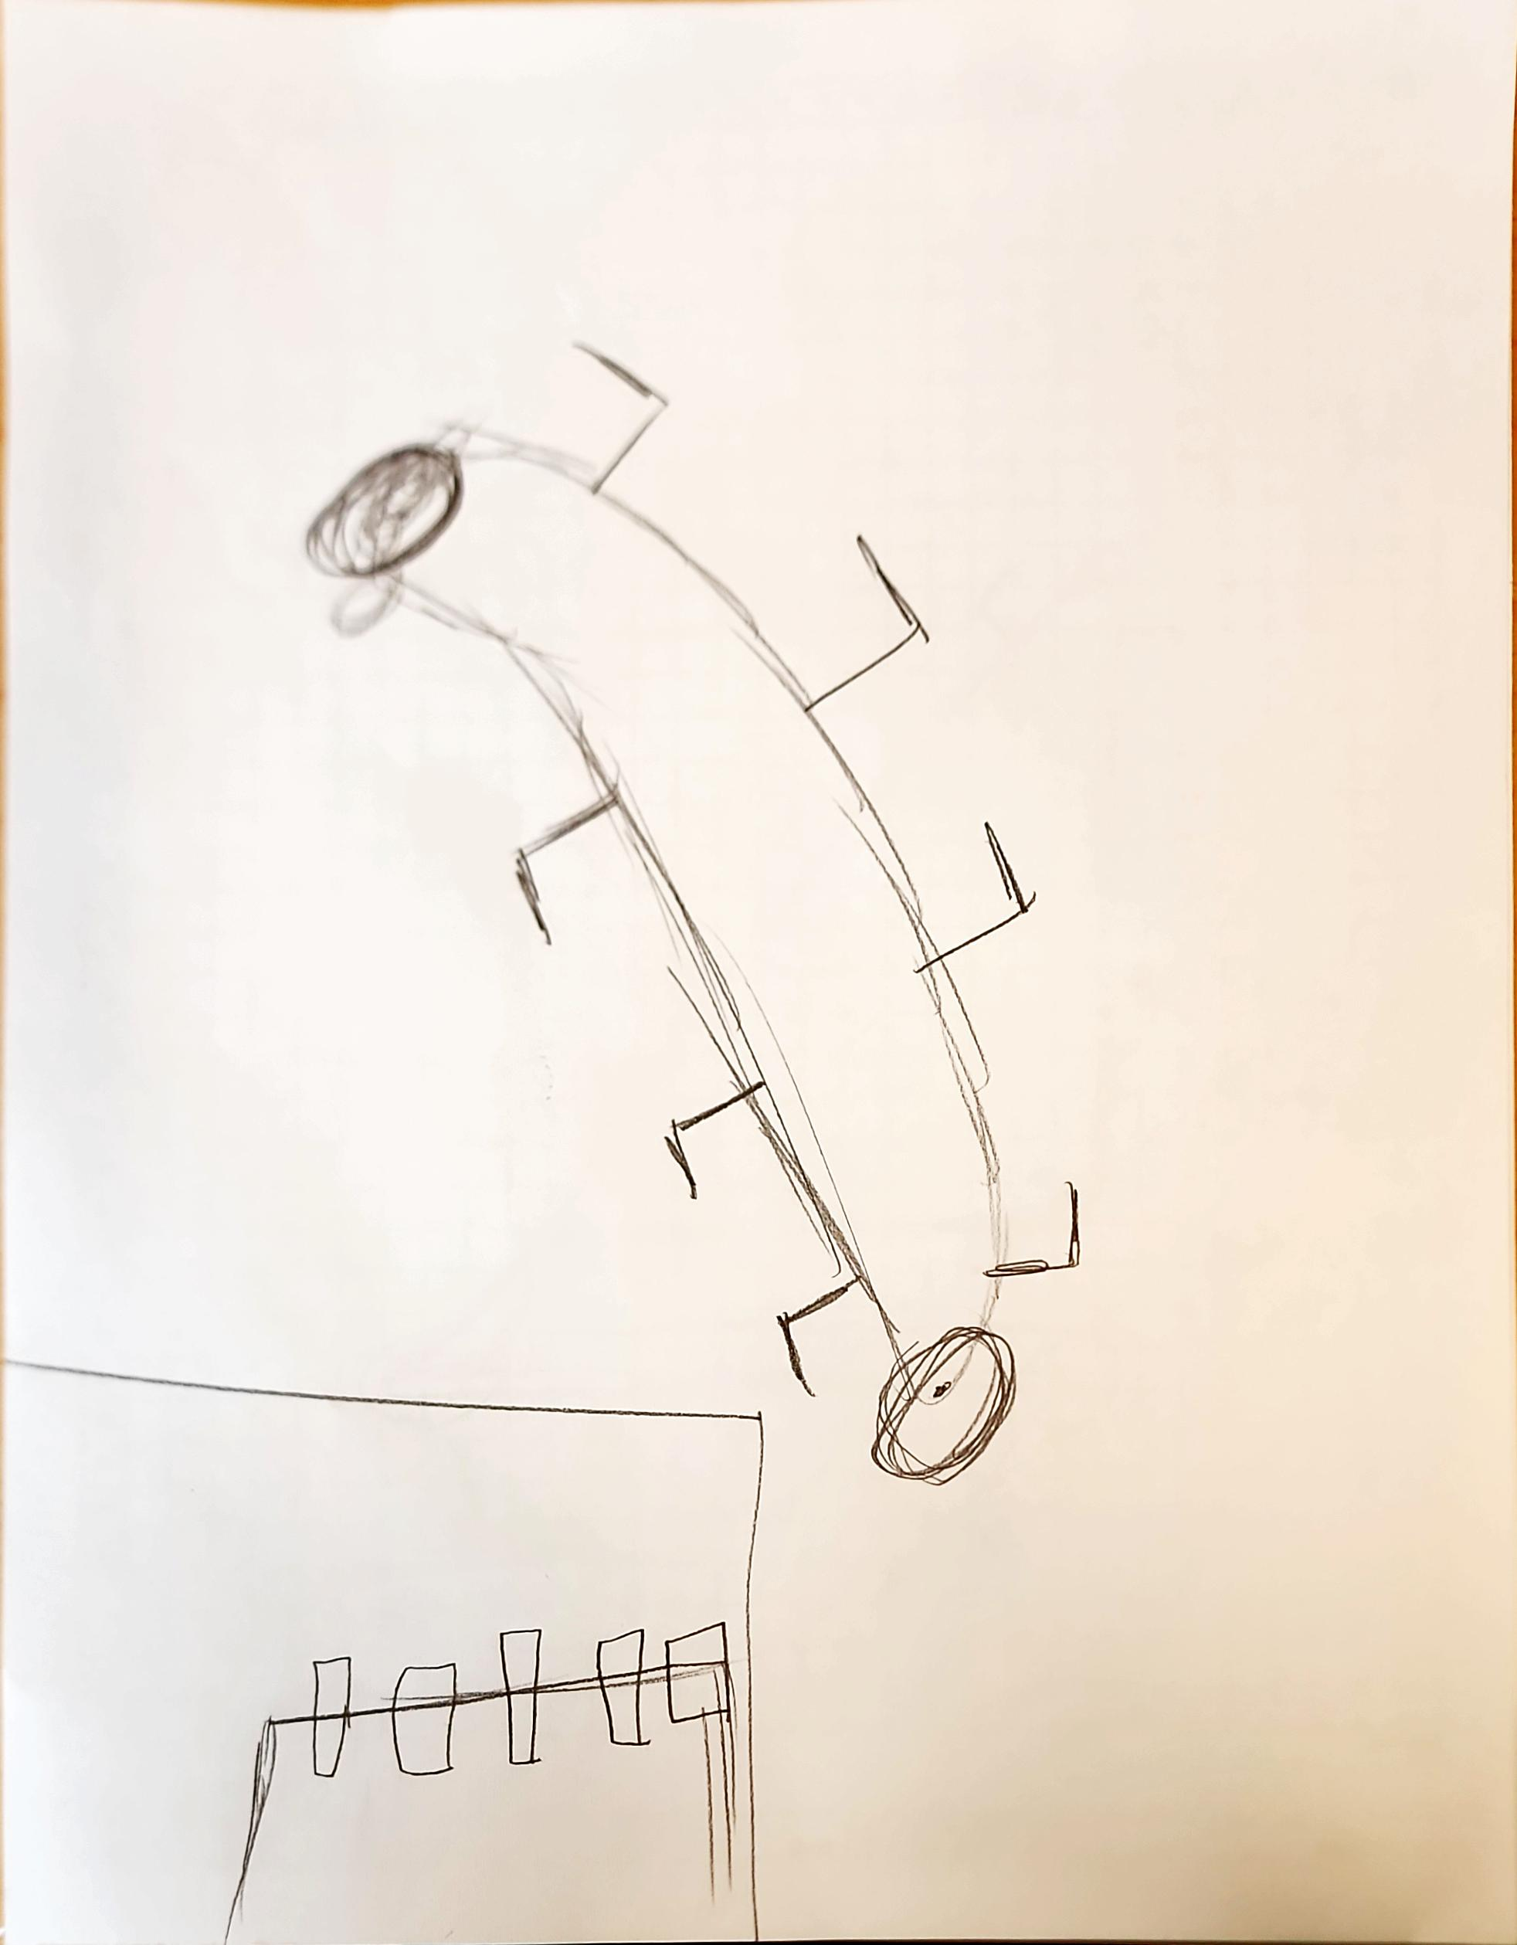
20

Slide 37
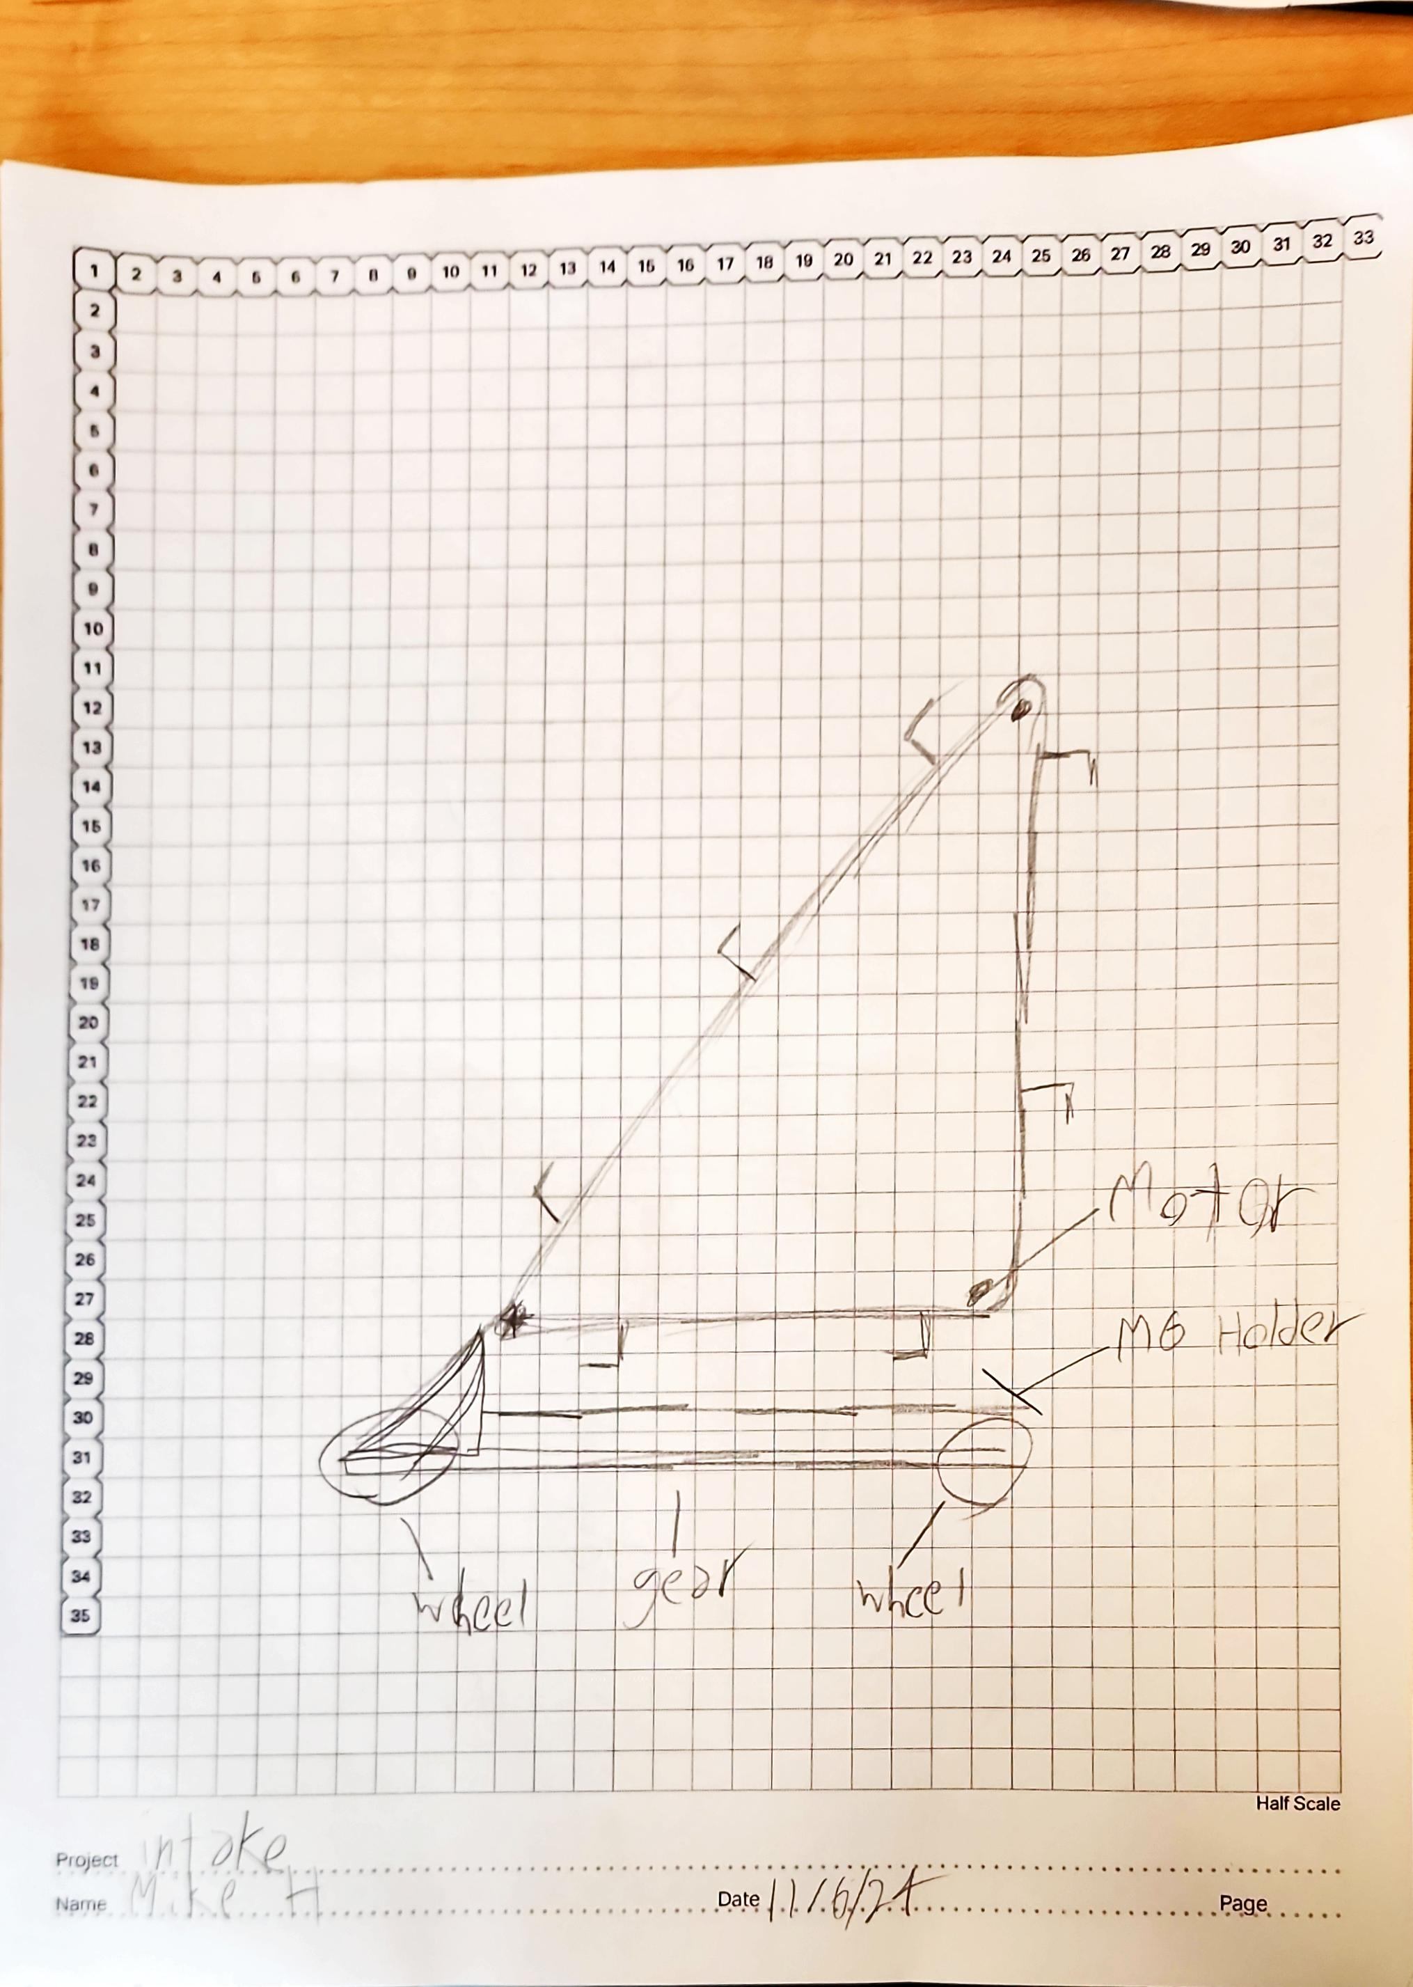
21

Slide 38
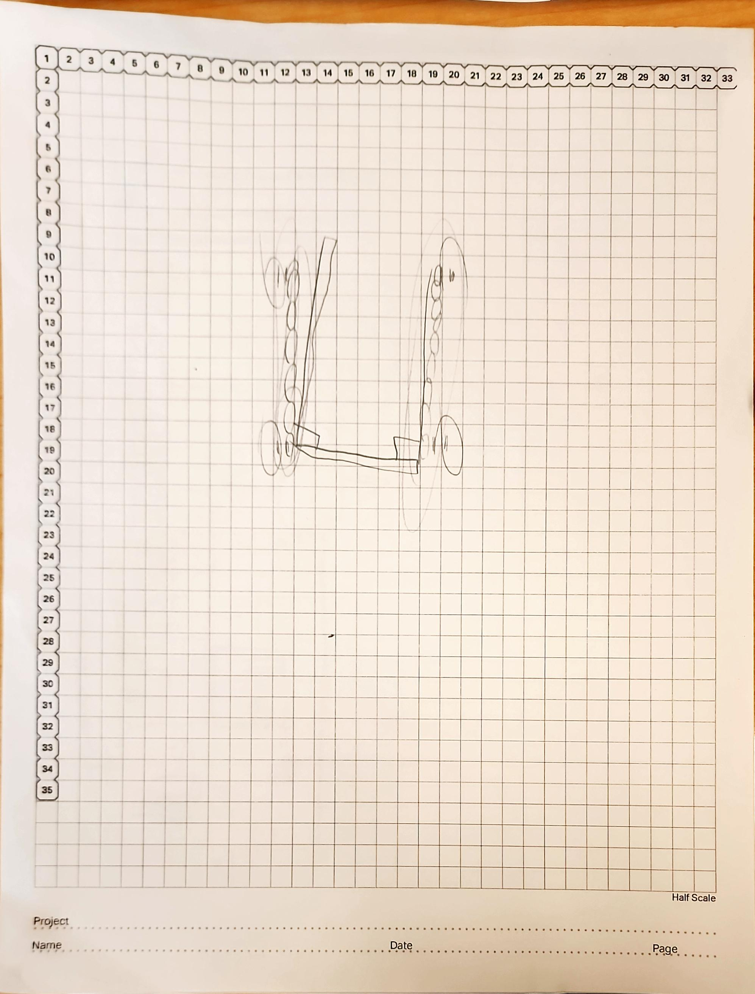
22

Slide 39
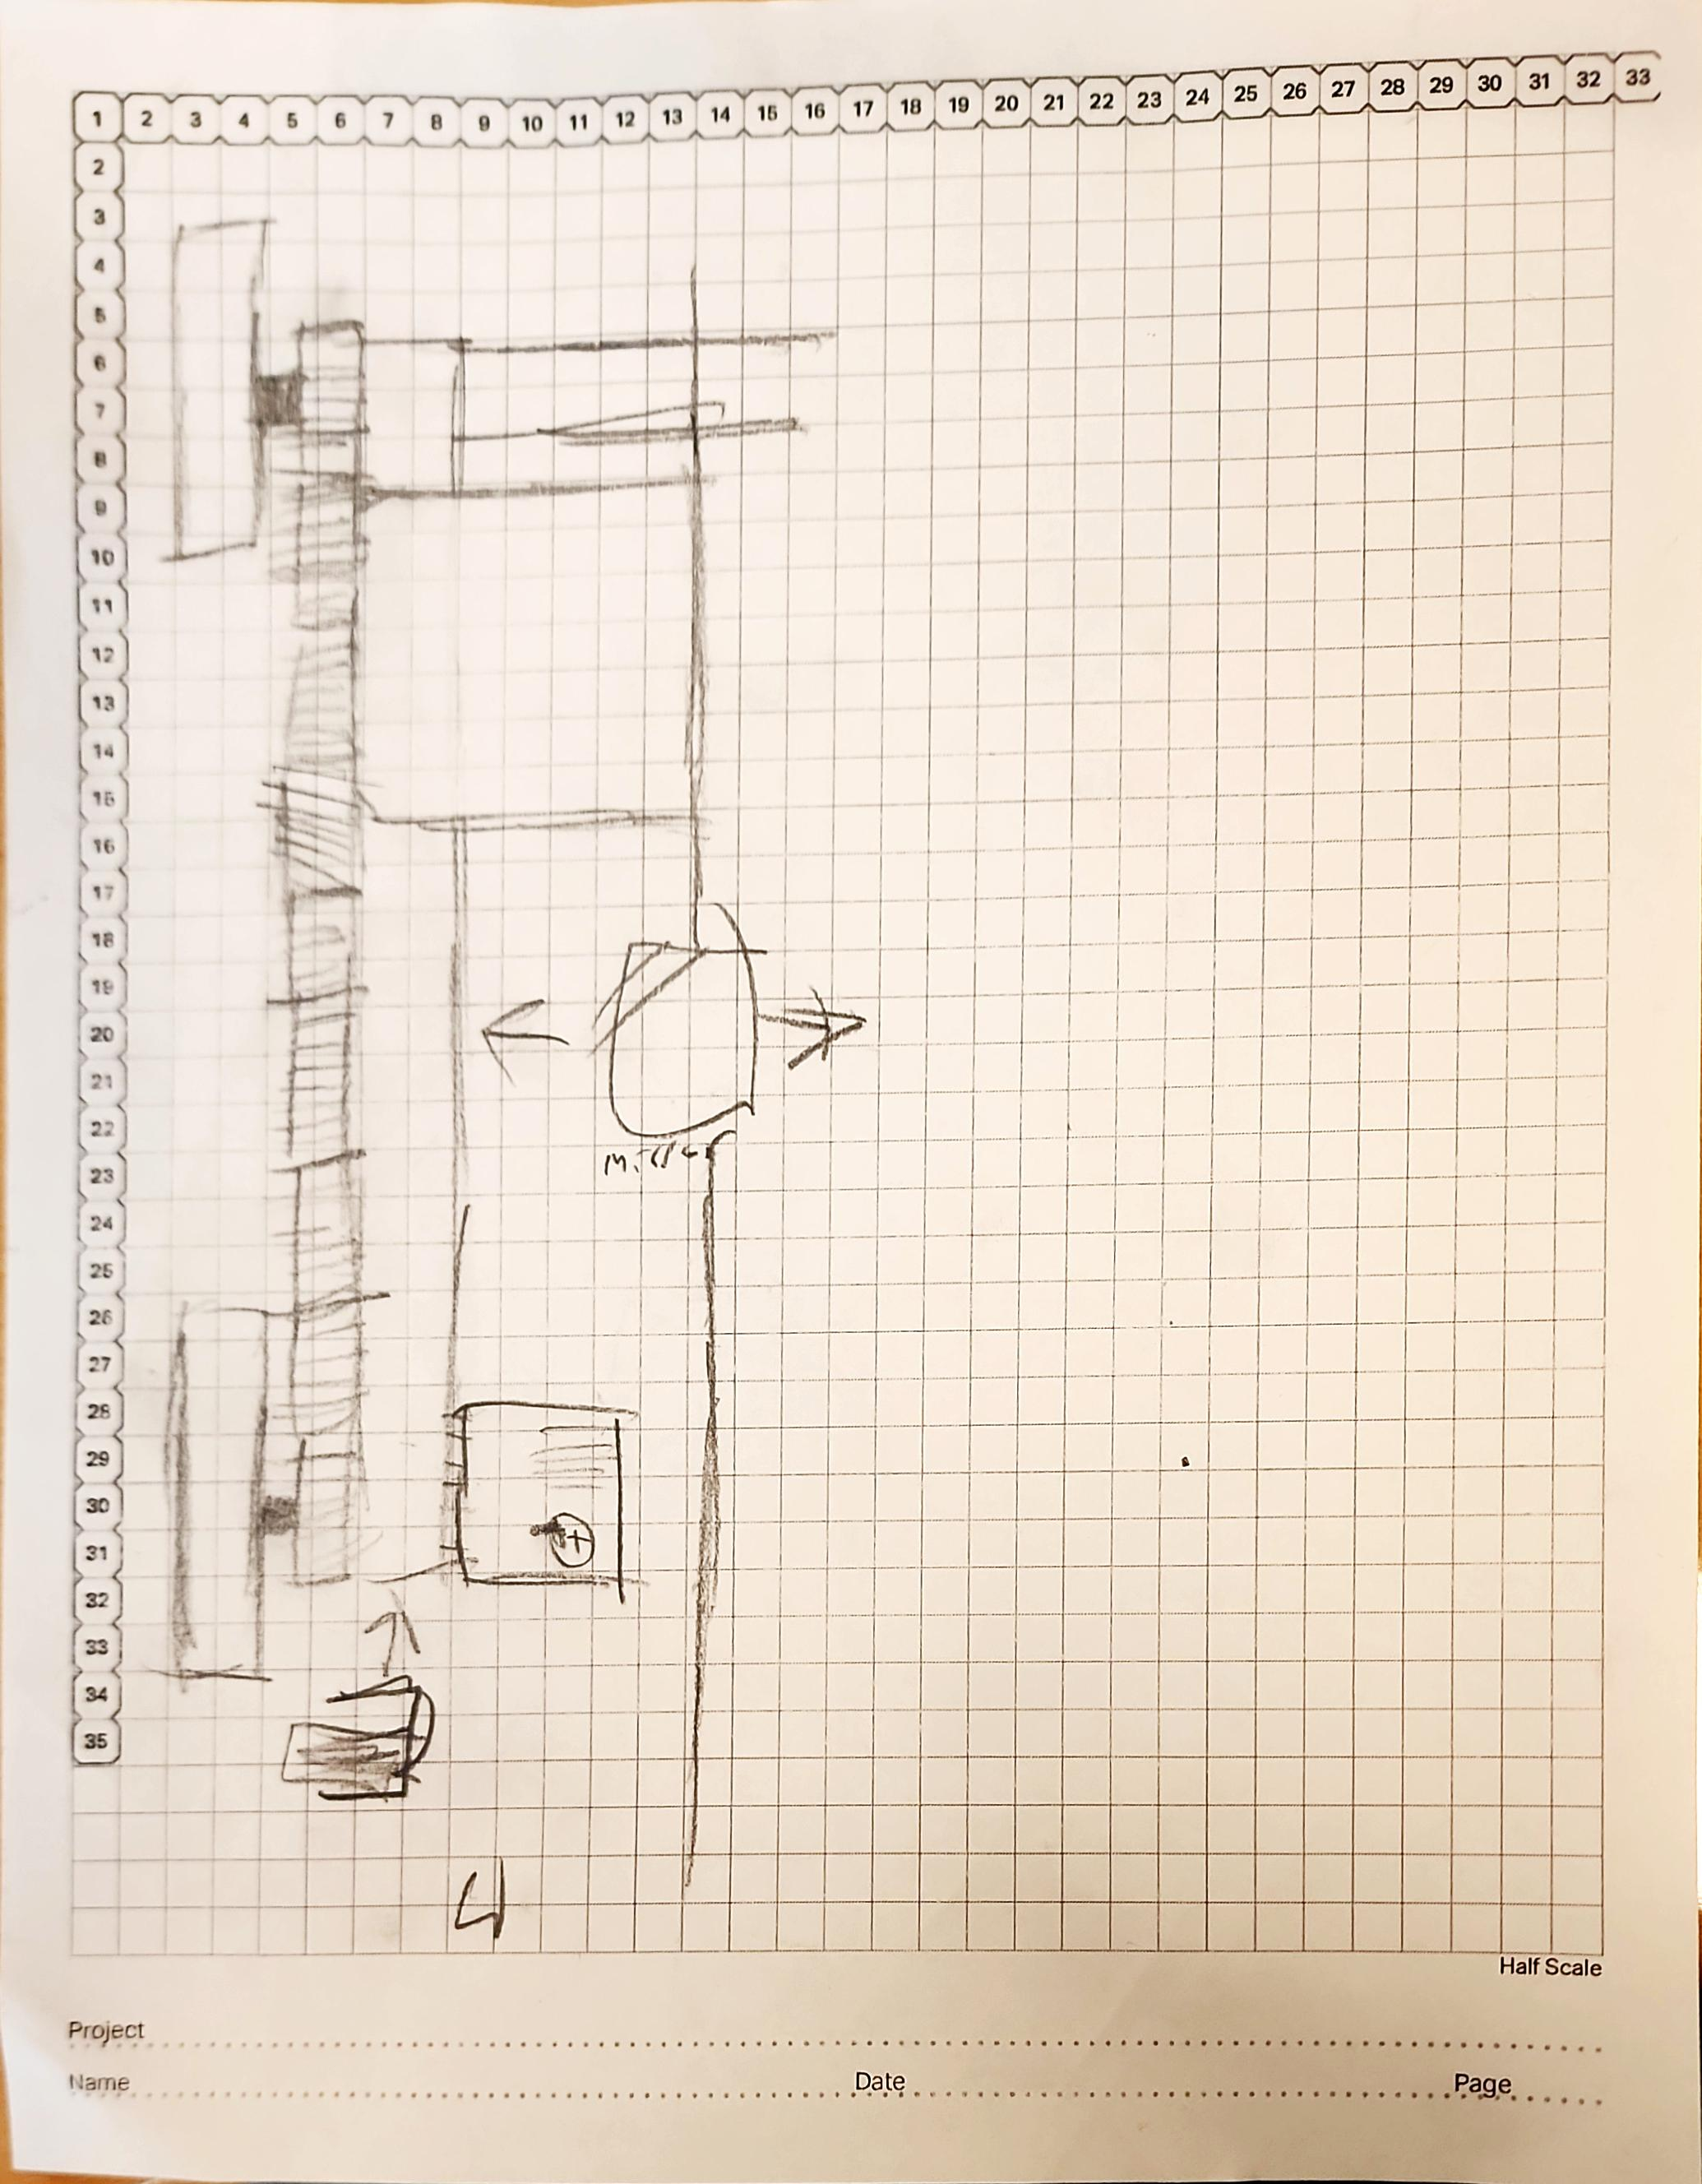
23

Slide 40
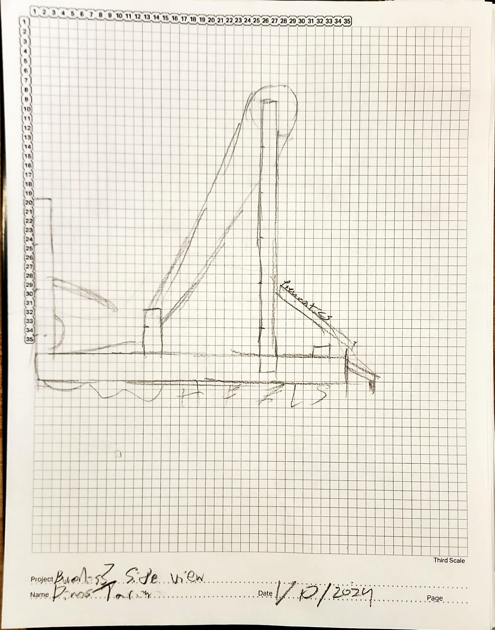

Slide 41
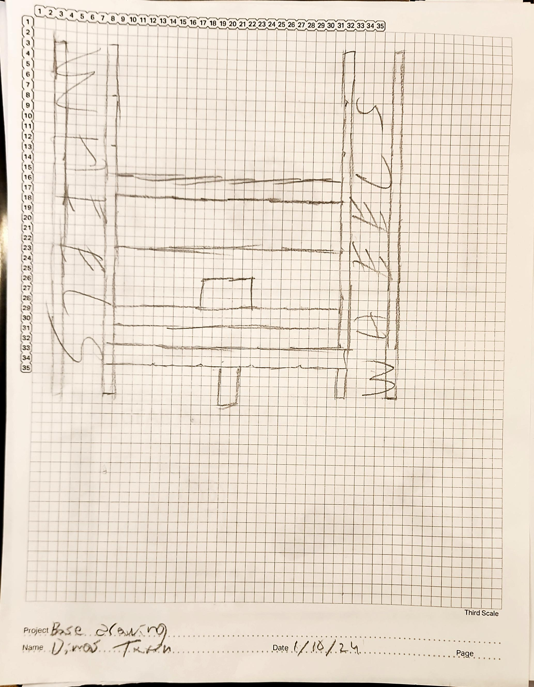
24

Slide 42
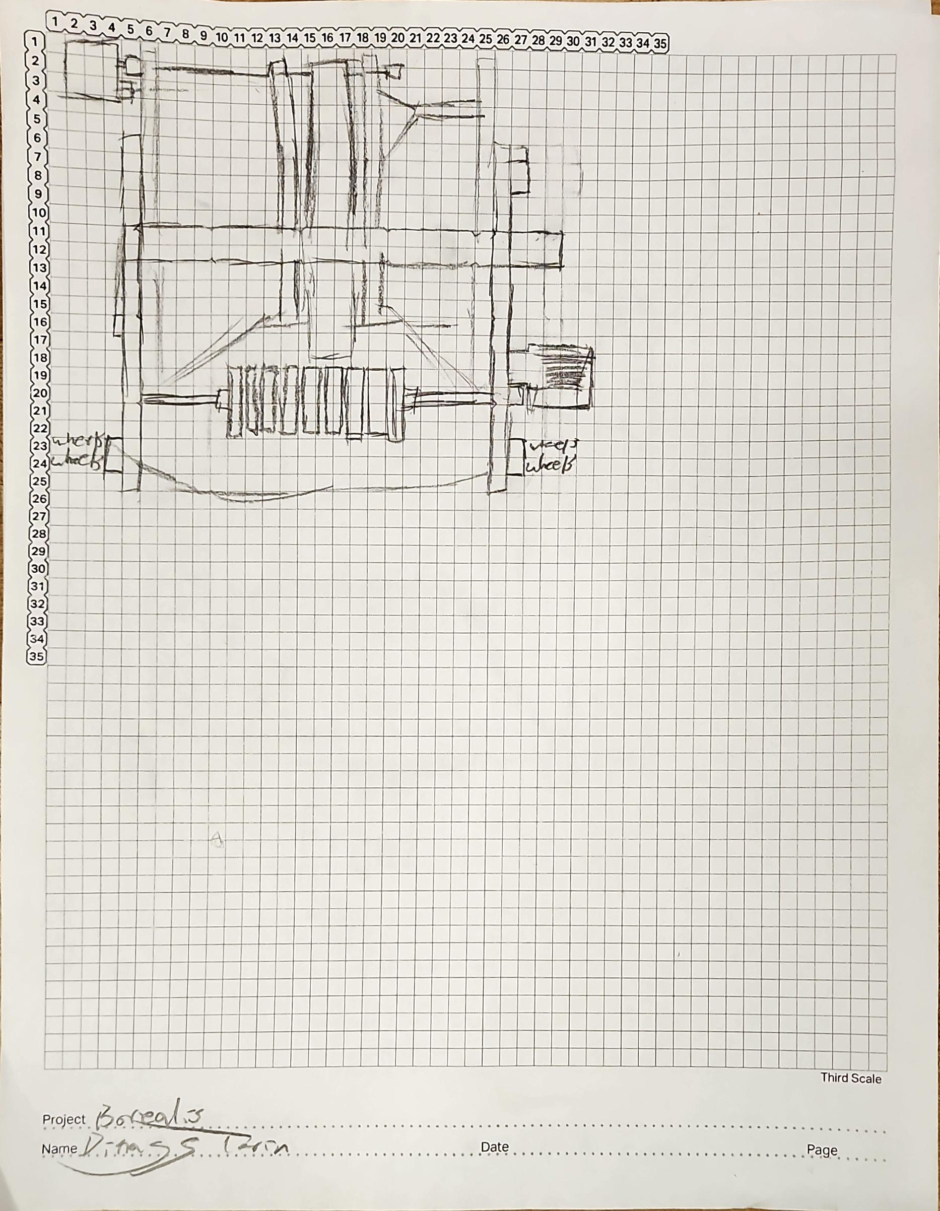

Slide 43
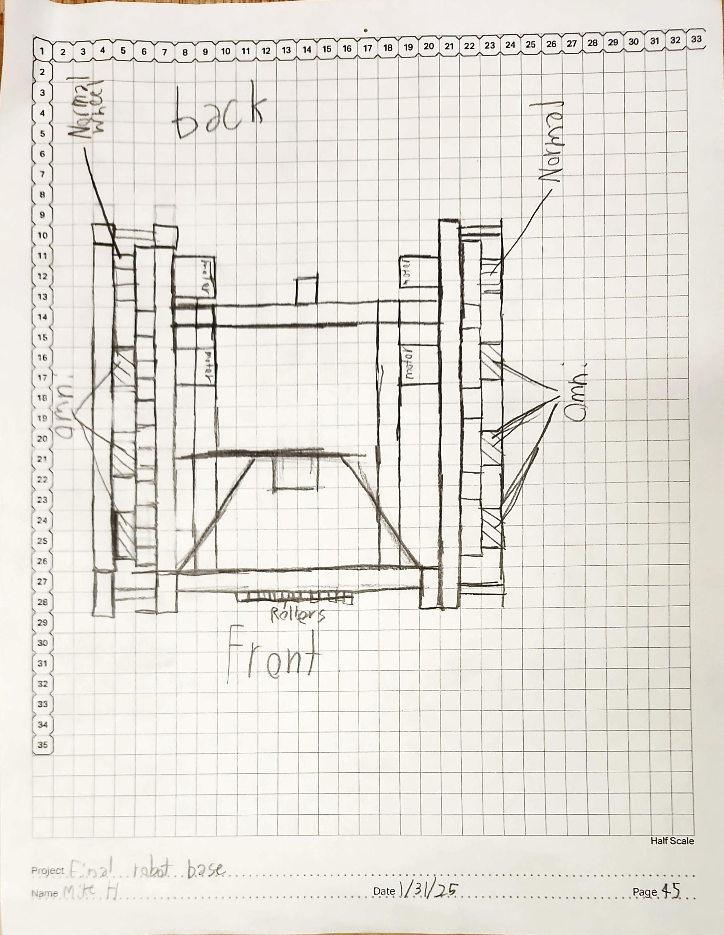

Slide 44
Engineering Design Process
Engineering Design Progress
Sprint #: 4
Team: Dimas
Team Members: Abby, Ryder, Dimas, Ryker, Mike, Auggie
Identify the Problem:
Our problem that we had was that we needed a better robot and notebook design from our last competition.
2. Brainstorm, Diagram, or Prototype Solutions and Select the Best Solution and Plan:
We come up with the idea to use online drawings instead of the paper drawings along with improving our mobile goal grabber and making a part to get rings out of the positive conners so we can double the point vale of our scored rings.
4. Build and Program the Solution: After producing our plan we went to execute everything.
5. Test: To test we improved our notebook by making it more up to date but for our robot we ran a problem. We were out of time to prototype; we need to test out code and practice driving so we put on our old mobile goal grabber. As for the thing to get rings out of the conner we have a good prototype we just need to put it on which will hopefully take 10 minutes max.
Abigail Way
1/28/25

Slide 45




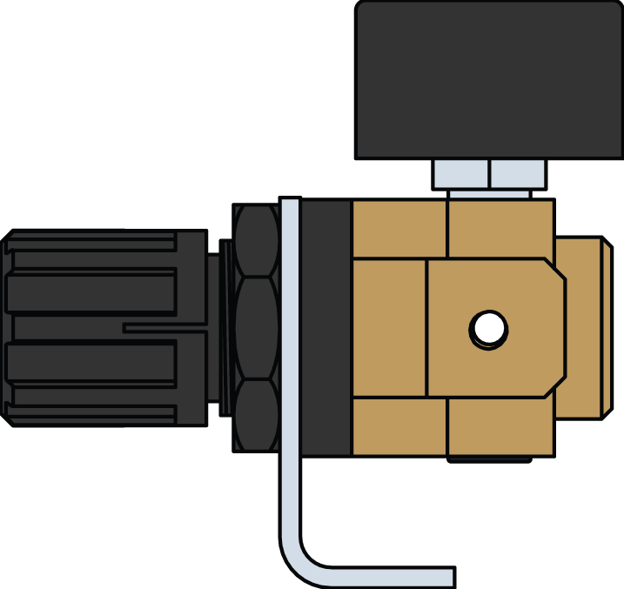






Left Sode View of Completed robot

Slide 46







Front veiw form completed robot

Slide 47













BackVeiw of completed robot

Slide 48


Side veiw of completed robot

Slide 49
Section D Brain Ports/ Controller Program and Game Map

Slide 50
Brain Ports
Right front motor
Inertial
Left front motor
Right Back Motor
Left back
radio
Intake Lifter
Intake spinner
Pneumatics
Abigail Way
10/28/24
25

Slide 51
Remote Control Program
Intake Up
Mobile grabber up
Intake Down
Mobile Grabber down
Robot Forward/Backward
Turn left/Right
Half speed drive train
Abigail Way
01/24/25
26

Slide 52
Brain Ports
Left Front Motor
Inertial
Right Front Motor
Left Back Motor
Right Back Motor
Radio
Intake Lift
Intake spinner
Pneumatics
Abigail Way
01/24/2025
28

Slide 53

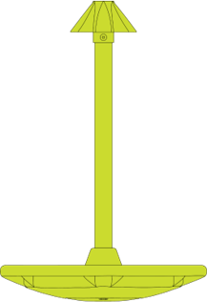


Autonmous Code Goal
Our goal is to get the preload on a mobile goal and then pick up another ring and score it onto the mobile goal as well.
(Code works for both colors/ alliances)
Ring from under
Preload
30

Slide 54
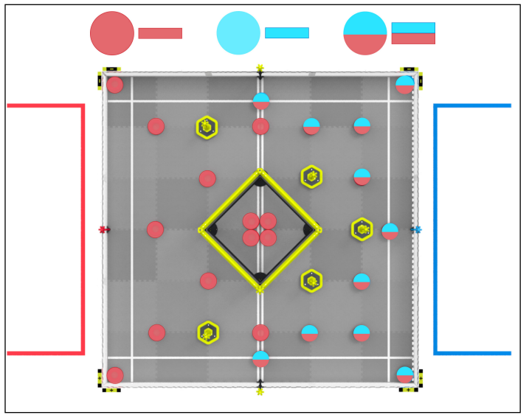

Slide 55
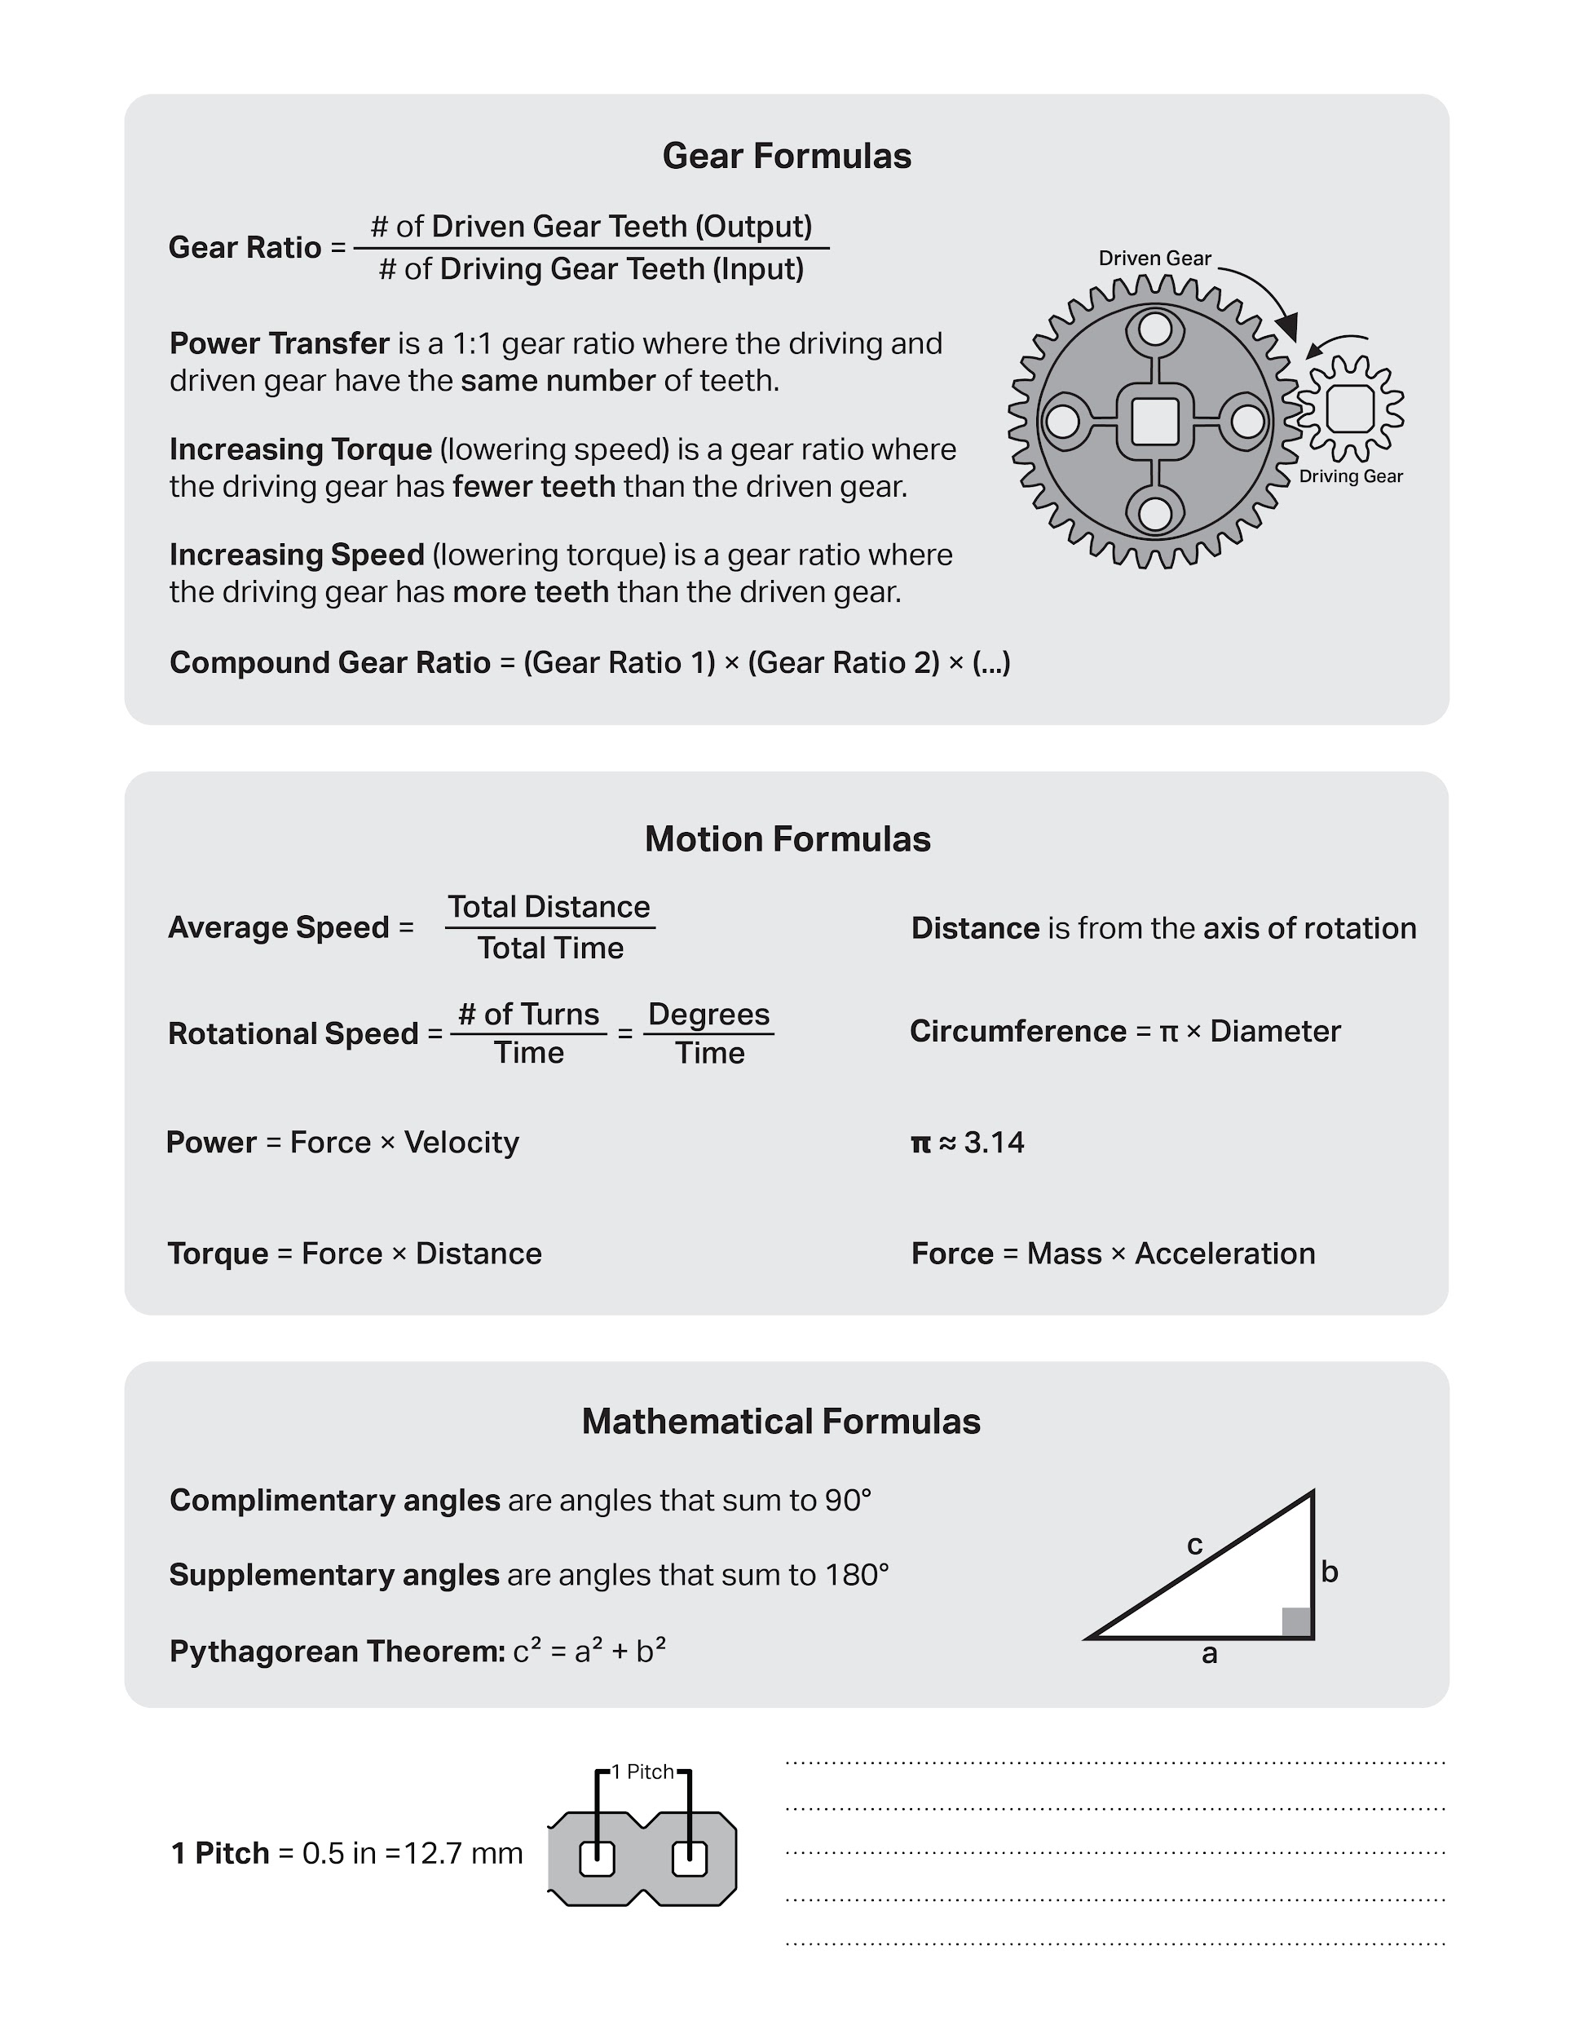

Slide 56
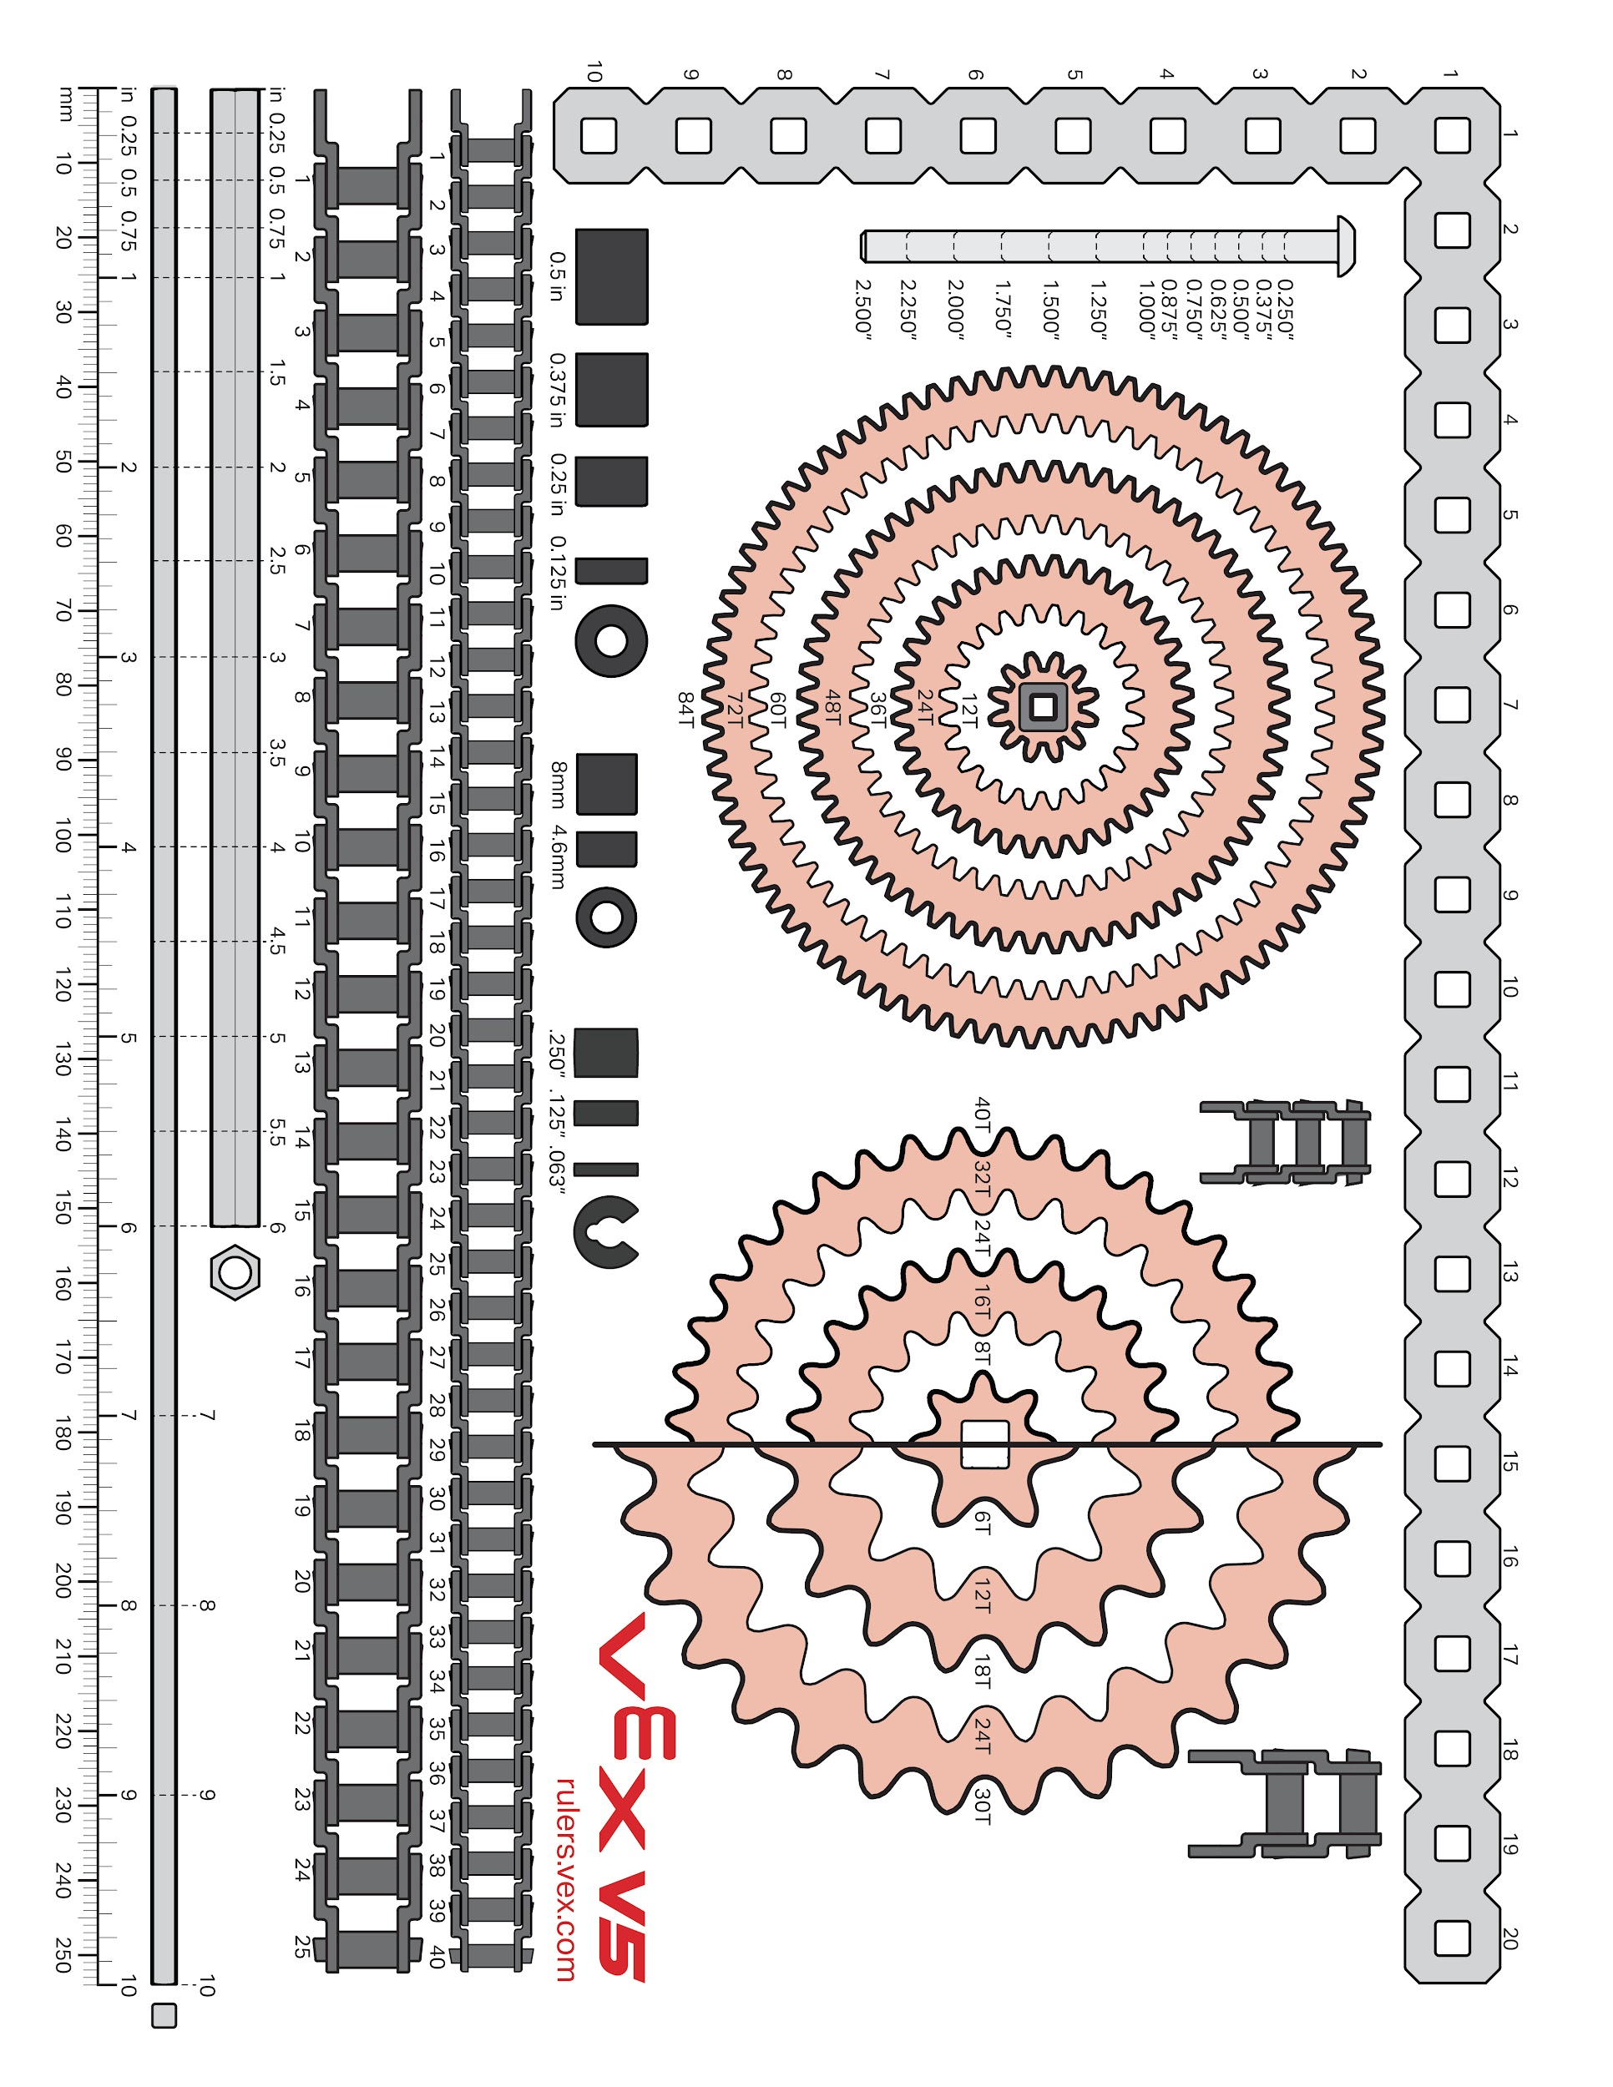

Slide 57
Section E Scrum Notes/ Calendars

Slide 58
Product Backlog
Product Backlog for Competition Bot:
Review and Understand the Rules
Identify any limiting rules
Make sure design within the size limit.
2. Design the robot
a. Generate ideas
b. Draw out ideas
c. Test ideas
2. Build the Robot
a. Build Conveyer Belt
b. Build Base
3. Code the Robot
a. Code for the main bot
b. Code for attachment
c. Code for controller
i. Code for secondary controller
d. Code for sensors
4. Test the Robot
5. Practice the Challenge
6. Evaluate our challenge results
Abigail Way
8/28/2024
34

Slide 59
Sprint Backlog
Sprint Backlog For Sprint #1
Building:
Build Base
Coding
Get familiar with the coding
Abigail Way
8/28/2024
35

Slide 60
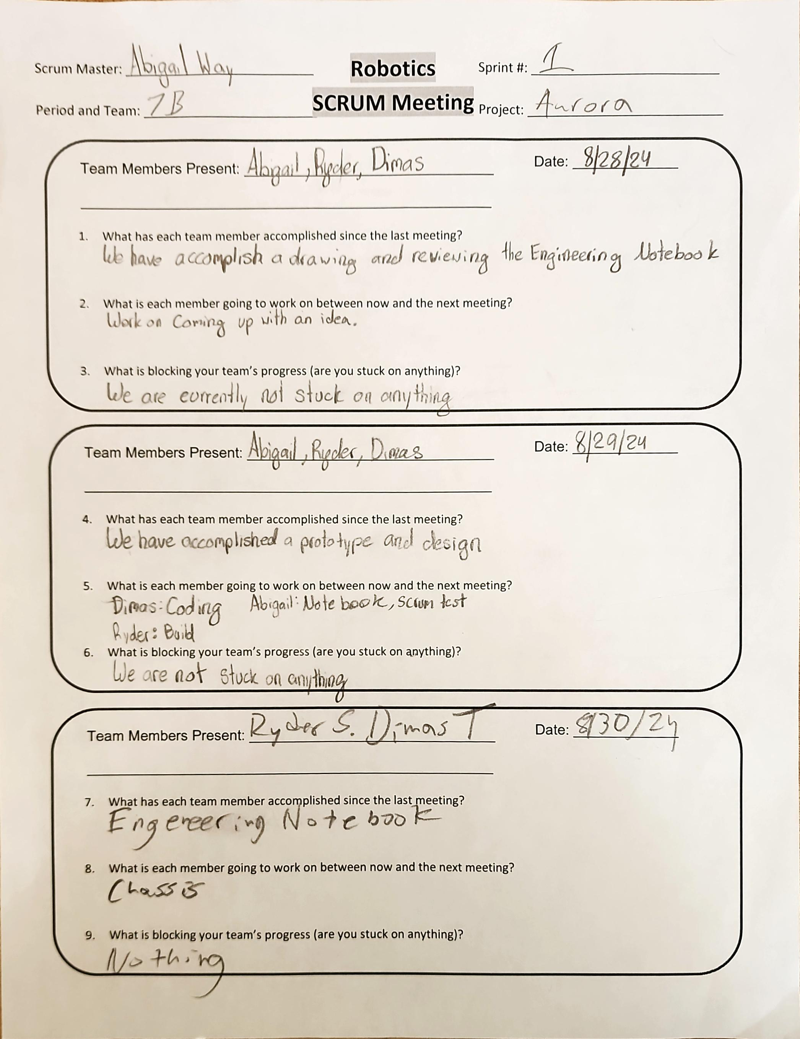
Project: Scrum Meeting
Name: Abigail Way Date:9/11/24 Page:36

Slide 61
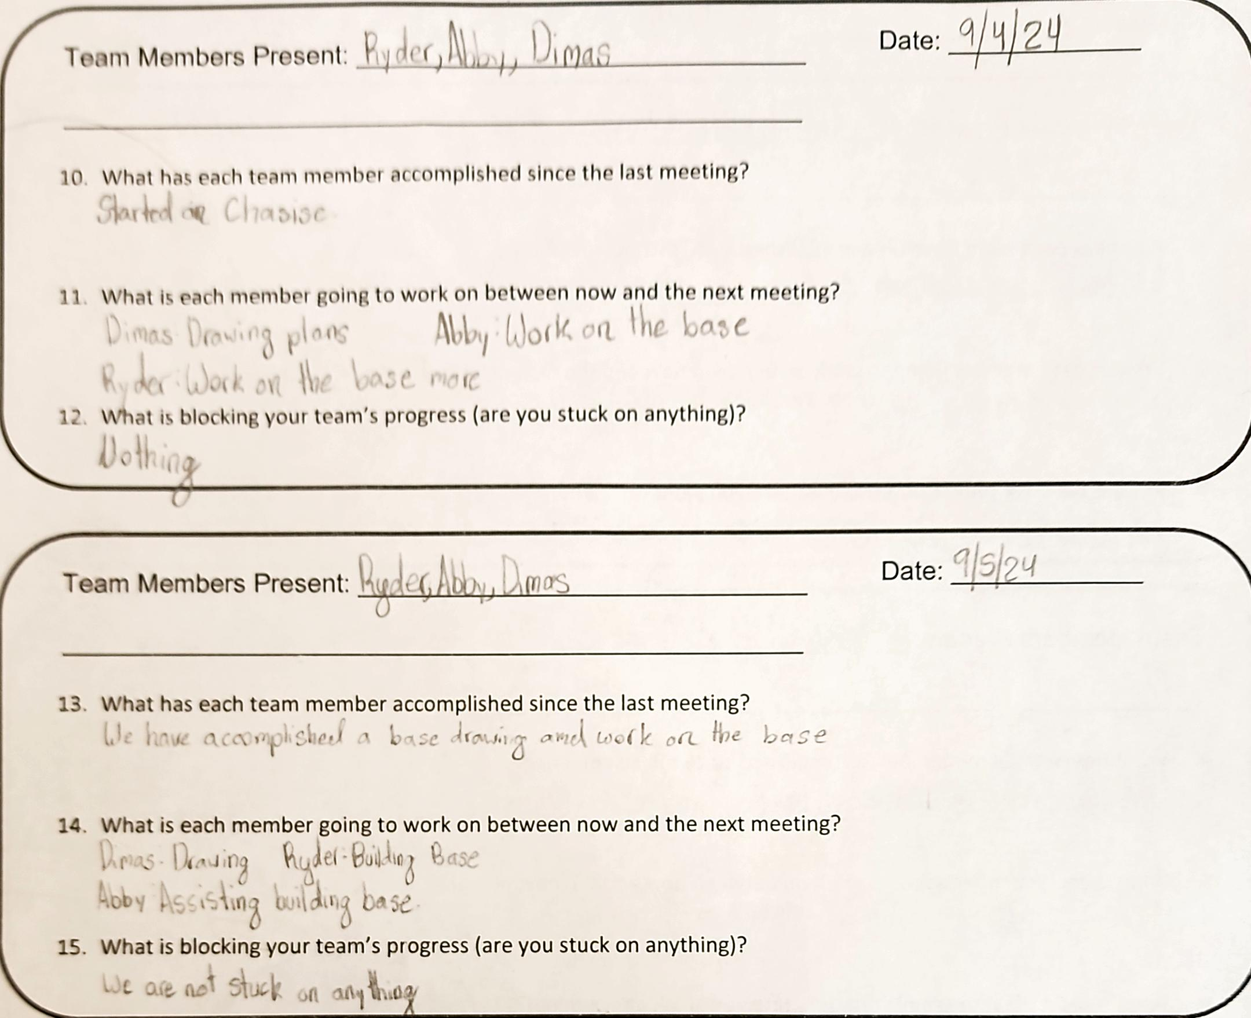
Project: Scrum Meeting
Name: Abigail Way Date:9/11/24 Page: 37

Slide 62
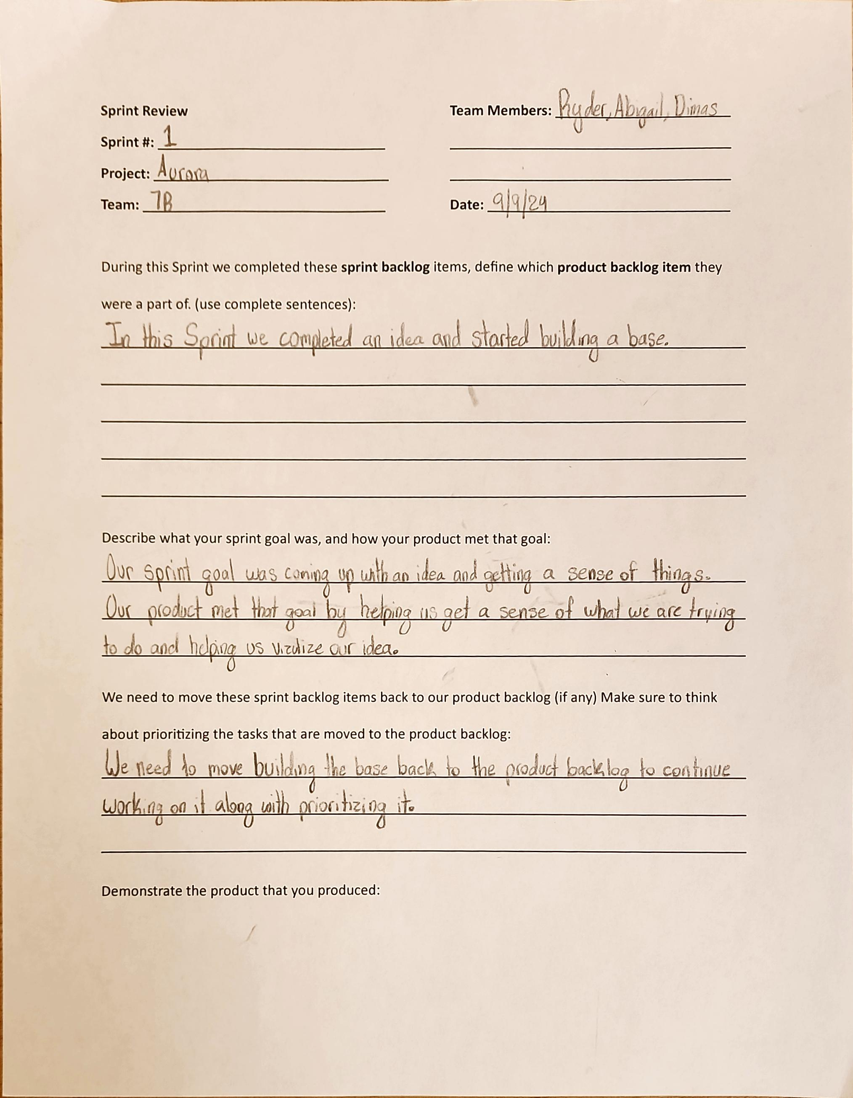
Project: Sprint Review
Name: Abigail Way Date:9/11/24 Page: 38

Slide 63
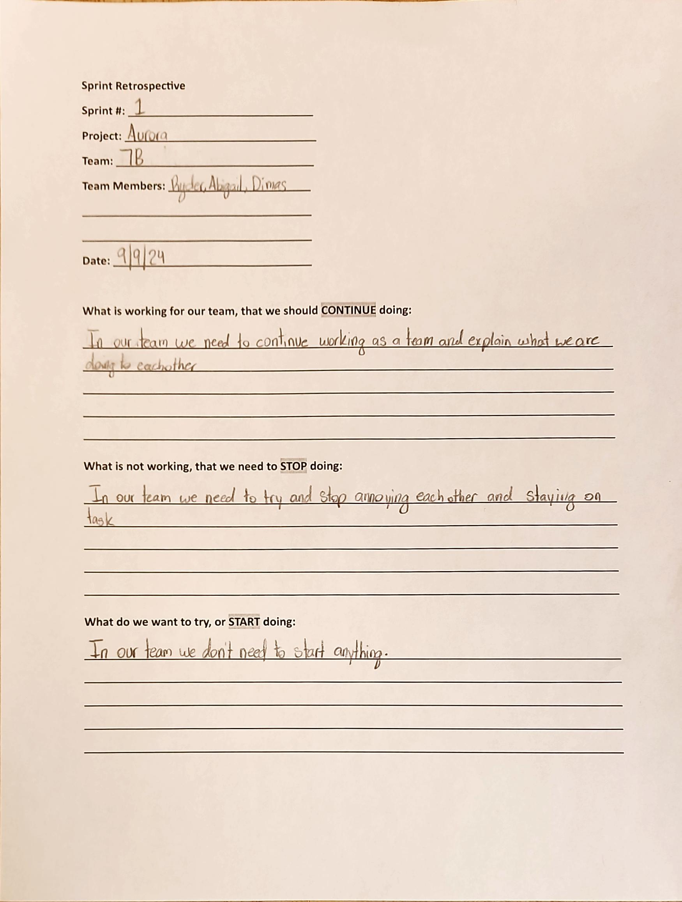
Project: Sprint Retrospective
Name: Abigail Way Date:9/11/24 Page: 39

Slide 64
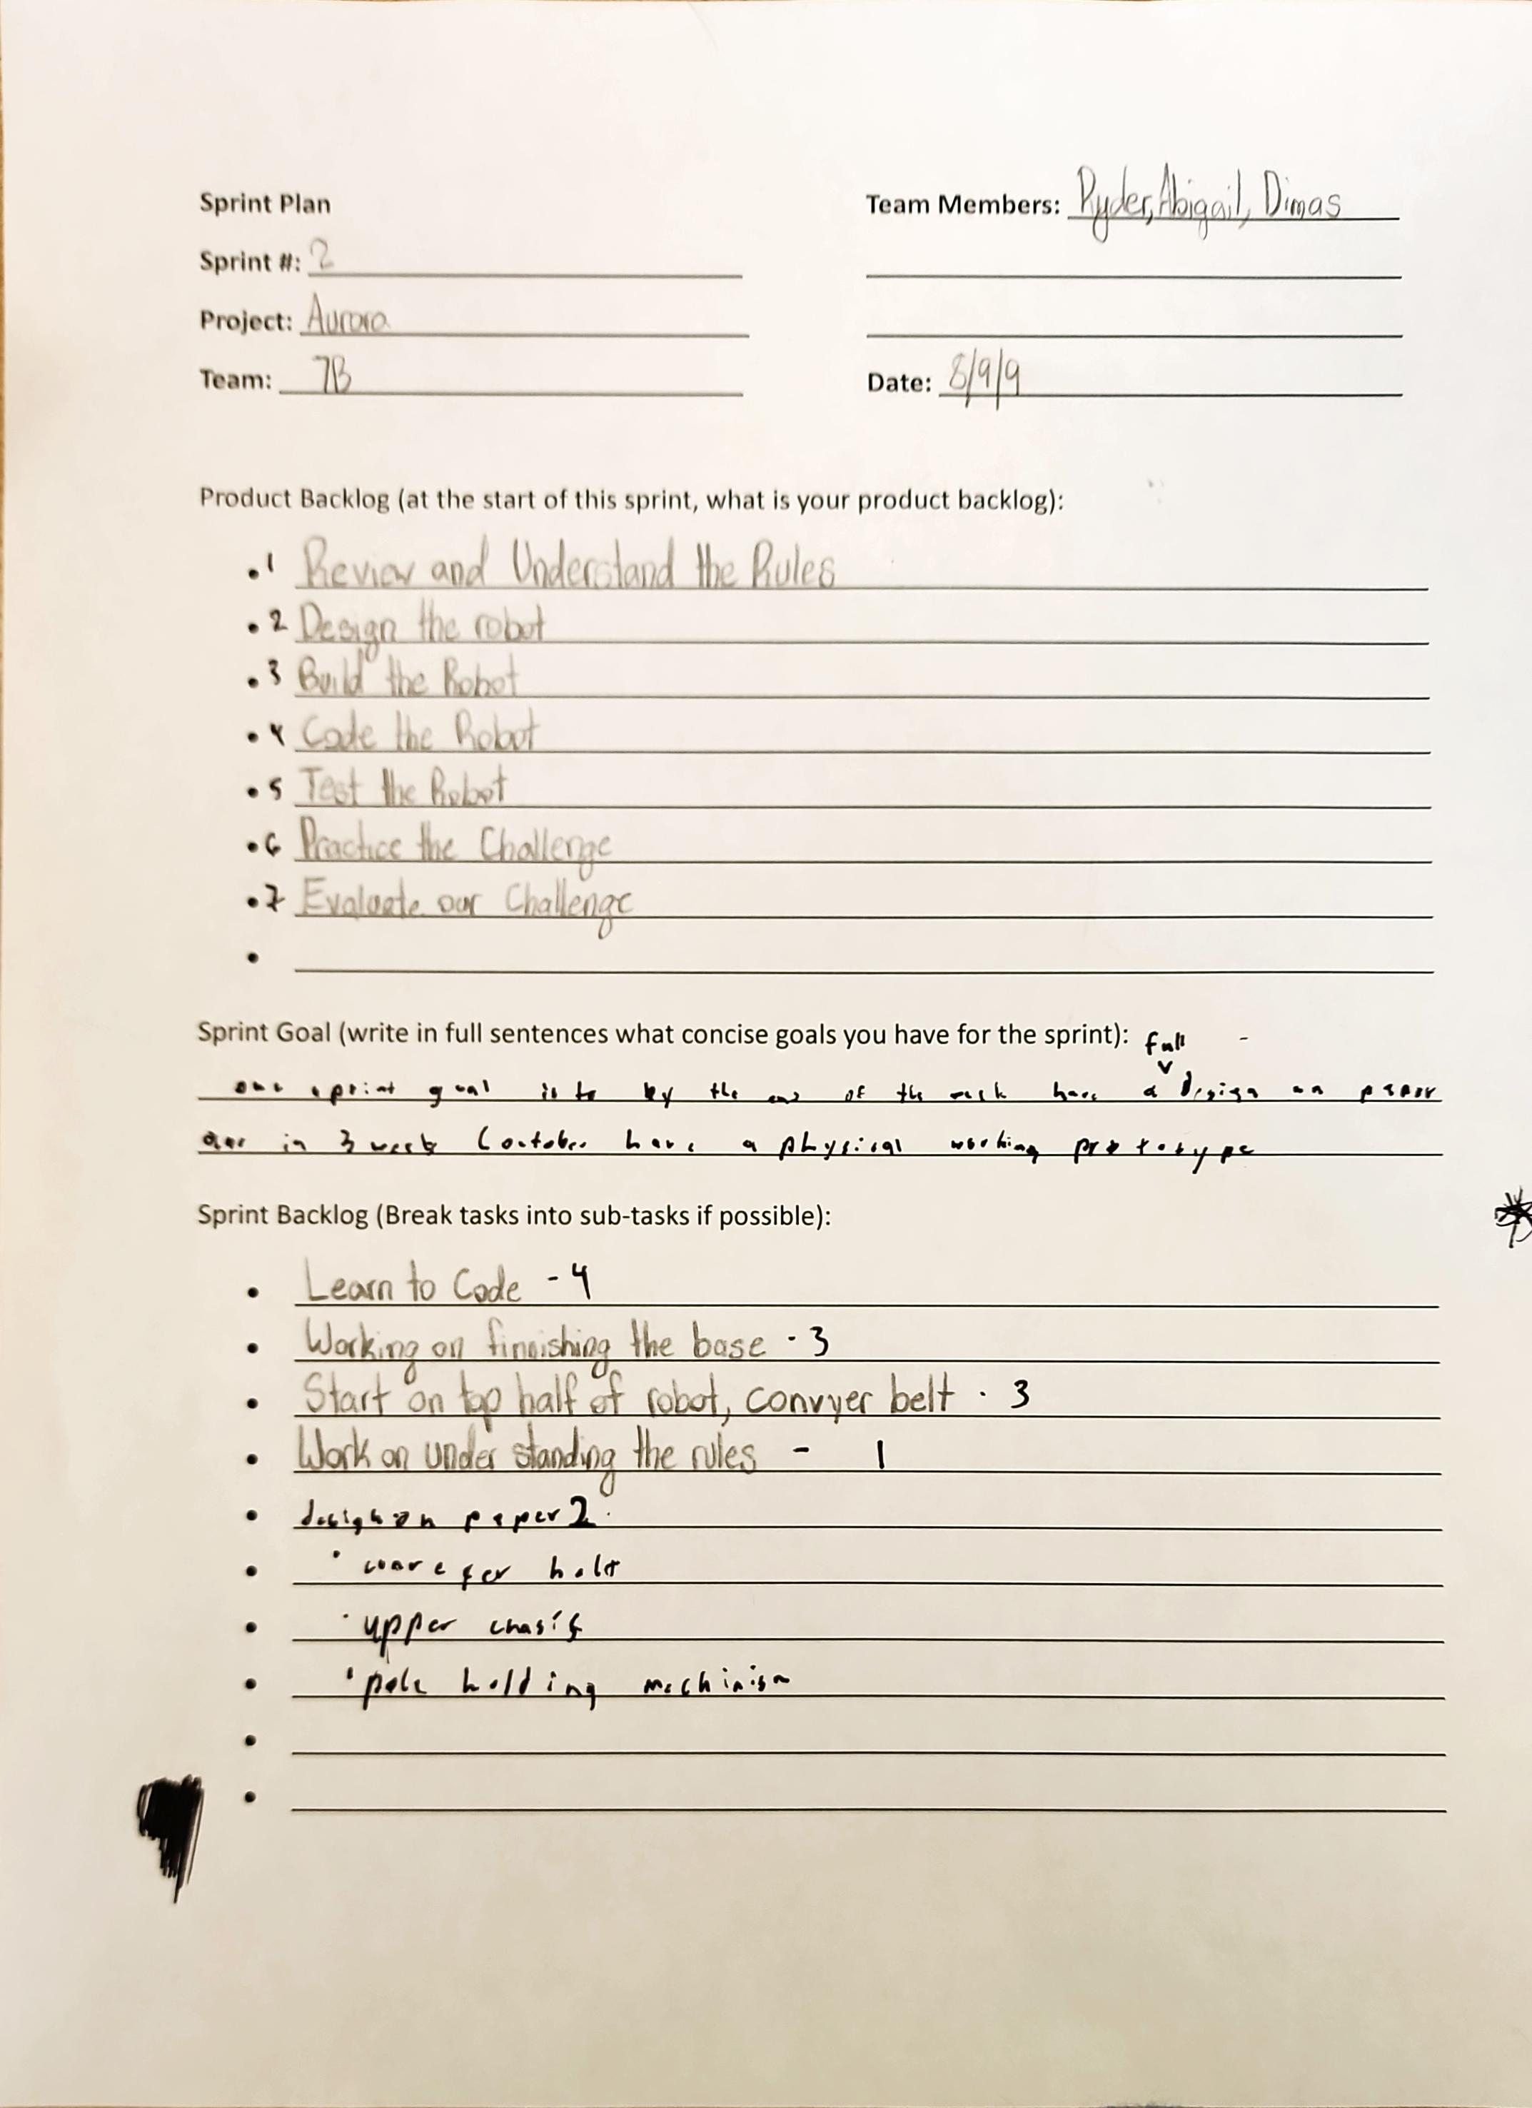
Project: Sprint Plan
Name: Abigail Way Date:9/11/24 Page: 40

Slide 65
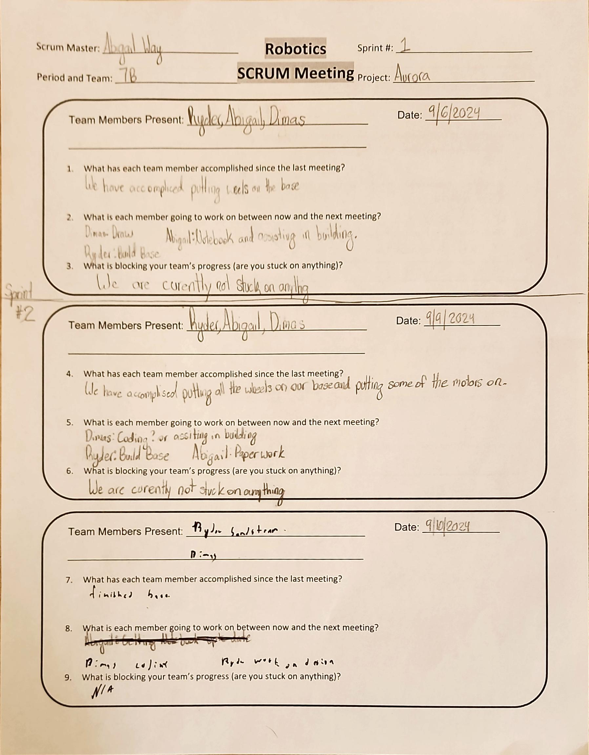
Project: Scrum Meeting
Name: Abigail Way Date:9/11/24 Page: 41

Slide 66
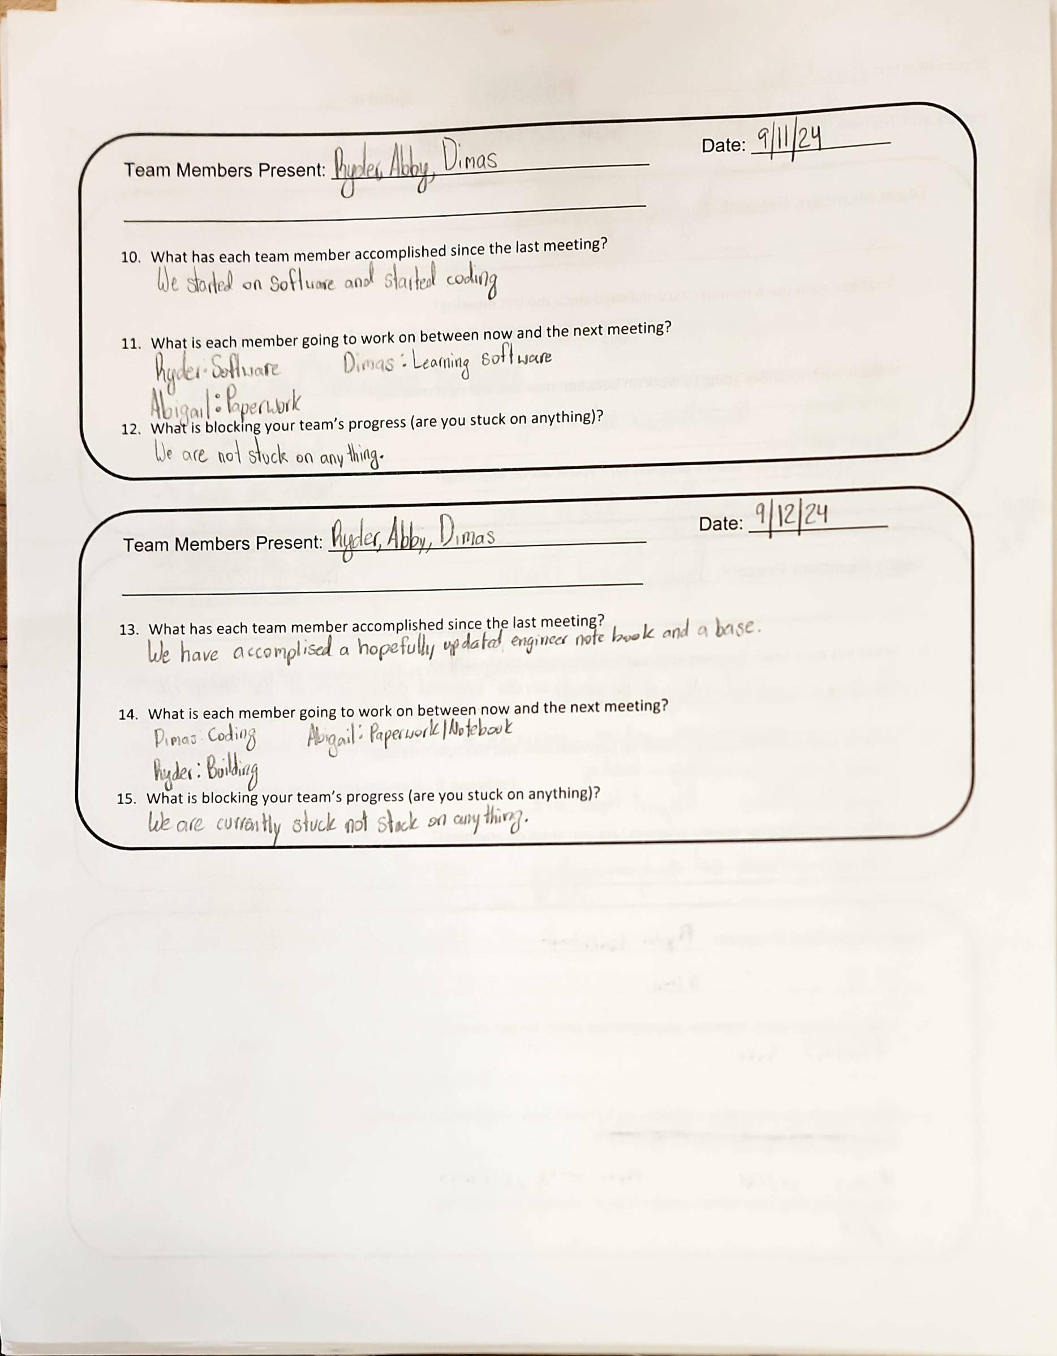
Project: Scrum Meeting
Name: Abigail Way Date:9/11/24 Page: 42

Slide 67
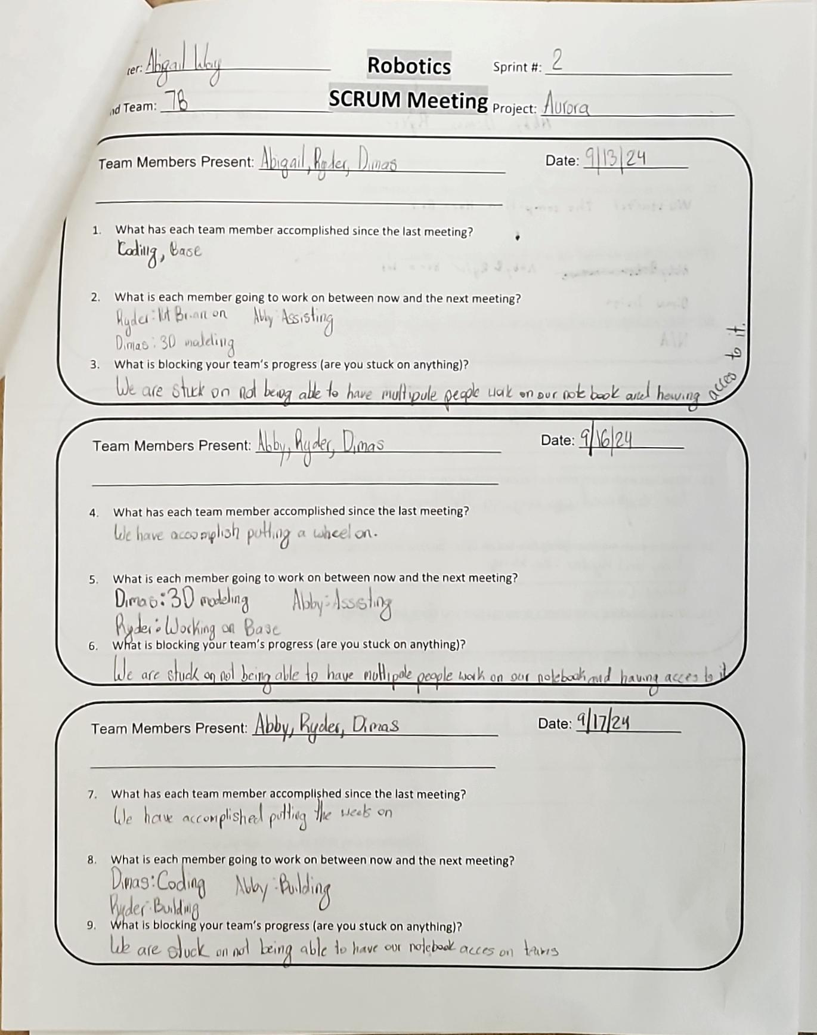
Project: Scrum Meeting
Name: Abigail Way Date:10/21/24 Page: 43

Slide 68
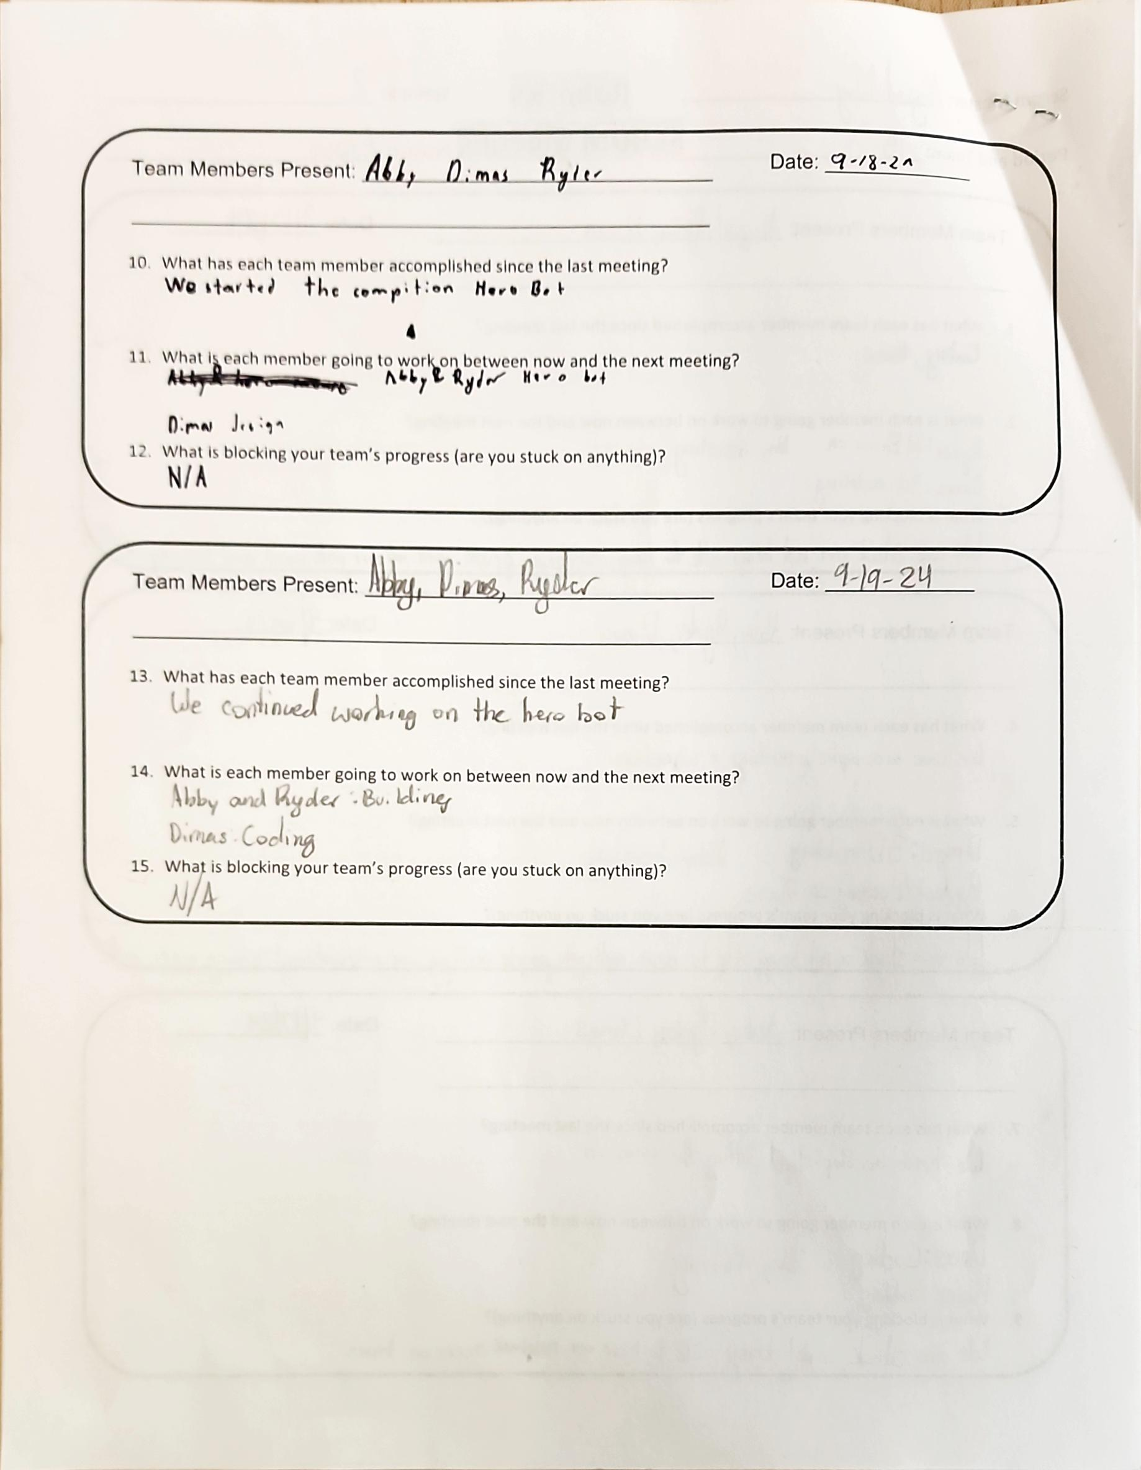
Project: Scrum Meeting
Name: Abigail Way Date:10/21/24 Page: 44

Slide 69
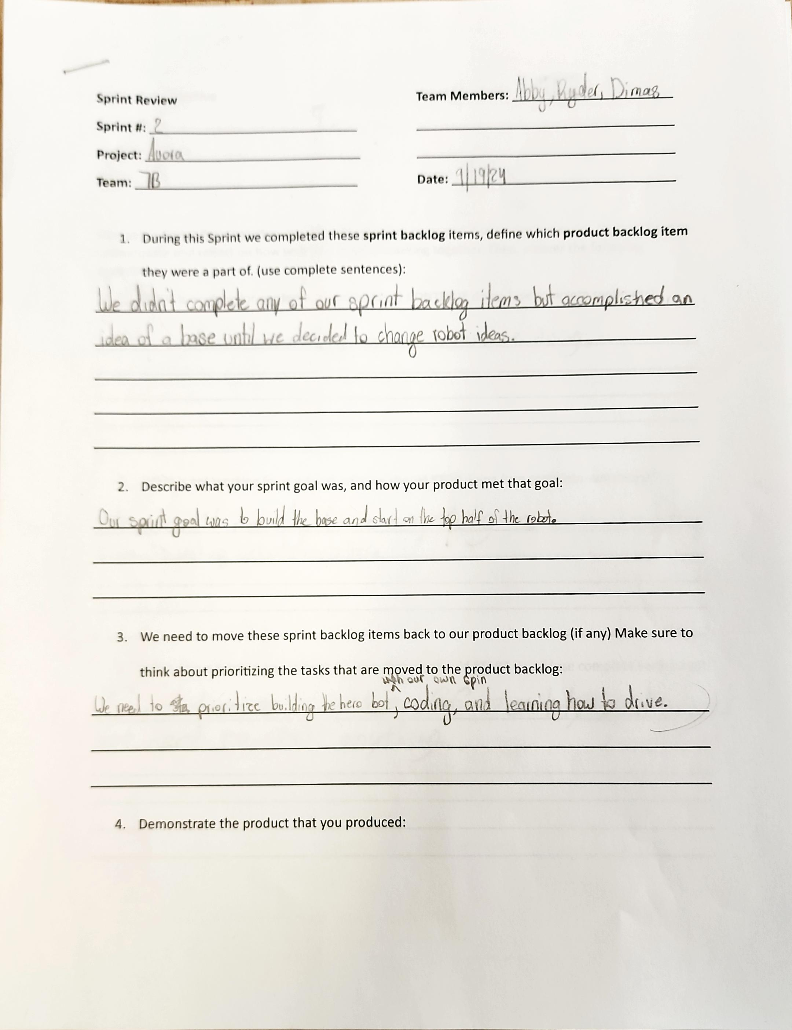
Project: Sprint Review
Name: Abigail Way Date:10/21/24 Page: 45

Slide 70
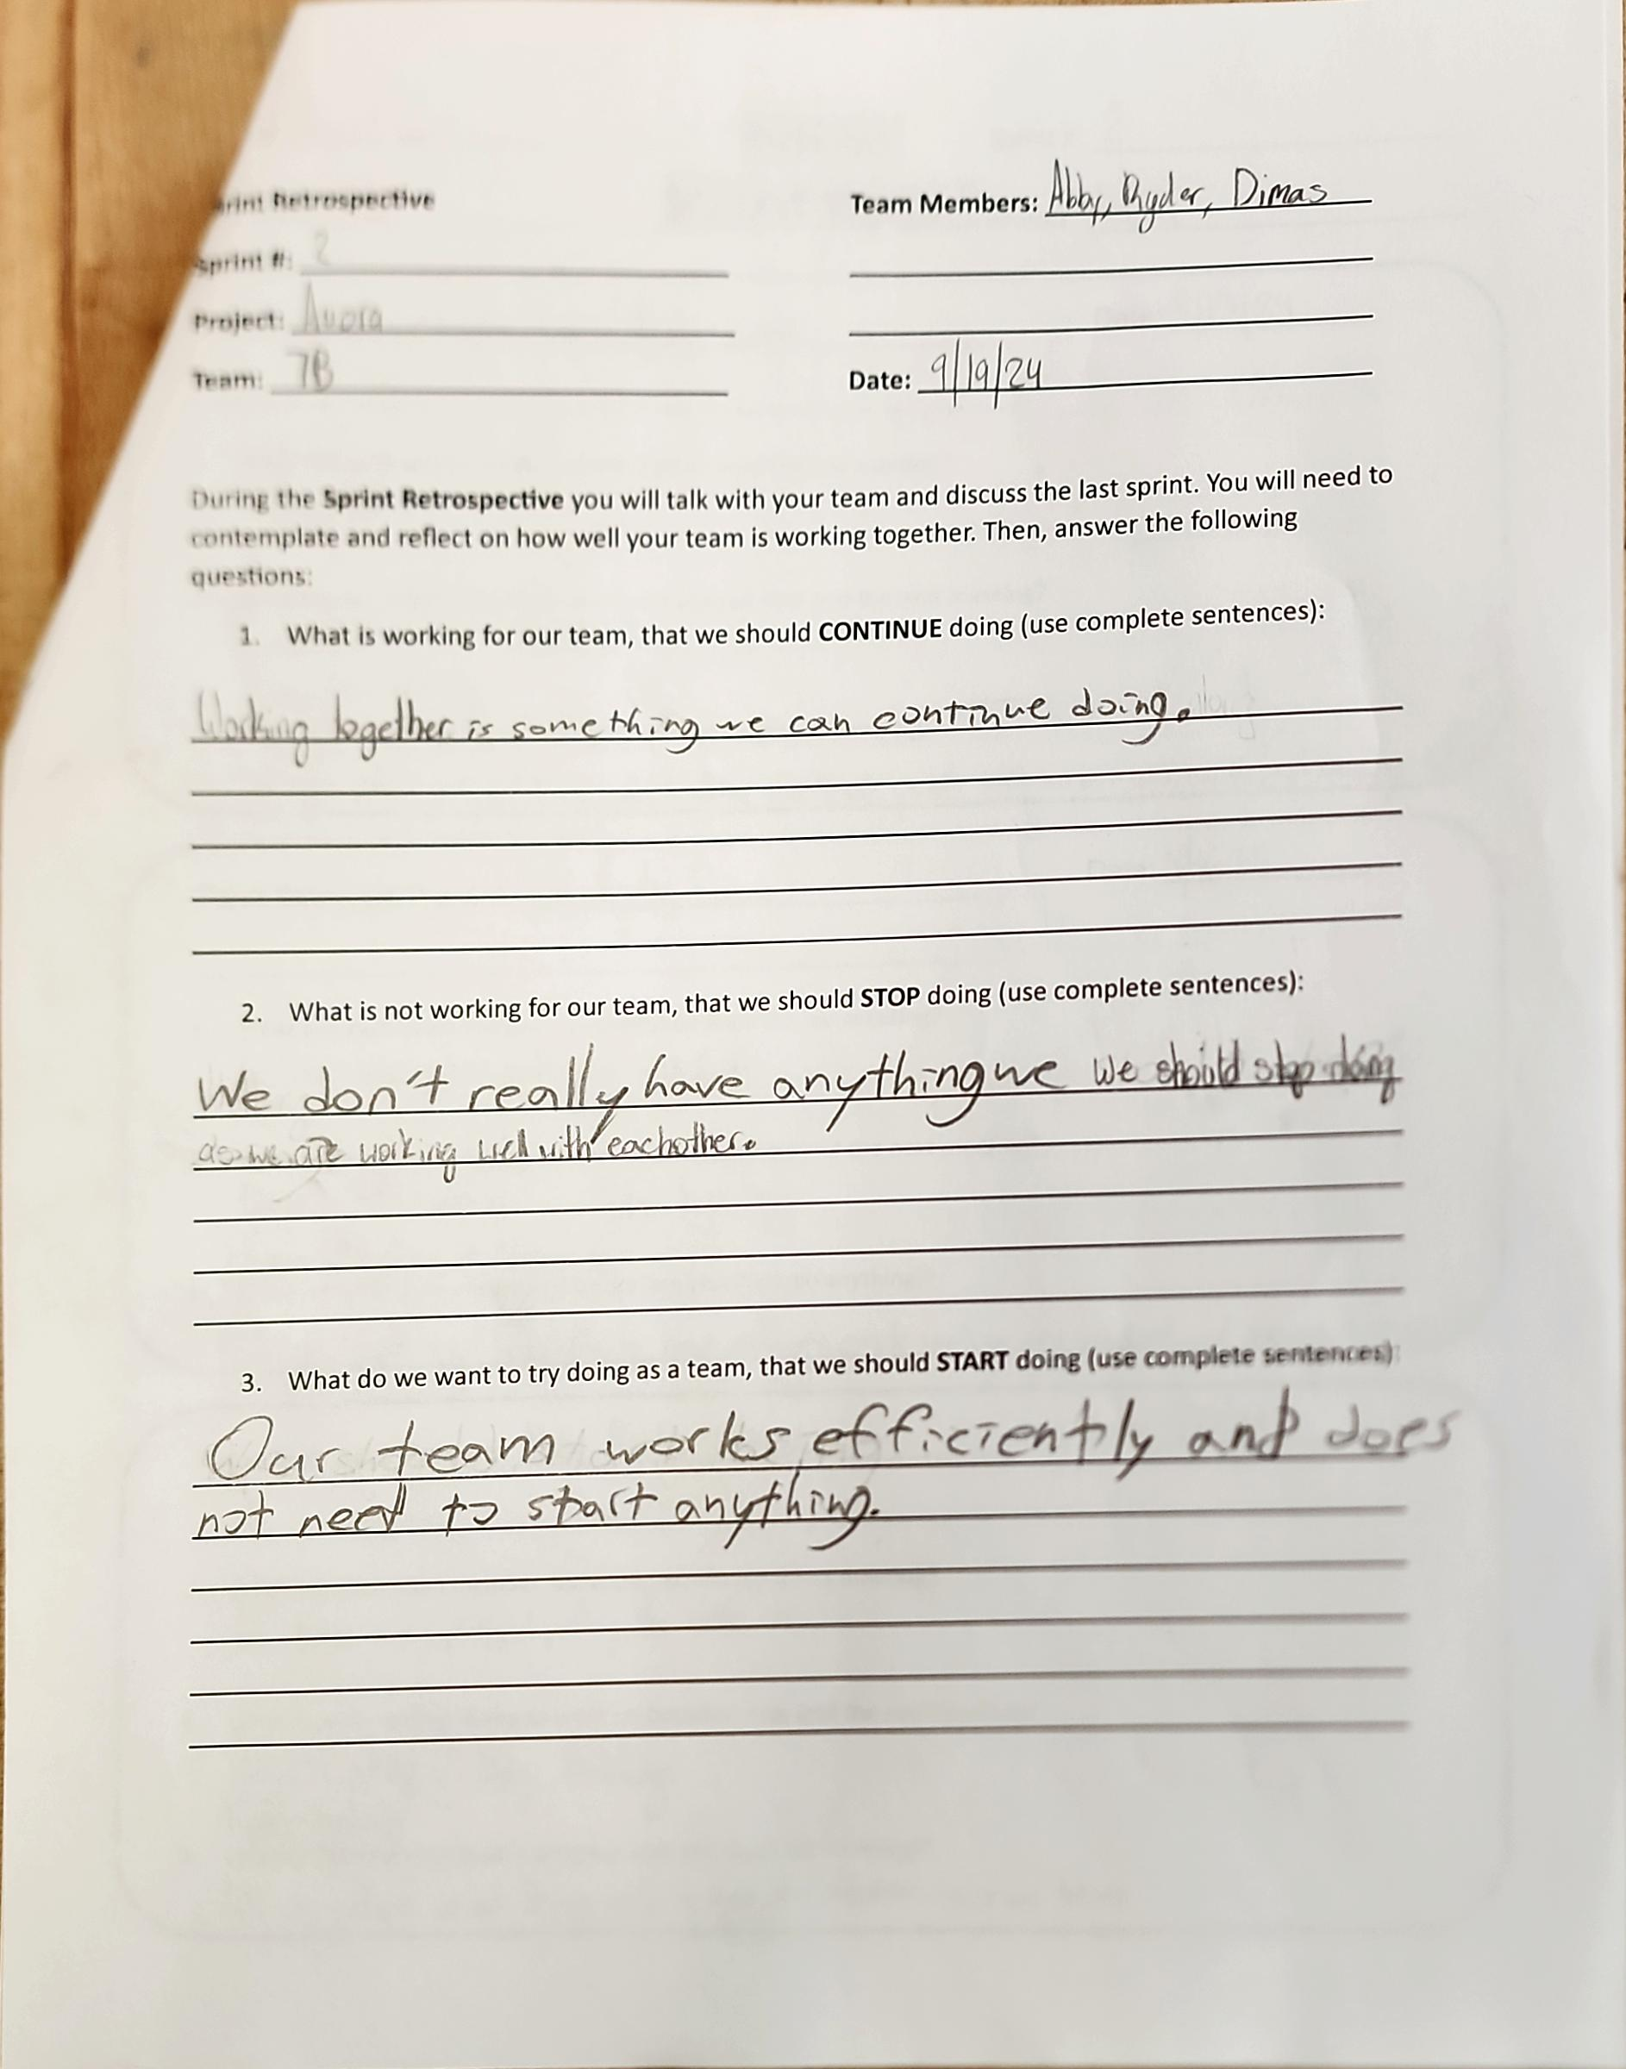
Project: Sprint Retrospective
Name: Abigail Way Date:10/21/24 Page:46

Slide 71
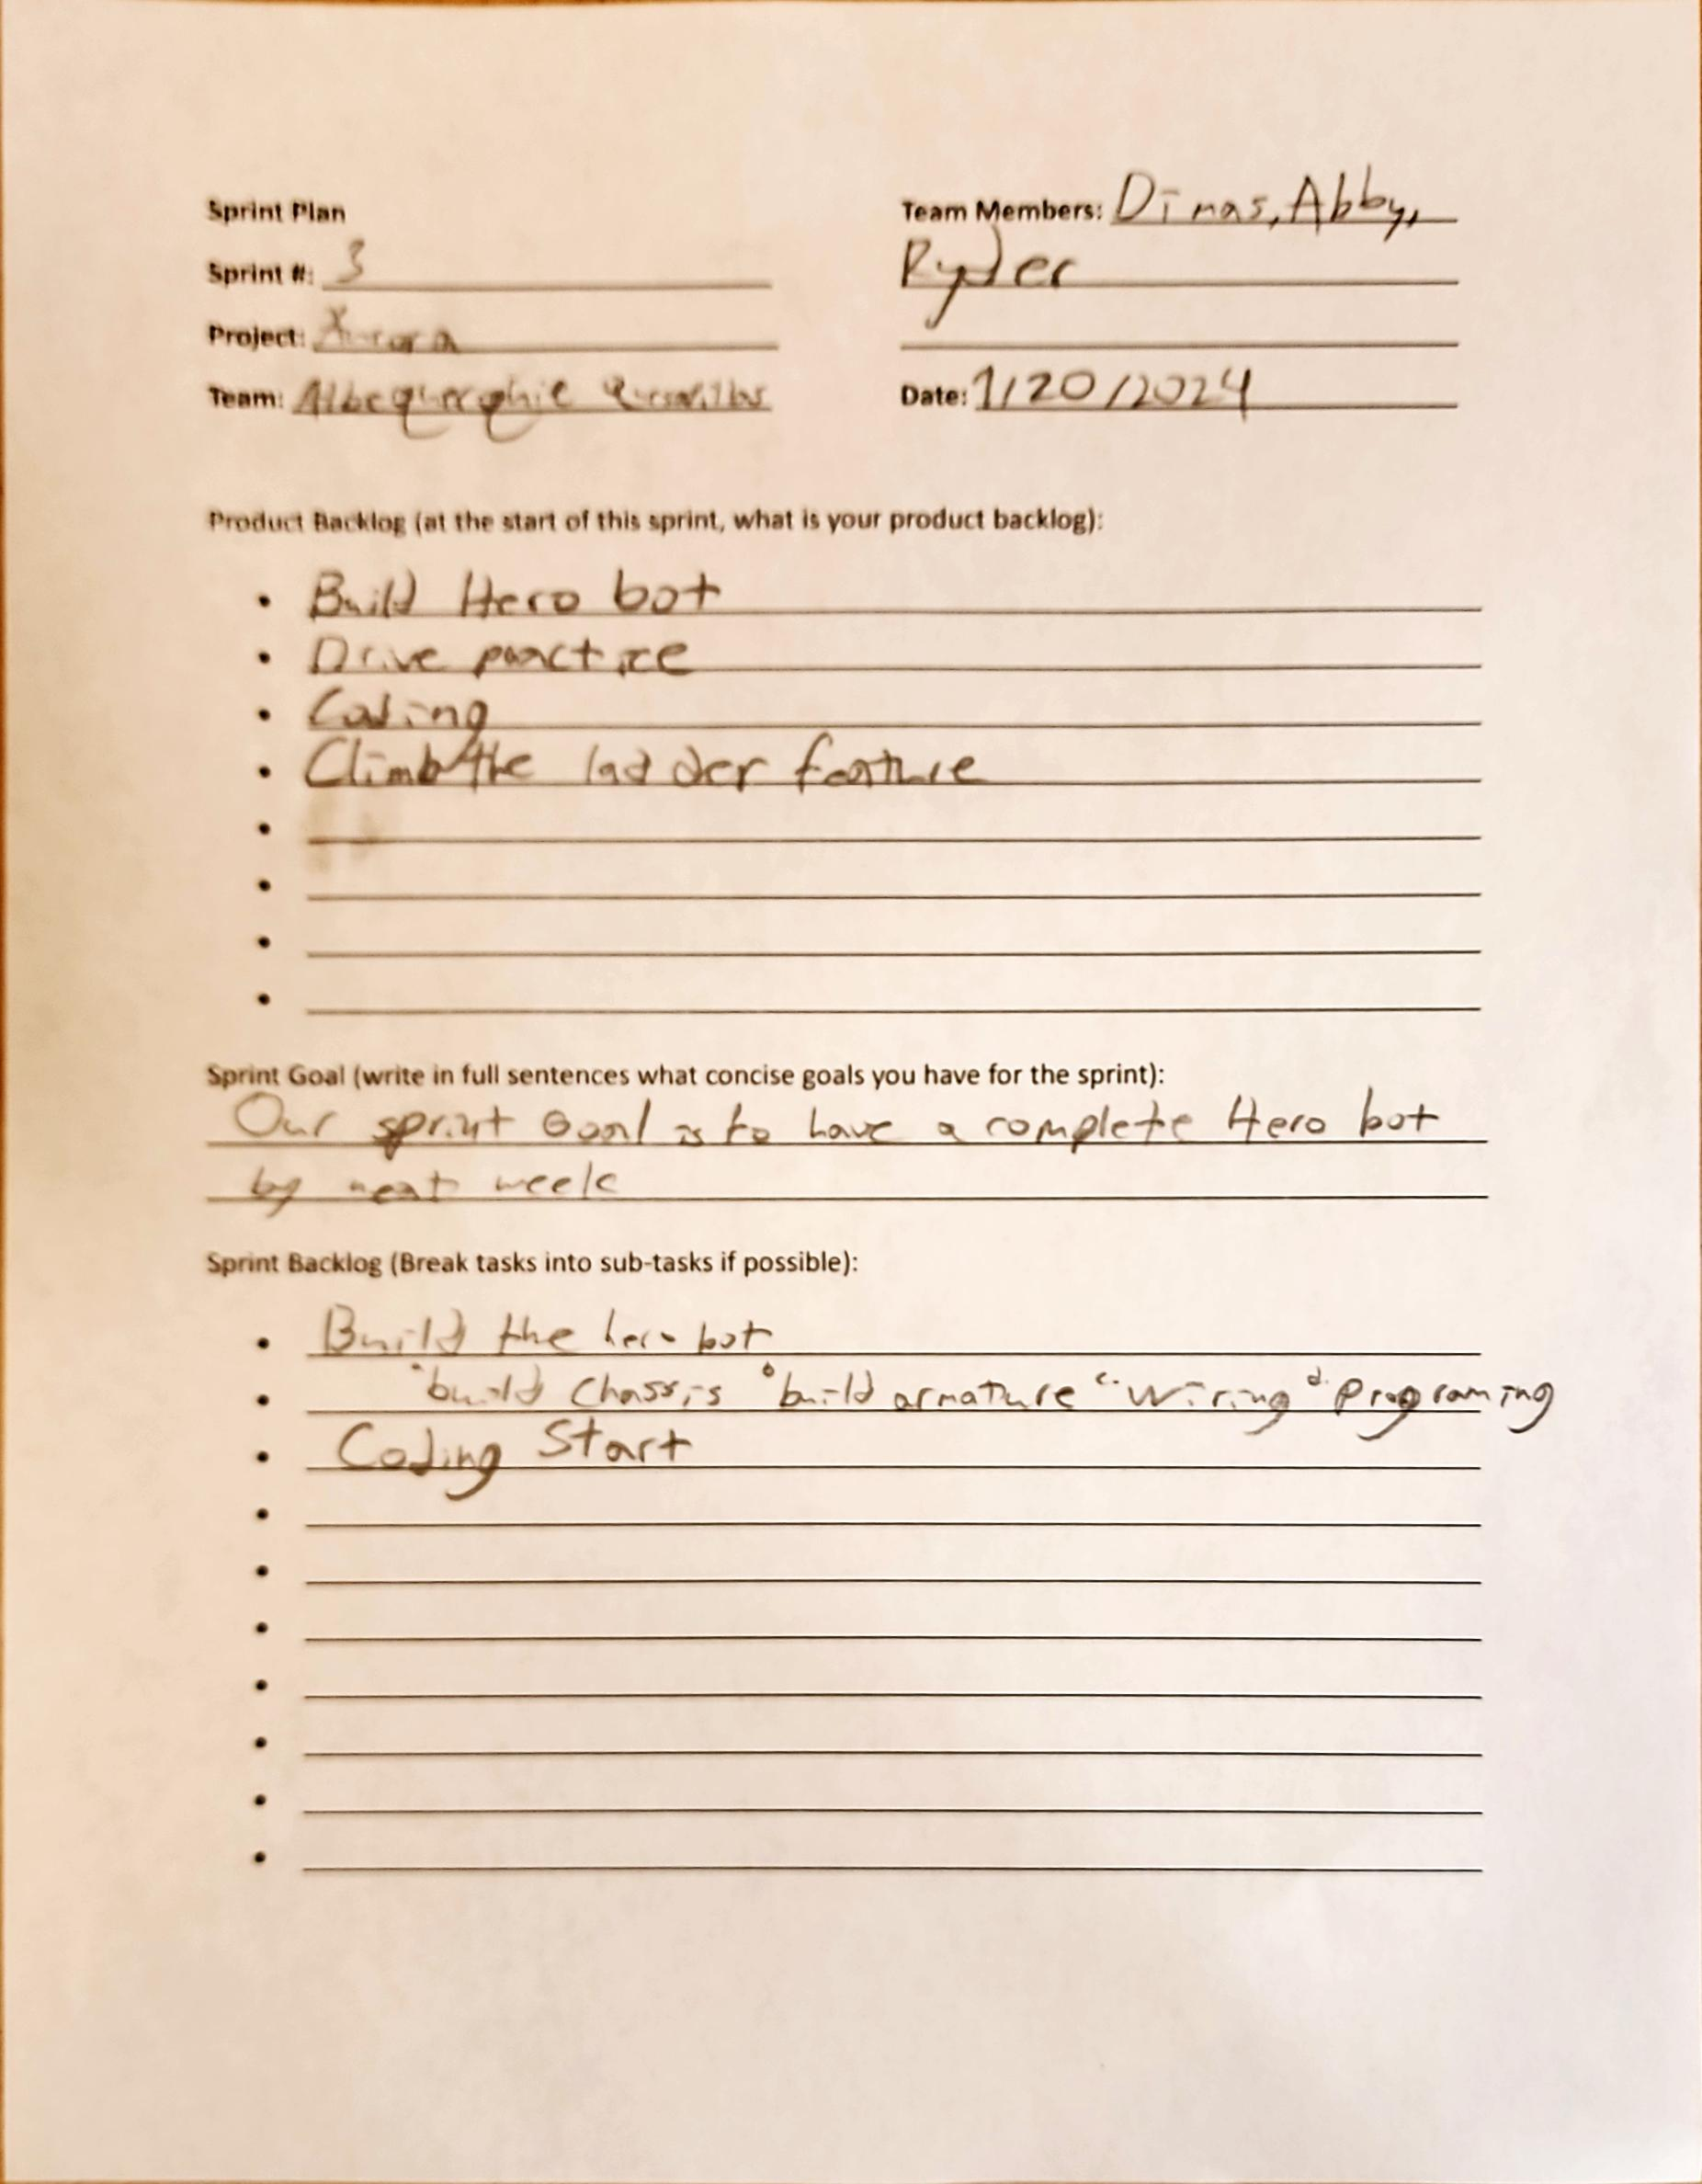
Project: Sprint Plan
Name: Abigail Way Date:10/21/24 Page: 47

Slide 72
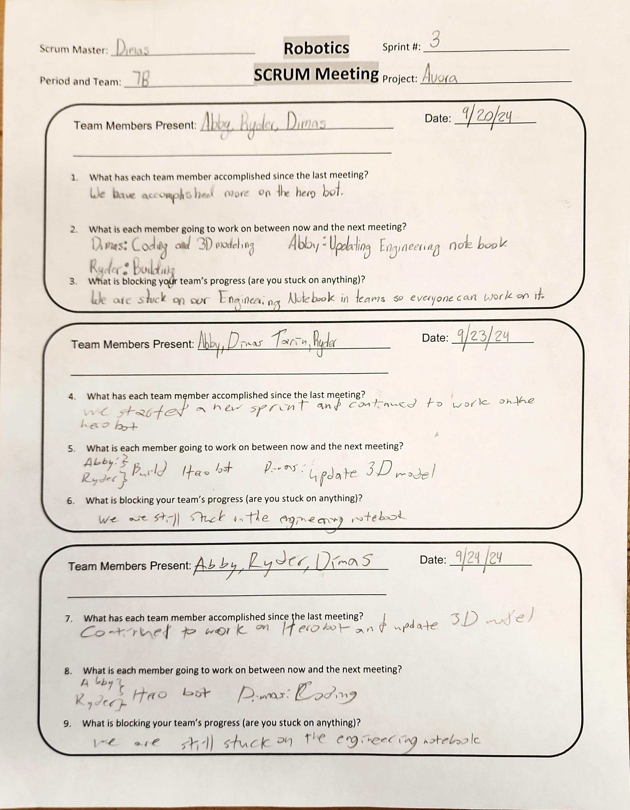
Project: Scrum Meeting
Name: Abigail Way Date:10/21/24 Page: 48

Slide 73
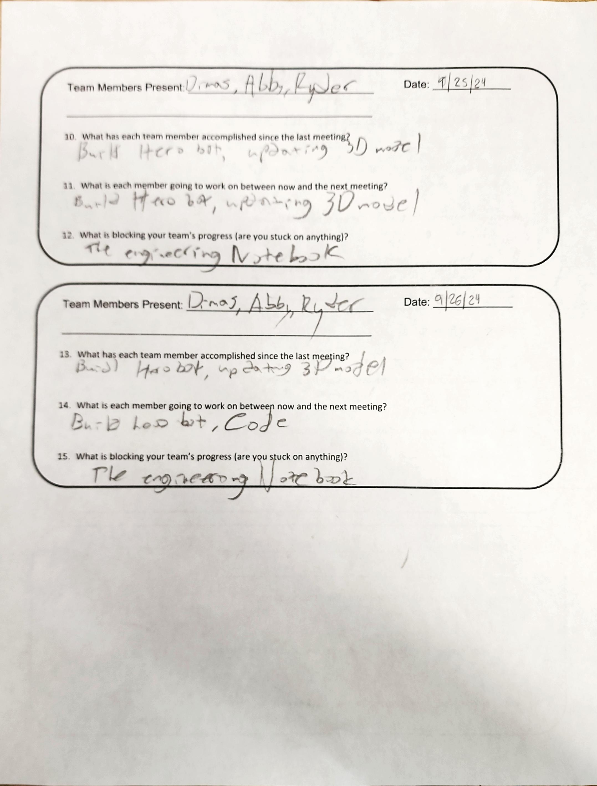
Project: Scrum Meeting
Name: Abigail Way Date:10/21/24 Page: 49

Slide 74
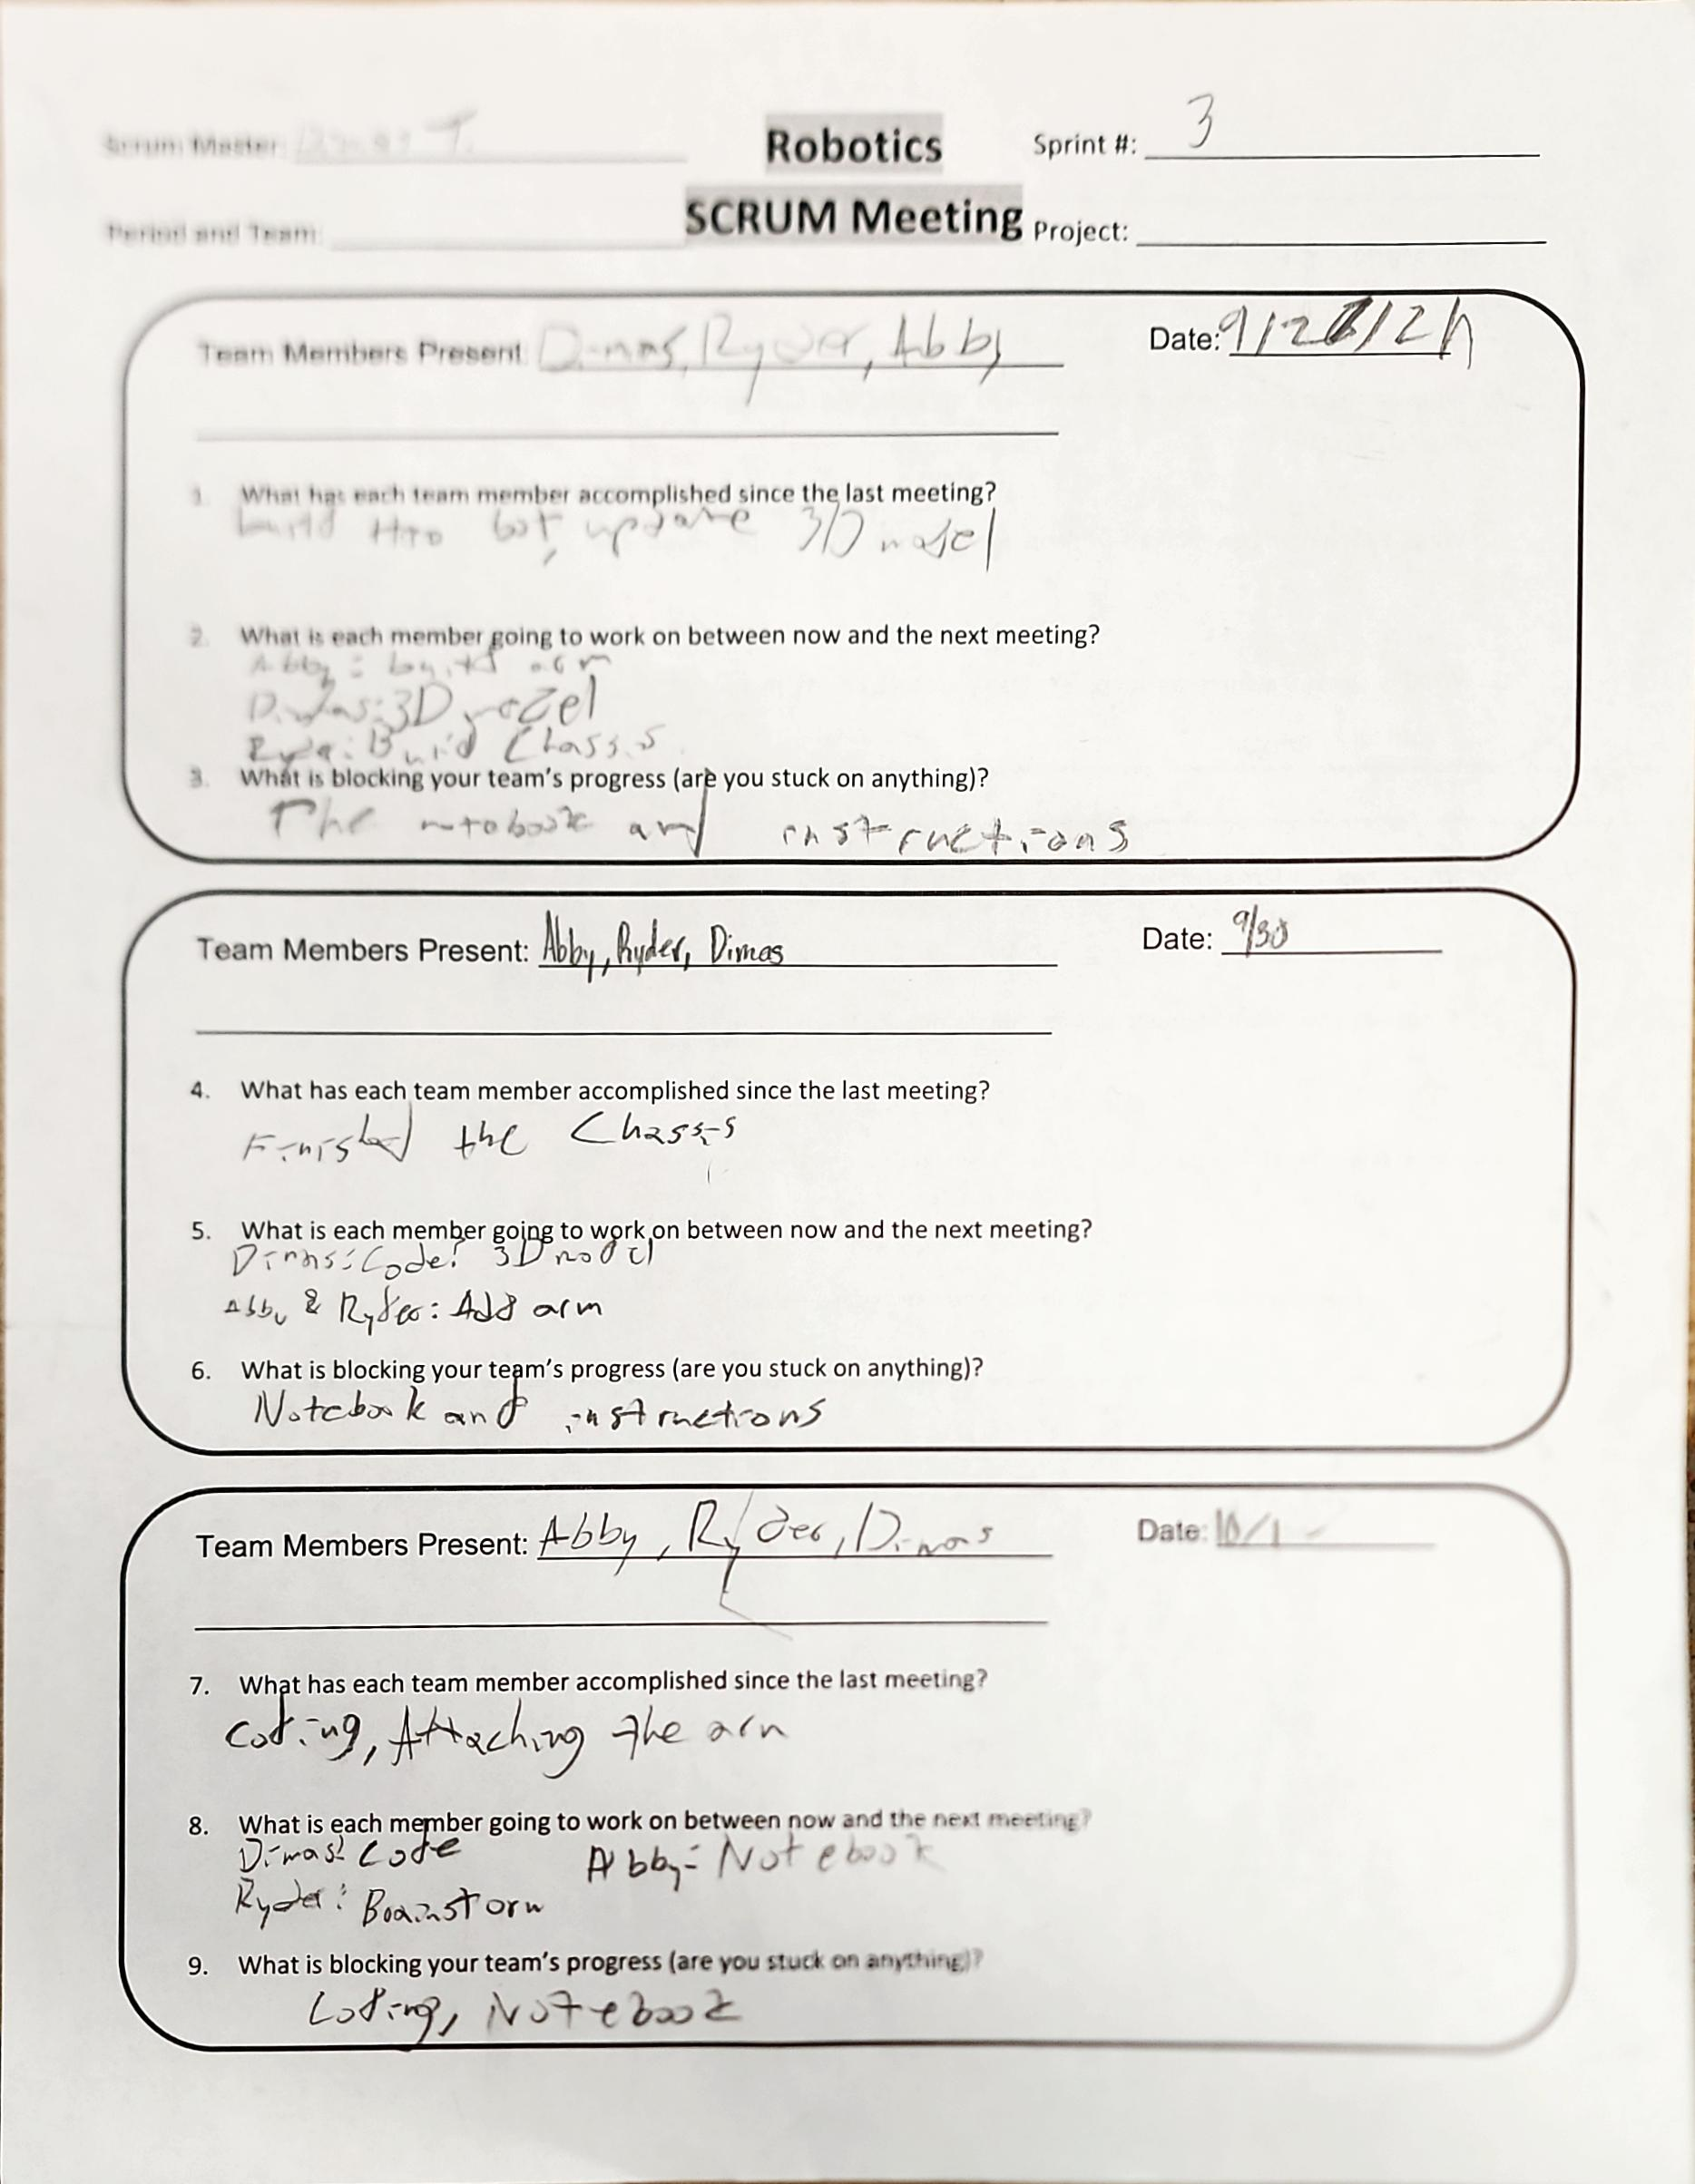
Project: Scrum Meeting
Name: Abigail Way Date:10/21/24 Page: 50

Slide 75
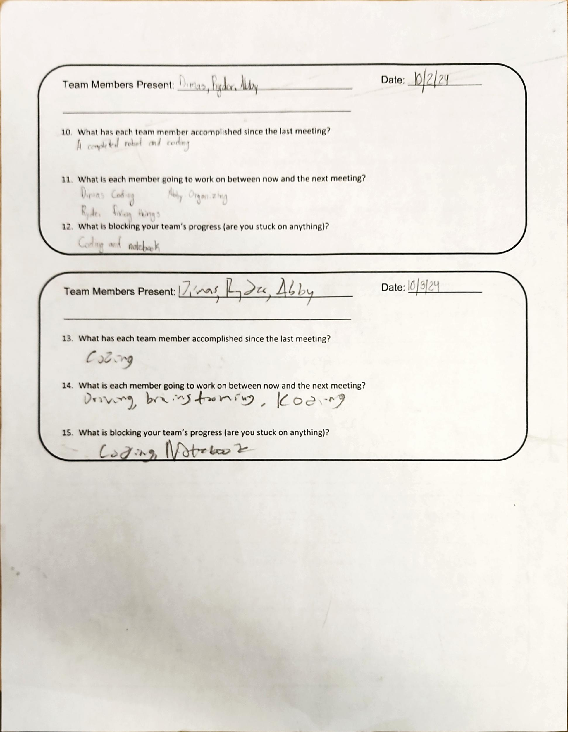
Project: Scrum Meeting
Name: Abigail Way Date:10/21/24 Page: 51

Slide 76
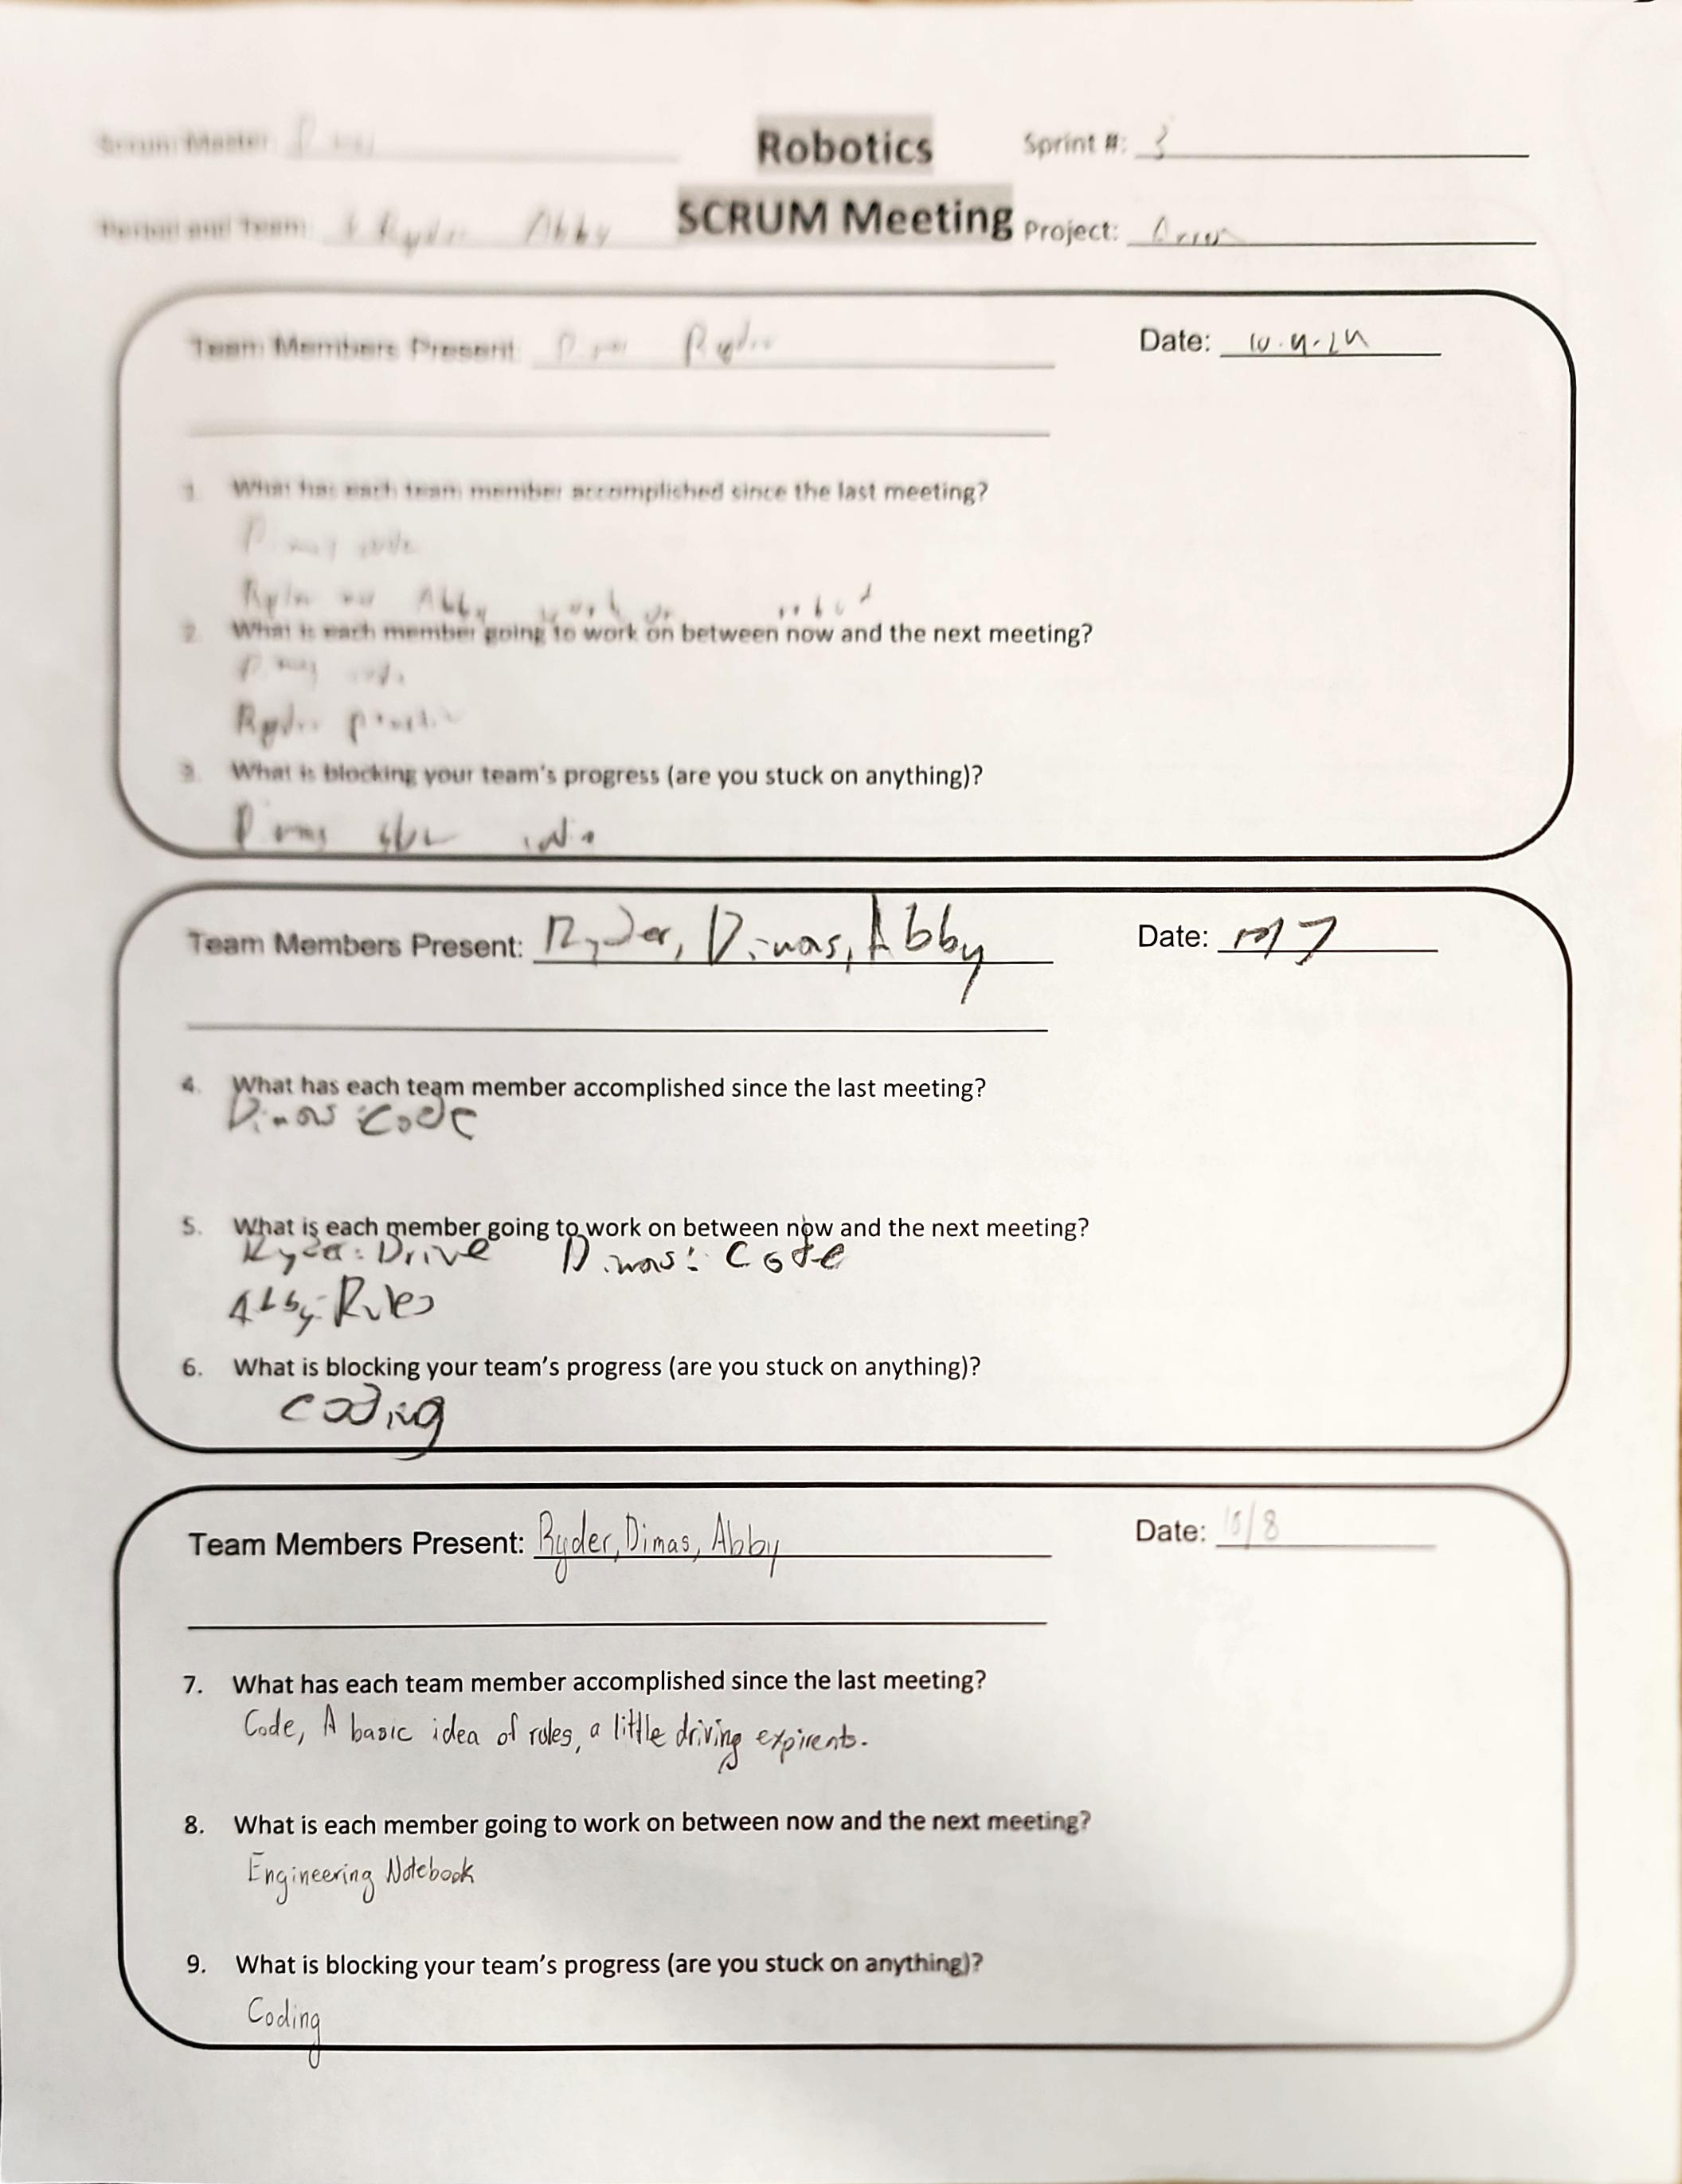
Project: Scrum Meeting
Name: Abigail Way Date:10/21/24 Page: 52

Slide 77
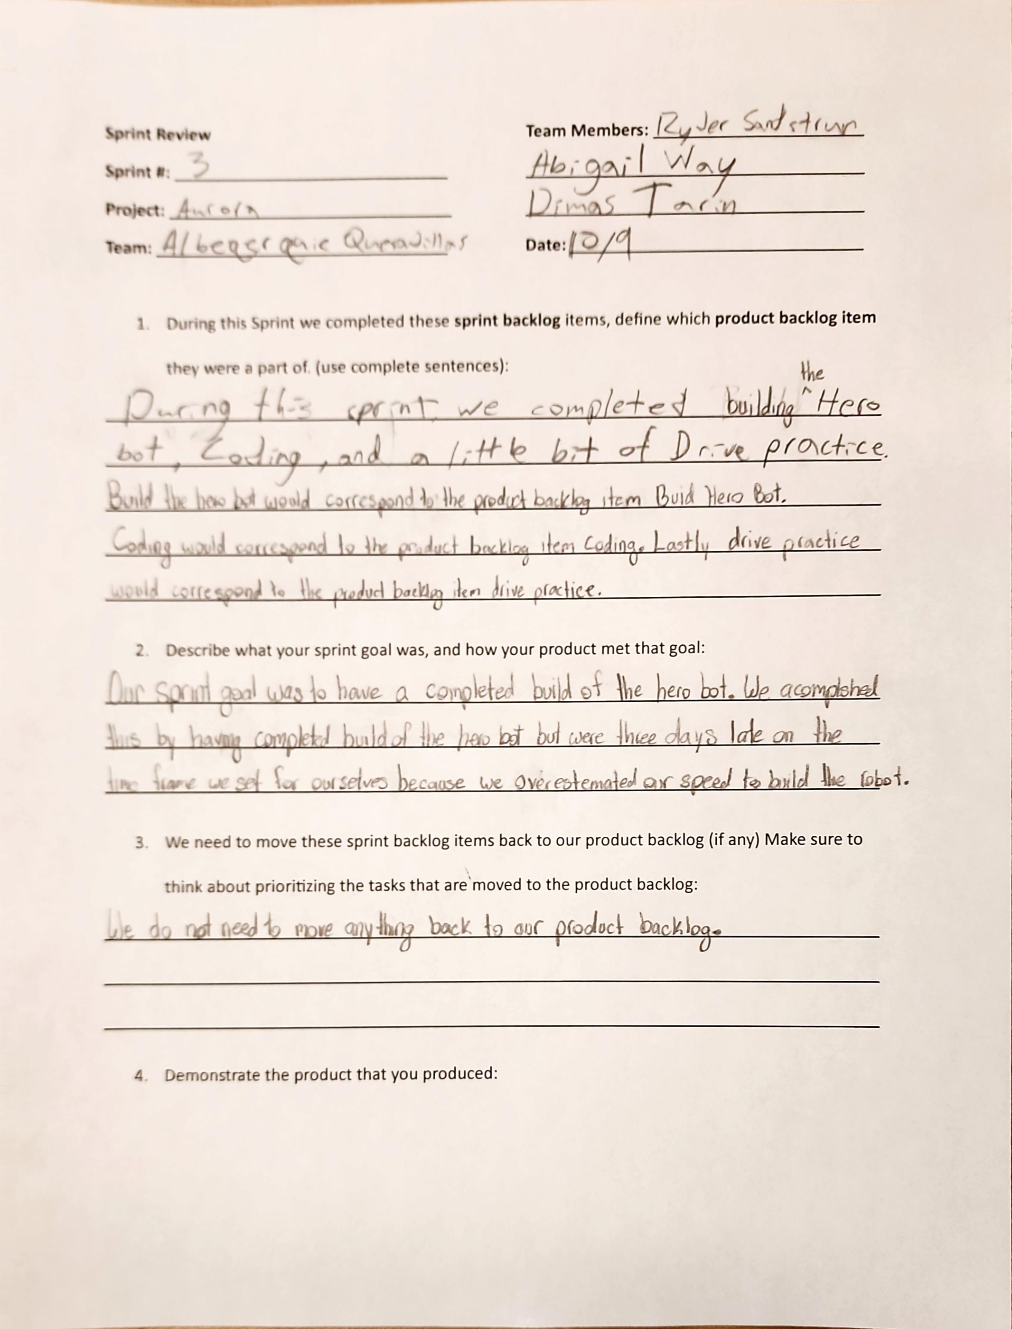
Project: Scrum Review
Name: Abigail Way Date:10/21/24 Page: 53

Slide 78
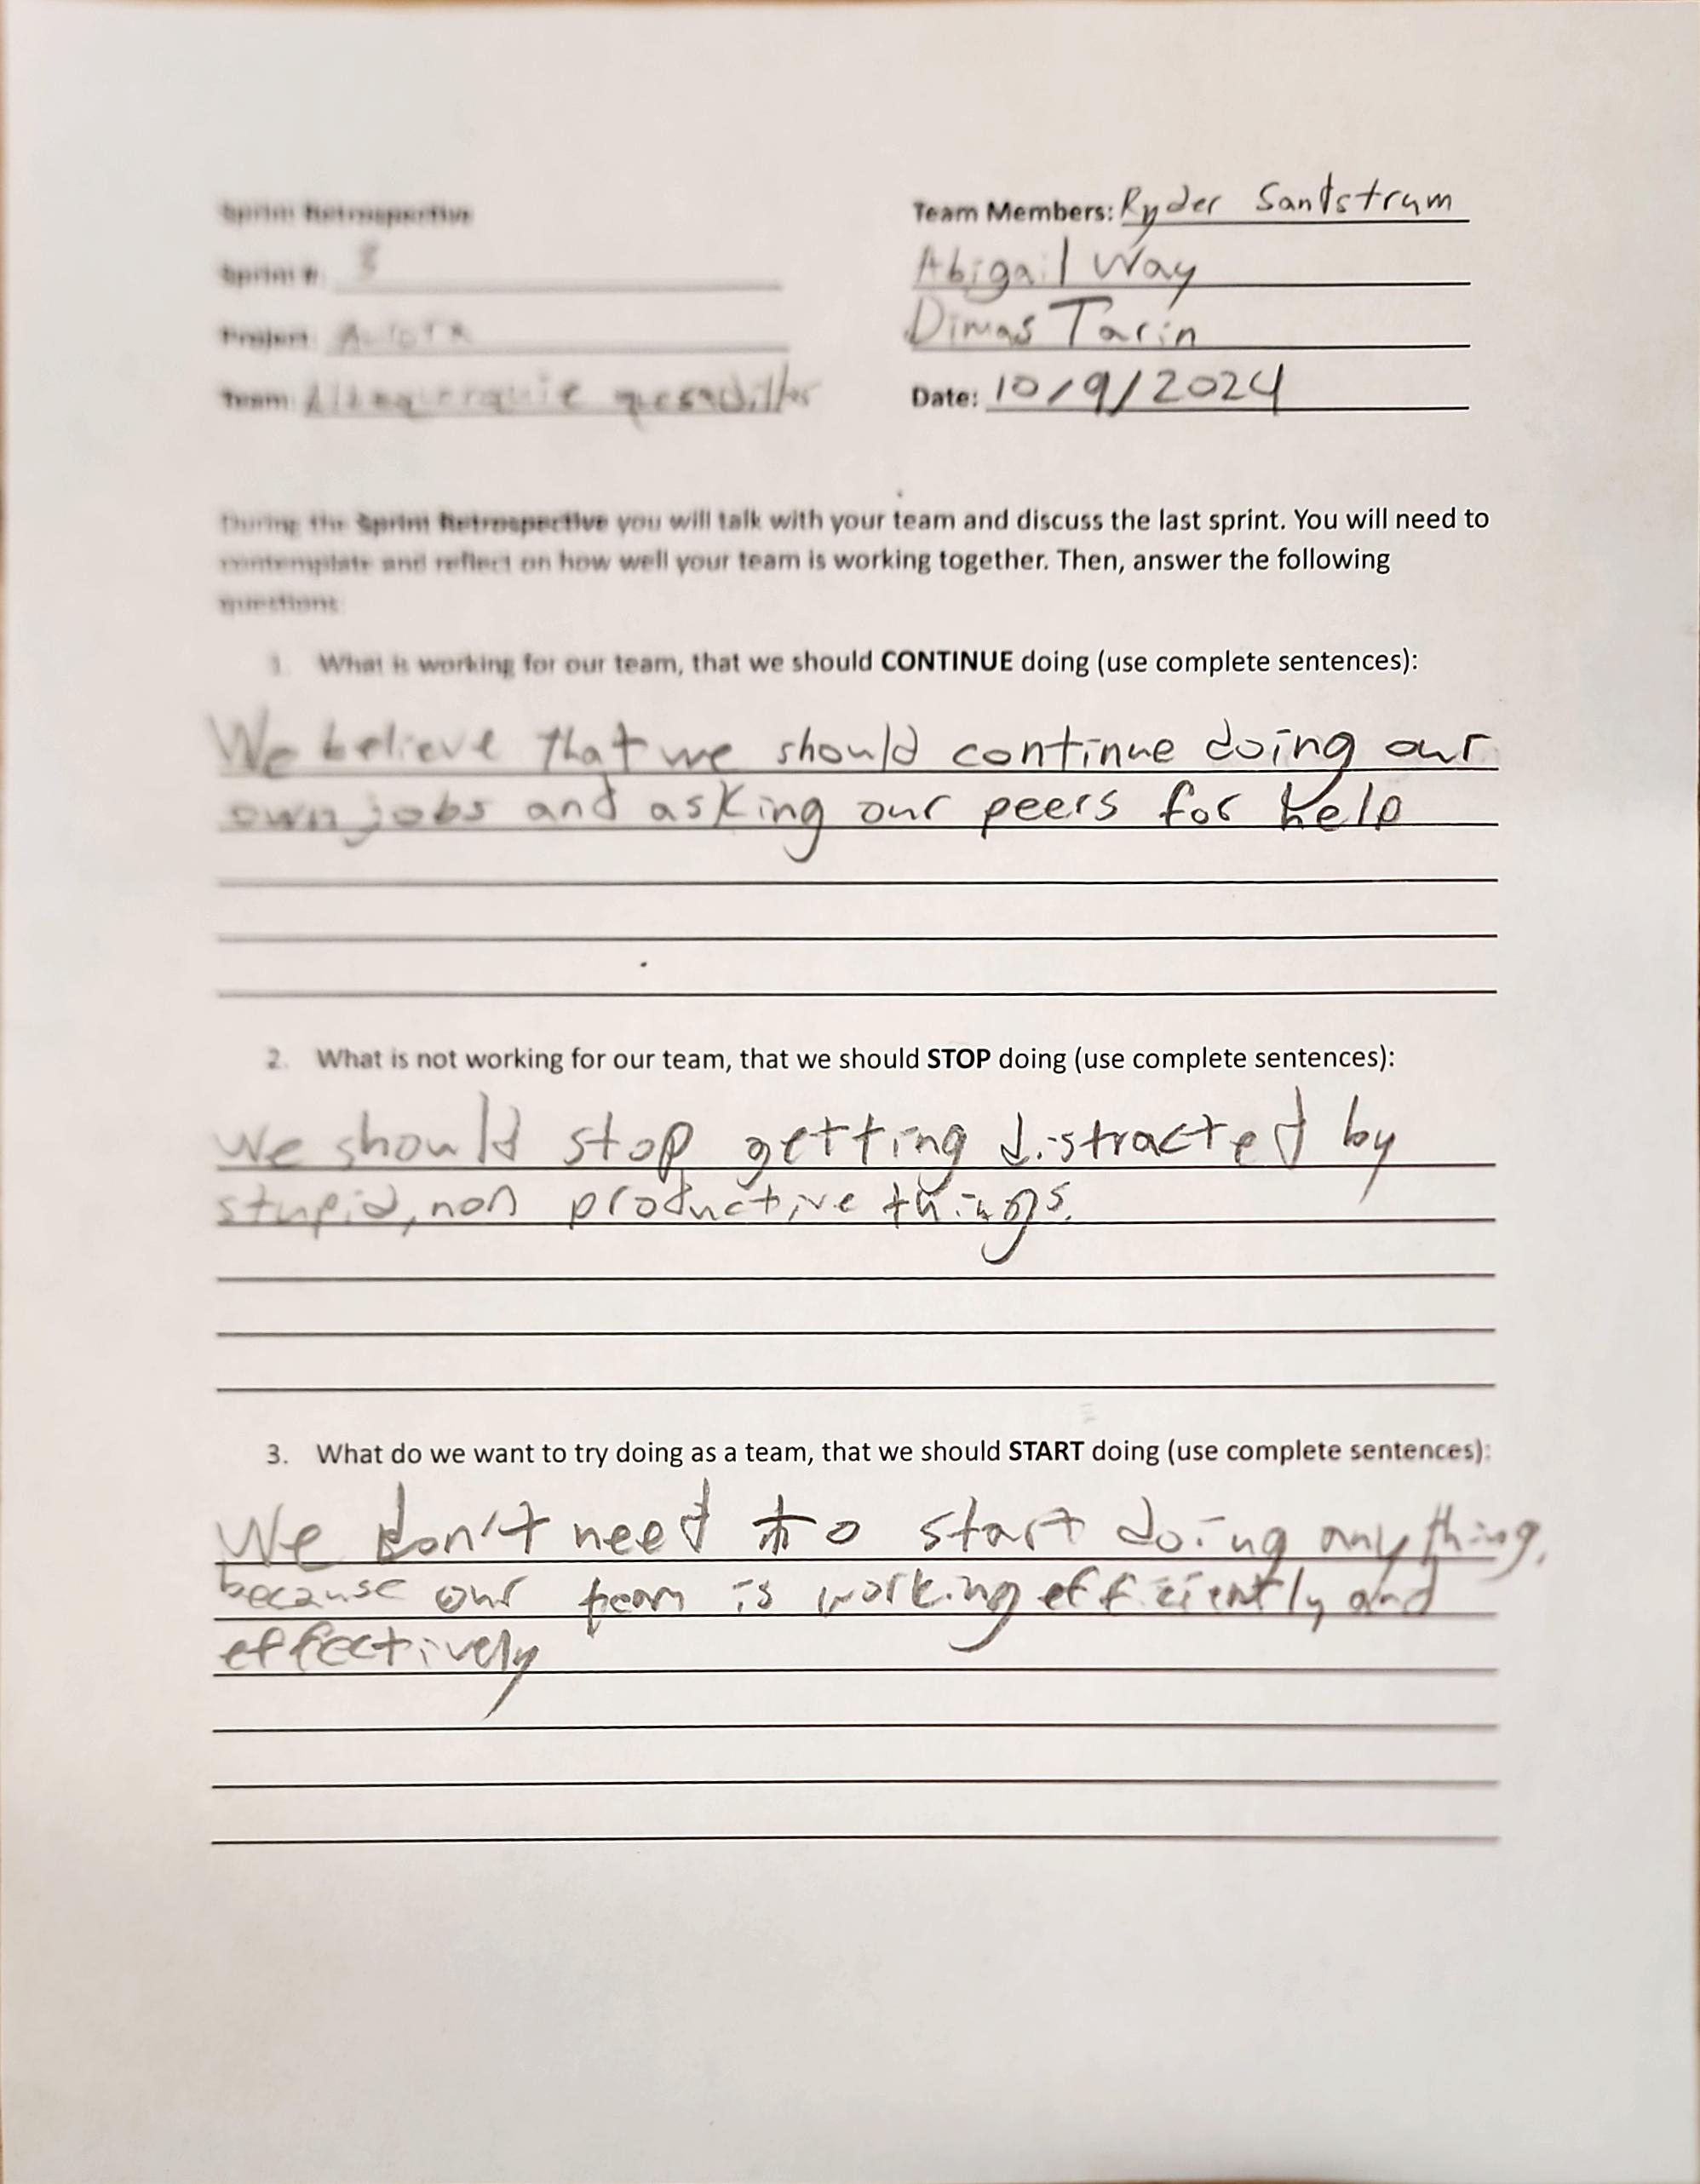
Project: Sprint Retrospective
Name: Abigail Way Date:10/21/24 Page: 54

Slide 79
Sprint Plan
This Sprint we are getting ready for our first competition on November 2. We will need to work on our code for an autonomous period. Along with that we will need to work on our driving skills and getting familiar with the rules.
Abigail Way
10/24/24
55

Slide 80
Scrum Meeting
Scrum Master: Dimas
Robotics
SCRUM Meeting
Sprint: 4
Team Members: Abby, Dimas,
Ryder
Project: Aurora
Team Members Present: Abby, Dimas, Ryder
Date: 10/22/24
What has each team member accomplished since the last meeting?
We have accomplish a basic code, a sense driving, and a competition ready engineering notebook.
What is each team member going to work on between now and the next meeting?
Ryder: Drive
Dimas: Code
Abby: Engineering notebook
What is blocking your team’s progress (are you stuck on anything)?
Our code is blocking our team’s progress.
Team Members Present: Abby, Dimas, Ryder
Date: 10/23/2024
What has each team member accomplished since the last meeting?
We have accomplish a basic code, an idea of driving, and a competition ready engineering notebook.
What is each team member going to work on between now and the next meeting?
Ryder: Drive
Dimas: Code
Abby: Get familiar with the rules
What is blocking your team’s progress (are you stuck on anything)?
Our code is blocking our team’s progress.
Abigail Way
10/24/2024 Page: 56

Slide 81
Scrum Meeting
Scrum Master: Dimas
Robotics
SCRUM Meeting
Sprint: 4
Team Members: Abby, Dimas,
Ryder
Project: Aurora
Team Members Present: Abby, Dimas, Ryder
Date:10/24/24
What has each team member accomplished since the last meeting?
We have accomplish a basic code, an idea of driving, and a competition ready engineering notebook.
What is each team member going to work on between now and the next meeting?
Ryder: Dive practice
Dimas: Code
Abby: Read the game manual
What is blocking your team’s progress (are you stuck on anything)?
Our code is blocking our team’s progress.
Team Members Present: Abby, Dimas, Ryder
Date: 10/25/24
What has each team member accomplished since the last meeting?
We have accomplish a basic code, an idea of driving, and a competition ready engineering notebook.
What is each team member going to work on between now and the next meeting?
Ryder: Drive
Dimas: Code
Abby: Read game manual
What is blocking your team’s progress (are you stuck on anything)?
Our code is blocking our team’s progress.
Abigail Way
10/24/2024 Page: 57

Slide 82
Scrum Meeting
Scrum Master: Dimas
Robotics
SCRUM Meeting
Sprint: 4
Team Members: Abby, Dimas,
Ryder
Project: Aurora
Team Members Present: Abby, Dimas, Ryder
Date: 10/28/24
What has each team member accomplished since the last meeting?
We have accomplish a completed basic code, a sense of driving and rules.
What is each team member going to work on between now and the next meeting?
Ryder: Drive
Dimas: Code
Abby: Read rules
What is blocking your team’s progress (are you stuck on anything)?
Our code is blocking our team’s progress.
Team Members Present: Abby, Dimas, Ryder
Date: 10/29/24
What has each team member accomplished since the last meeting?
We have accomplish a completed code, A sense of driving rules.
What is each team member going to work on between now and the next meeting?
Ryder: Drive
Dimas: Code and draw
Abby: Finnish updating engineering notebook
What is blocking your team’s progress (are you stuck on anything)?
We were currently not stuck on anything.
Abigail Way
10/29/24 Page: 58

Slide 83
Scrum Meeting
Scrum Master: Dimas
Robotics
SCRUM Meeting
Sprint: 4
Team Members: Abby, Dimas,
Ryder
Project: Aurora
Team Members Present: Abby, Dimas, Ryder
Date: 10/30/24
What has each team member accomplished since the last meeting?
We have accomplish a completed basic code, a sense of driving and rules.
What is each team member going to work on between now and the next meeting?
Ryder: Drive
Dimas: Work on driving
Abby: Engineering notebook
What is blocking your team’s progress (are you stuck on anything)?
Our code is blocking our team’s progress along with our flaps not staying up.
Team Members Present: Abby, Dimas, Ryder
Date: 10/31/24
What has each team member accomplished since the last meeting?
We have accomplish a completed basic code, a sense of driving and rules.
What is each team member going to work on between now and the next meeting?
Ryder: Fix length of robot
Dimas: Code
Abby: Fix length of robot
What is blocking your team’s progress (are you stuck on anything)?
Our code is blocking our team’s progress.
Abigail Way
10/31/24 Page:59

Slide 84
Scrum Meeting Ryker is a midget
Scrum Master: Abby
Robotics
SCRUM Meeting
Sprint: 4/5
Team Members: Abby, Dimas,
Ryder, Augie, Ryker, Mike
Project:
Team Members Present: Abby, Dimas,
Ryder, Augie, Ryker, Mike
Date: 11/1
What has each team member accomplished since the last meeting?
A completed robot
What is each team member going to work on between now and the next meeting?
Prep For Competion
What is blocking your team’s progress (are you stuck on anything)?
Nothing
Team Members Present: Abby, Dimas,
Ryder, Ryker, Mike
Date: 11/4
What has each team member accomplished since the last meeting?
A first Competion under our belt
What is each team member going to work on between now and the next meeting?
Competion Debrief
What is blocking your team’s progress (are you stuck on anything)?
Nothing
Abigail Way
Page: 61

Slide 85
Scrum Meeting
Scrum Master: Abby
Robotics
SCRUM Meeting
Sprint: 5
Team Members: Abby, Dimas,
Ryder, Augie, Ryker, Mike
Project:
Team Members Present: Abby, Dimas,
Ryder, Augie, Ryker, Mike
Date: 11/5/24
What has each team member accomplished since the last meeting?
We have accomplish a full new team and a tun of new ideas for a robot.
What is each team member going to work on between now and the next meeting?
Everyone else: Take apart current robot and come up with bigger team rules
Abby: Engineering notebook
What is blocking your team’s progress (are you stuck on anything)?
We are not stuck on anything currently.
Team Members Present: Abby, Dimas,
Ryder, Augie, Ryker, Mike
Date: 11/6/24
What has each team member accomplished since the last meeting?
We have accomplish big team rules that we all agreed upon
What is each team member going to work on between now and the next meeting?
Everyone: Sprint plan and start designing our robot (s)
What is blocking your team’s progress (are you stuck on anything)?
We and not stuck on anything currently.
Abigail Way
11/6/2024 Page:62

Slide 86
Scrum Meeting
Scrum Master: Abby
Robotics
SCRUM Meeting
Sprint: 5
Team Members: Abby, Dimas,
Ryder, Augie, Ryker, Mike
Project:
Team Members Present: Abby, Dimas,
Ryder, Augie, Ryker, Mike
Date: 11/11/24
What has each team member accomplished since the last meeting?
We have accomplish a basic robot design.
What is each team member going to work on between now and the next meeting?
Abby: Note book and sort Augie: Build
Dimas: Build Ryker: Build
Ryder: Build Mike: Build
What is blocking your team’s progress (are you stuck on anything)?
We are currently not stuck on anything.
Team Members Present: Abby, Dimas,
Ryder, Ryker, Mike
Date: 11/12/24
What has each team member accomplished since the last meeting?
We have accomplish a basic robot design and a half completed base.
What is each team member going to work on between now and the next meeting?
Abby: Engineering note book Augie: Build
Dimas: Build Ryker: Build
Ryder: Build Mike: Build
What is blocking your team’s progress (are you stuck on anything)?
We are currently not stuck on anything.
Abigail Way
11/12/24 Page: 64

Slide 87
Scrum Meeting
Scrum Master: Abby
Robotics
SCRUM Meeting
Sprint: 5
Team Members: Abby, Dimas,
Ryder, Augie, Ryker, Mike
Project:
Team Members Present: Abby, Dimas,
Ryder, Augie, Ryker, Mike
Date: 11/7/24
What has each team member accomplished since the last meeting?
We have accomplish a full new team and a tun of new ideas for a robot.
What is each team member going to work on between now and the next meeting?
Everyone: work on build the vacuum robot.
What is blocking your team’s progress (are you stuck on anything)?
We are not stuck on anything currently.
Team Members Present: Abby, Dimas,
Ryder, Ryker, Mike
Date: 11/8/24
What has each team member accomplished since the last meeting?
We have accomplish a basic robot design.
What is each team member going to work on between now and the next meeting?
Everyone: work on building the vacuum robot.
What is blocking your team’s progress (are you stuck on anything)?
We and not stuck on anything currently.
Abigail Way
11/8/24 Page: 63

Slide 88
Scrum Meeting
Scrum Master: Abby
Robotics
SCRUM Meeting
Sprint: 5
Team Members: Abby, Dimas,
Ryder, Augie, Ryker, Mike
Project:
Team Members Present: Abby, Dimas,
Ryder, Augie, Ryker, Mike
Date: 11/13/24
What has each team member accomplished since the last meeting?
We have accomplish a half- completed base.
What is each team member going to work on between now and the next meeting?
Abby: Engineering Notebook Augie: Build
Dimas: Code Ryker: Build
Ryder: Build Mike: Build
What is blocking your team’s progress (are you stuck on anything)?
We are not stuck on anything
Team Members Present: Abby, Dimas,
Ryder, Ryker, Mike
Date: 11/14/24
What has each team member accomplished since the last meeting?
We have accomplish half completed base
What is each team member going to work on between now and the next meeting?
Abby: build 1 Augie: build 1
Dimas: build 2 Ryker: build 2
Ryder: build 1 Mike: build 1
What is blocking your team’s progress (are you stuck on anything)?
We are
Abigail Way
11/13/24 Page: 65

Slide 89
Scrum Meeting
Scrum Master: Abby
Robotics
SCRUM Meeting
Sprint: 5
Team Members: Abby, Dimas,
Ryder, Augie, Ryker, Mike
Project:
Team Members Present: Abby, Dimas,
Ryder, Augie, Ryker, Mike
Date: 11/15/24
What has each team member accomplished since the last meeting?
We have accomplish two half completed bases.
What is each team member going to work on between now and the next meeting?
Everyone; Build and design
What is blocking your team’s progress (are you stuck on anything)?
We are not stuck on anything.
Team Members Present: Abby, Dimas,
Ryder, Ryker, Mike
Date:11/18/24
What has each team member accomplished since the last meeting?
We have accomplished building more of our bases
What is each team member going to work on between now and the next meeting?
Abby: Build Augie: build
Dimas:build Ryker:build
Ryder:build Mike:build
What is blocking your team’s progress (are you stuck on anything)?
We are not stuck on anything
Abigail Way & Dimas!!!!!!!
Page: 66

Slide 90
Scrum Meeting
Scrum Master: Abby
Robotics
SCRUM Meeting
Sprint: 5
Team Members: Abby, Dimas,
Ryder, Augie, Ryker, Mike
Project:
Team Members Present: Abby, Dimas,
Ryder, Augie, Ryker, Mike
Date:11/19/24
What has each team member accomplished since the last meeting?
We have accomplished more building
What is each team member going to work on between now and the next meeting?
Abby:build bot 1 Augie:build 1
Dimas:build bot 1 Ryker:build 1
Ryder:build bot 1 Mike:build 1
What is blocking your team’s progress (are you stuck on anything)?
We are not stuck on anything
Team Members Present: Abby, Dimas,
Ryder, Mike
Date: 11/20/24
What has each team member accomplished since the last meeting?
We have accomplished more building
What is each team member going to work on between now and the next meeting?
Abby:build 1 Augie: build 1
Dimas: build 2 Ryker: build 2
Ryder: Mike: build 1
What is blocking your team’s progress (are you stuck on anything)?
We are waiting on some parts, but we’re going along without them
Dimas Tarin
Page: 67

Slide 91
Scrum Meeting
Scrum Master: Abby
Robotics
SCRUM Meeting
Sprint: 5
Team Members: Abby, Dimas,
Ryder, Augie, Ryker, Mike
Project:
Team Members Present: Abby, Dimas,
Ryder, Augie, , Mike
Date: 11/21/24
What has each team member accomplished since the last meeting?
We have accomplished more building
What is each team member going to work on between now and the next meeting?
Abby: build 1 Augie: build 1
Dimas: build 2 Ryker: build 2
Ryder: Mike: build 1
What is blocking your team’s progress (are you stuck on anything)?
We are stuck on waiting for parts to come
Team Members Present: Abby, Dimas,
, Ryker, Mike
Date: 11/22/24
What has each team member accomplished since the last meeting?
We have accomplished more building
What is each team member going to work on between now and the next meeting?
Abby: build 1 Augie: build 1
Dimas: build 1 Ryker: nothing
Ryder: Mike: nothing
What is blocking your team’s progress (are you stuck on anything)?
We are still waiting for parts
Dimas again
Page: 68
Notes:
71

Slide 92
Scrum Meeting
Scrum Master: Abby
Robotics
SCRUM Meeting
Sprint: 5
Team Members: Abby, Dimas,
Ryder, Augie, Ryker, Mike
Project: Borealis I
Team Members Present: Abby, Dimas,
Ryder, Augie, Ryker
Date:12/2/24
What has each team member accomplished since the last meeting?
We have accomplished more building
What is each team member going to work on between now and the next meeting?
Abby: Build Augie: build 1
Dimas: code Ryker: build 2
Ryder: Mike: build 1
What is blocking your team’s progress (are you stuck on anything)?
We are stuck on waiting for parts to come
Team Members Present: Abby, Dimas,
Ryder, Ryker, Mike
Date: 12/3/2024
What has each team member accomplished since the last meeting?
We have accomplished more building
What is each team member going to work on between now and the next meeting?
Abby:Build 2 Augie: build 2
Dimas:Notebook/ coding Ryker:build 1
Ryder:build 1 Mike: build 1
What is blocking your team’s progress (are you stuck on anything)?
We are still waiting for parts
Dimas!!!!!!!
Page: 69

Slide 93
Scrum Meeting
Scrum Master: Abby
Robotics
SCRUM Meeting
Sprint: 5
Team Members: Abby, Dimas,
Ryder, Augie, Ryker, Mike
Project: borealis
Team Members Present: Abby, Dimas,
Ryder, Augie, Ryker, Mike
Date:12/4/24
What has each team member accomplished since the last meeting?
We’ve been building the robot and Dimas has been coding
What is each team member going to work on between now and the next meeting?
Abby: build Augie:build 1
Dimas:coding/notebooking Ryker:build 1/ doing nothing
Ryder:build 1 Mike:coding/goofing off
What is blocking your team’s progress (are you stuck on anything)?
We are waiting for parts, but we have given up on their arrival in time. Defeat is immenent
Team Members Present: Abby, Dimas, Ryker, Mike
Date: 12/5/2024
What has each team member accomplished since the last meeting?
More Building
What is each team member going to work on between now and the next meeting?
Abby: build 1 Augie:build 1
Dimas: coding/notebook Ryker: drive
Ryder: Mike: read the rules
What is blocking your team’s progress (are you stuck on anything)?
Same as last time
Dimas
Page: 70

Slide 94
Scrum Meeting
Scrum Master: Abby
Robotics
SCRUM Meeting
Sprint:
Team Members: Abby, Dimas,
Ryder, Augie, Ryker, Mike
Project:
Team Members Present: Abby, Dimas,
Ryder, Augie, Ryker,
Date: 12/6/2024
What has each team member accomplished since the last meeting?
Build.
What is each team member going to work on between now and the next meeting?
Abby: english homework Augie: building
Dimas: coding Ryker: whatever abby says
Ryder: griping Mike: dead
What is blocking your team’s progress (are you stuck on anything)?
Team mates not getting along
Team Members Present: Abby, Dimas,
Ryder, Ryker, Mike
Date: 12/9/24
What has each team member accomplished since the last meeting?
What is each team member going to work on between now and the next meeting?
Abby: Build Augie:Build
Dimas: Build Ryker: Build
Ryder: Build Mike: Code
What is blocking your team’s progress (are you stuck on anything)?
Parts still not arived
Page: 71

Slide 95
Scrum Meeting
Scrum Master: Abby
Robotics
SCRUM Meeting
Sprint:
Team Members: Abby, Dimas,
Ryder, Augie, Ryker, Mike
Project:
Team Members Present: Abby, Dimas,
Ryder, Augie, Ryker, Mike
Date: 12/10/24
What has each team member accomplished since the last meeting?
A mostly completed Robot
What is each team member going to work on between now and the next meeting?
Abby: Build Augie: Build
Dimas:Build Ryker: Code?
Ryder: Build Mike: Code
What is blocking your team’s progress (are you stuck on anything)?
Team Members Present: Abby, Dimas,
Ryder, Ryker, Mike
Date: 10/11
What has each team member accomplished since the last meeting?
A mostly completed robot
What is each team member going to work on between now and the next meeting?
Abby: Scrum things Augie: Build
Dimas: Build Ryker:
Ryder: Build Mike: Code
What is blocking your team’s progress (are you stuck on anything)?
Bot having enough time
Page: 72

Slide 96
Scrum Meeting
Scrum Master: Abby
Robotics
SCRUM Meeting
Sprint:
Team Members: Abby, Dimas,
Ryder, Augie, Ryker, Mike
Project:
Team Members Present: Abby, Dimas,
Ryder, Augie, Ryker, Mike
Date: 12/13/24
What has each team member accomplished since the last meeting?
A completed working robot.
What is each team member going to work on between now and the next meeting?
Everyone: Working on sprint review and retrospective.
What is blocking your team’s progress (are you stuck on anything)?
We are not stuck on anything.
Abigail Way
Page: 73

Slide 97
Scrum Meeting
Scrum Master: Abby
Robotics
SCRUM Meeting
Sprint:
Team Members: Abby, Dimas,
Ryder, Augie, Ryker, Mike
Project:
Team Members Present: Abby, Dimas,
Ryder, Augie, Ryker, Mike
Date: 1/7/25
What has each team member accomplished since the last meeting?
We have accomplished a completed sprint review and retrospective.
What is each team member going to work on between now and the next meeting?
Abby: Build Augie: Build
Dimas: Code Ryker: Read rules
Ryder: Build Mike: Code
What is blocking your team’s progress (are you stuck on anything)?
A not working robot
Team Members Present: Abby, Dimas,
Ryder, Ryker, Mike
Date: 1/8/25
What has each team member accomplished since the last meeting?
What is each team member going to work on between now and the next meeting?
Abby: Augie:
Dimas: Ryker:
Ryder: Mike:
What is blocking your team’s progress (are you stuck on anything)?
Page: 74

Slide 98
Scrum Meeting
Scrum Master: Abby
Robotics
SCRUM Meeting
Sprint:
Team Members: Abby, Dimas,
Ryder, Augie, Ryker, Mike
Project:
Team Members Present: Abby, Dimas,
Ryder, Augie, Ryker, Mike
Date: 1/9/25
What has each team member accomplished since the last meeting?
A completed robot.
What is each team member going to work on between now and the next meeting?
Abby: Notebook, competition prep Augie: 2nd robot
Dimas: Test code Ryker:
Ryder: Drive Mike: Code
What is blocking your team’s progress (are you stuck on anything)?
Pneumatics not working
Team Members Present: Abby, Dimas,
Ryder, Ryker, Mike
Date: 1/15/25
What has each team member accomplished since the last meeting?
We’ve continued to work on the second robot, and fixed finnicky things oon the first robot
What is each team member going to work on between now and the next meeting?
Abby:Notebook Augie:Second robot
Dimas:Digging through API Ryker: Help Ryder
Ryder:Fix little things Mike: Dig through API
What is blocking your team’s progress (are you stuck on anything)?
Second Robot
Page: 75

Slide 99
Scrum Meeting
Scrum Master: Abby
Robotics
SCRUM Meeting
Sprint:
Team Members: Abby, Dimas,
Ryder, Augie, Ryker, Mike
Project:
Team Members Present: Abby, Dimas,
Ryder, Augie, Ryker, Mike
Date:1/16/25
What has each team member accomplished since the last meeting?
What is each team member going to work on between now and the next meeting?
Abby: Help Ryder Augie:2nd robot
Dimas: Draw Ryker:Help Ryder
Ryder: 1st Robot Mike: Code
What is blocking your team’s progress (are you stuck on anything)?
Team Members Present: Abby, Dimas,
Ryder, Ryker, Mike
Date: 1/17/25
What has each team member accomplished since the last meeting?
What is each team member going to work on between now and the next meeting?
Abby: Be ryder's intern Augie: 2nd robot
Dimas:Wires dude Ryker: gerardo'd
Ryder: Fix the drivetrain Mike: being abby''s intern
What is blocking your team’s progress (are you stuck on anything)?
Abby getting the thing off and the drivetrain
Page: 51

Slide 100
Scrum meeting.
SCRUM Meetings If someone is not mentioned, they didn’t do work
Week of 01/20/2025
Monday: No School What has each team member done since the last meeting? What will each team member do today? What problems are holding the team back?
Tuesday: 1/21/25 What has each team member done since the last meeting? Drive train done on 2nd robot and a new drive code What will each team member do today? Auggy: Getting the second robot done Dimas and Mike: working on improving codes What problems are holding the team back? Nothing
Wednesday: 1/22/25 What has each team member done since the last meeting? More work on 2nd robot and a better code What will each team member do today? Auggy: Work on 2nd robot Dimas and Mike:Work on autonomous code What problems are holding the team back? Nothing
Thursday: 1/23/25 What has each team member done since the last meeting? More work on 2nd robot and a more completed code What will each team member do today? Auggy: Work on 2nd robot Ryder: Drive first robot Dimas and Mike: Improve code What problems are holding the team back? Nothing
Friday: 1/24/25 What has each team member done since the last meeting? 2nd robot more completed, a working drive code What will each team member do today? Auggy: Build second robot Dimas and Mike:work both codes Abby: notebook, and organize whilst being sick What problems are holding the team back? Mike no worky
Abigail Way

Slide 101
Scrum meeting.
SCRUM Meetings
Week of 01/27/2025
Monday: 1/27/2025 What has each team member done since the last meeting? More advanced notebook, coding and a more completed second robot What will each team member do today? Dimas and Mike: Work on code Auggy: building second robot Ryder: being quarantine What problems are holding the team back? Code not working/not being able to test code
Tuesday: 1/28/2025 What has each team member done since the last meeting? Test Code, Work on second robot, more advanced robot What will each team member do today? Auggy: Working on the second robot Dimas and Mike: code Ryker and Ryder: assisting What problems are holding the team back? Codes not working
Wednesday: 1/29/2025 Field Trip
Thursday: 1/30/2025 What has each team member done since the last meeting? We have worked on testing out code and building the second robot. What will each team member do today? Dimas and Mike: work on our code Auggy: get the second robot done! What problems are holding the team back? We our not facing any problems currently
Friday: 1/31/2025 What has each team member done since the last meeting? Code is working better, Second robot, notebooking What will each team member do today? Sprint Review and Retrospective What problems are holding the team back? None
Abigail Way
Week of 1/27/2025

Slide 102
Sprint Review
Sprint #: ____________________________
Team: _____________________________
Team Members: __________________________________
__________________________________
During this Sprint we completed these sprint backlog items, define which product backlog item they were a part of. (use complete sentences):
During this sprint we finished all of the product backlog item, Coding. This backlog item includes Competition code, skills code and testing both. For fixing small items, we finished, working on the chain, cord management, and repair drivetrain. What we still need to finish includes make scoring more consitant, however, in order to do that. We need to finish another sprint backlog item which is fix mobile goal grabber. Which we will create a Product Backlog item. Finaly we also almost completed the 2nd robot.
2. Describe what your sprint goal was, and how your product met that goal:
Our sprint goal was to enhance the robot and code to preform constantly and well during the competition. Our product met this goal by working on the code a whole lot and perfecting it. However, we didn’t meet our sprint goal because we didn’t really enhance the robot to make it better we really just fixed the little things from the competition that broke. We did not complete out Sprint goal because we were; sidetracked, focused on other things
3. We need to move these sprint backlog items back to our product backlog (if any) Make sure to think about prioritizing the tasks that are moved to the product backlog:
4. Demonstrate the product that you produced:
The one item that will become a product backlog item will be the mobile goal grabber. That makes the only 2 product backlog items that we will have will be practice driving and the mobile goal grabber. We also need to finish building the second robot back to the product backlog because we didn’t have the parts to complete it.

Slide 103
Sprint Retrospective
Sprint #: ____6__________________________
Team: _DIMAS!!!!!!______________________
Team Members: _______________________
_____________________________________
_____________________________________
During the Sprint Retrospective you will talk with your team and discuss the last sprint. You will need to contemplate and reflect on how well your team is working together. Then, answer the following questions:
What is working for our team, that we should CONTINUE doing (use complete sentences):
Some things that are working really well is that everyone has their own individual jobs that they can do separate from other people. Another thing that works is having the robot always in use, like Michael and Dimas working on their code, and when they are not coding, Ryder or Ryker drives.
2. What is not working for our team, that we should STOP doing (use complete sentences):
We need to stop neglecting the notebook. We are neglecting the notebook because Abby is the one that does it, and no one wants to do it because it's long and complicated. We need to try and stop getting distracted even though it's going to be really hard to do.
3. What do we want to try doing as a team, that we should START doing (use complete sentences):
Something we need to do is to have Abby teach as many people as possible how to do the notebook.
We need to have others keep people accountable for getting off topic and help them get back on task.
Ryder should have time set aside to drive
We need to be occupied because when we are occupied, we don't goof off. We will achieve this by (as seen above), keeping each other accountable for getting off task and finding tasks for people to do, however boring and/or small

Slide 104
Scrum meeting. Week of: MM/DD/YYYY
SCRUM Meetings
Week of 02/03/2025
Monday: 2/3/25 What has each team member done since the last meeting? Sprint Review and Sprint Retrospective What will each team member do today? Whole Team: Finish Retrospective What problems are holding the team back?
Tuesday: 2/4/25 What has each team member done since the last meeting? We accomplished a sprint retrospective and plan. What will each team member do today? Auggie: Work on mobile goal grabber Mike: Drawing Dimas: Code half speed button Ryker: Drive Skills Ryder: Help Auggie Abby: Notebook What problems are holding the team back?
Wednesday: 2/5/25 What has each team member done since the last meeting? We have accomplished a completed code and driving practice. What will each team member do today? Dimas: Code Ryker: Online drawings Mike: Code Abby: Notebook Ryder: Drive What problems are holding the team back? Nothing
Thursday: 2/6/25 What has each team member done since the last meeting? We have accomplished a completed code and more driving practice What will each team member do today? Dimas: Code Ryker: Online drawings Mike: Code Abby: Notebook Ryder: Drive Augie: Prototype What problems are holding the team back? Nothing
Friday: What has each team member done since the last meeting? Dimas and Mike have finished their code. Auggy has done more work on the second robot. What will each team member do today? Dimas and Mike: Code. Ryder: Swiper thing What problems are holding the team back? Nothing.

Slide 105
Sprint Plan / Sprint Backlog / Burndown Chart
Sprint #: ___________7___________________
Team: DIMAS!!!!!!_______________________
Team Members: ____Abby, Dimas, Augie, Ryder, Ryker___________________
Product Backlog (at the start of this sprint, what is your product backlog):
Coding
driving
adding things to the first robot
Note booking
Complete Second Robot
Sprint Goal (write in full sentences what concise goals you have for the sprint):
Our sprint goal is to have one fully competition ready robot that can overall score 15 points in driver control. Along with an autonomous code that can score at least 4 points and a skills code that can score 18 points.
Sprint Backlog / Burndown (Break product backlog items into sprint backlog items) Remember to INDENT sprint backlog items:
Task Date and name of who worked on this task:
___________________________________________________________________________________________________________________________________________________________________________________________________________
Coding
Insure completion of skill code
Insure completion of autonomous code
Driving
Practice skills driving
Practice normal competition driving
Adding things to the robot
Fine tune the mobile goal grabber (MGG)
Make a thing to get rings out of the corner (Ryders Thing)
Notebook
Add updated pictures and online drawings
Fix table of contents | 2/10/25
Teach stuff
Random Little Things
Set up Pit
Organize Parts

Slide 106
Scrum meeting. Week of: MM/DD/YYYY
SCRUM Meetings
Week of 02/10/2025
Monday: 2/10/25 What has each team member done since the last meeting? We have accomplished two completed codes and more work on the second robot What will each team member do today? Augie: Second Robot Mike: Code Abby: Notebook Dimas: Code Ryker: Online Drawing Ryder: thing to get rings out of conner What problems are holding the team back? Nothing
Tuesday: 2/11/25 What has each team member done since the last meeting? We have accomplished worked more on the second robot What will each team member do today? Augie: Second Robot Dimas: Code Abby: Notebook Ryder: fix first robot Mike: Code What problems are holding the team back? Nothing
Wednesday: 2/12/24 What has each team member done since the last meeting? We have unsuccessfully moved the pneumatics from one robot to the other. What will each team member do today? Abby: work on first robot Ryder: work on first robot What problems are holding the team back? The pneumatics not working
Thursday: What has each team member done since the last meeting? We have gotten the pneumatics to work What will each team member do today? Dimas: Code Abby: Notebook Mike: Code Ryder: drive Ryker: work on online drawing Augie: Work on prototyping What problems are holding the team back? The competetion coming to soon.
Friday: 2/14/25 NO SCHOOL

Slide 107
Scrum meeting. Week of: MM/DD/YYYY
SCRUM Meetings
Week of 00/00/2025
Monday: No School
Tuesday: What has each team member done since the last meeting? We have gotten a competition ready robot. What will each team member do today? Dimas: Code Abby: Notebook Mike: Code Ryder: Online Drawing? Ryker: Drive Skills Augie: Online Drawing? What problems are holding the team back? The Competition coming to soon
Wednesday: What has each team member done since the last meeting? We have done nothing of help since our last meeting What will each team member do today? Dimas: Code Ryker: Online Drawing Mike: Code Abby: Online Drawing Ryder: Attack plastic that took forever Augie: Online Drawing What problems are holding the team back? The robot not being "done" to test out code along with the cometeion coming up to fast.
Thursday: What has each team member done since the last meeting? We have completed the online drawings and work on code What will each team member do today? Ryder: Drive Ryker: Set up pit Mike: Code Abby: Notebook Dimas: Code Auggie: put pneumatics on other robot What problems are holding the team back?
Friday: What has each team member done since the last meeting? What will each team member do today? What problems are holding the team back?

Slide 108
Section F Calendars

Slide 109

August 2024
 |  | Went through Engineering Notebook | Started coming up with robot ideas | Worked on first conveyor belt prototype as well as watching a video about award winning Engineering Notebook. | Worked on base by taking apart claw bot as well as scrum test
Abigail Way
79

Slide 110

September 2024
 | NO SCHOOL | NO SCHOOL | Worked on base | Continue to work on base and drawings. | Continue to work on base and drawings.
 | Sprint Retrospective, and Sprint Review | Started Sprint 2 | Continued working on base, 3D modeling, and updated Notebook | Coding, Updated Notebook, Continued working on base | Continued working on base, 3D modeling, and updated Notebook
 | Continued working on base, 3D modeling, and updated Notebook | Coding, Updated Notebook, Continued working on base | Continued working on base, 3D modeling, and updated Notebook | Coding, Updated Notebook, Continued working on base | Continued working on base, 3D modeling, and updated Notebook
 | Continued working on base, 3D modeling, and updated Notebook | Coding, Updated Notebook, Continued working on base | Continued working on base, 3D modeling, and updated Notebook | Coding, Updated Notebook, Continued working on base | Continued working on base, 3D modeling, and updated Notebook
 | Continued working on base, 3D modeling, and updated Notebook
Abigail Way
80

Slide 111

October 2024
 |  | Code | Code | Code | Code
 | Code | Code, Drive, get a sense of rules | Code, Drive, get a sense of rules | Half Day No Class | Half Day Code, Drive, Engineering Notebook
 | No School | No School | No School | No School | No School
 | Code, Drive, Engineering Notebook | Code, Drive, get a sense of rules | Code, Drive, get a sense of rules | Prepare for competition. Code, Drive, get a sense of rules | Prepare for competition. Code, Drive, get a sense of rules
 | Prepare for competition. Code, Drive, get a sense of rules | Prepare for competition. Code, Drive, get a sense of rules | Prepare for competition. Code, Drive, get a sense of rules | Prepare for competition. Code, Drive, get a sense of rules
Abigail Way
81

Slide 112

November 2024
 |  |  |  |  | No School | Competition
 | Competition debrief | Team Rules | Sprint Plan and design new robot | Work on Building a vacuum robot | Work on Building a vacuum robot
 | Work on Building a vacuum robot | Work on Building a vacuum robot | Work on Building a vacuum robot | Work on Building a vacuum robot | Work on Building a vacuum robot
 | Work on Building a vacuum robot | Work on Building a vacuum robot | Work on Building a vacuum robot | Work on Building a vacuum robot | Work on Building a vacuum robot
 | No School | No School | No School | No School | No School
82

Slide 113

December 2024
 | Work on Building a vacuum robot | Work on Building a vacuum robot | Work on Building a vacuum robot | Work on Building a vacuum robot | Work on Building a vacuum robot
 | Work on Building a vacuum robot | Work on Building a vacuum robot | Work on Building a vacuum robot | Work on Building a vacuum robot | Sprint review and Retrospective
 | No School | No School | No School | No School | No School
 | No School | No School | No School | No School | No School
 | No School | No School
83

Slide 114

January 2025
 |  |  | No School | No School | No School
 | No School | Competiton Prep. | Competiton Prep. | Competiton Prep. | Competiton Prep. | Competiton (Got 9th Place)
 | Code, finishing second robot, improving first robot | Code, finishing second robot, improving first robot | Code, finishing second robot, improving first robot | Code, finishing second robot, improving first robot | Code, finishing second robot, improving first robot
 | No School | Code, finishing second robot, dive first robot | Code, finishing second robot, dive first robot | Code, finishing second robot, dive first robot | Code, finishing second robot, dive first robot
 | Code, finishing second robot, dive first robot | Code, finishing second robot, dive first robot | Field Trip | Code, finishing second robot, dive first robot | Code, finishing second robot, dive first robot
Abigail Way
84

Slide 115

February 2025
 | Sprint Review | Prototype, Code, Notebook, Online Drawing | Prototype, Code, Notebook, Online Drawing | Prototype, Code, Notebook, Online Drawing | Prototype, Code, Notebook, Online Drawing
 | Prototype, Code, Notebook, Online Drawing | Prototype, Code, Notebook, Online Drawing | Prototype, Code, Notebook, Online Drawing | Prototype, Code, Notebook, Online Drawing | No School
 | No School | Prototype, Code, Notebook, Online Drawing | Online drawing, code | Code

Slide 116

March 2025
 |  |  |  | Half Day | Half Day
 | No School | No School | No School | No School | No School

Slide 117

April 2025
 |  |  |  |  | No School

Slide 118

May 2025

Slide 119

Resources
engineering.vex.com
notebooking.vex.com
coding.vex.com
Judging Rubric for Notebooks
vex.com
roboticseducation.org
V5RC 2024-2025 Game - Rules & Game Video
Send suggestions and comments about these Digital Notebooks and Digital Parts
to notebooks@vex.com

